Slide 1
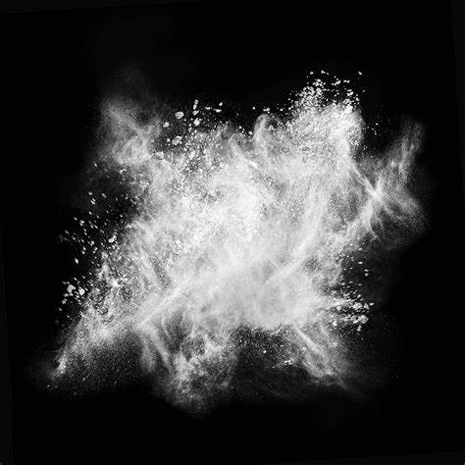
Electrostatic Dust Precipitators
By Anita, Kaden, Andra, Shawn

Slide 2
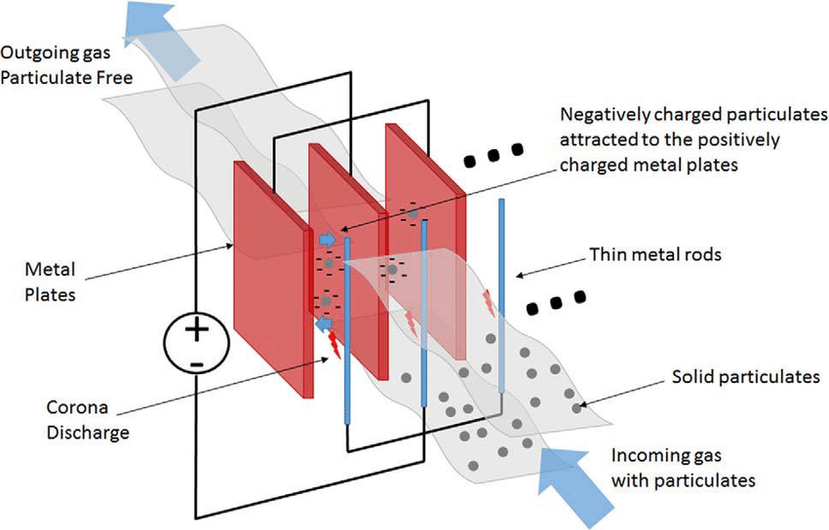
What are electrostatic dust precipitators?
Electrostatic dust precipitators are a type of filter that is used to remove soot and ash from exhaust fumes right before they exit the smokestacks
It uses static electricity to control air pollution
Power stations produce smoke from burning fossil fuels and coal that can be harmful for the environment and for humans
Smoke has tiny particles of soot
It is able to collect as much as 99.9% of the particles from the gas exhaust before it is released into the air.

Slide 3
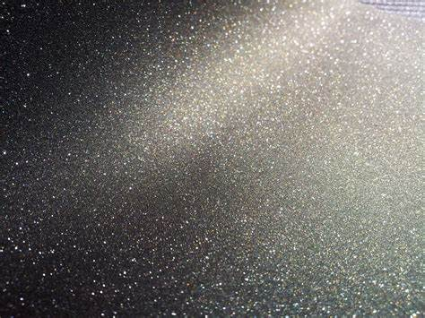
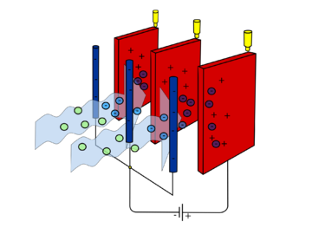
How do they work?
The dirty gas passes through two conductors called electrodes
The electrodes can be either metal bars, wires, plates
Located in the inside of a pipe or in the actual smokestack
One of the electrodes is negatively charged which causes the particles in the smoke to be negatively charged
The next plate is positively charged and this attracts the negatively charged particles and makes them stick to the plate
These can take various shapes and sizes based on how big the particles are or what type they are

Slide 4
How do they use static electricity?
Static electricity is used by making the harmful particles negatively charged
Then the particles get attached to the plates on the insides of the smokestack
The plates have to get cleaned off once in a while so the negatively charged particles can stick to it better
This is similar to the sweater and how the negatively charged balloons are attracted to the sweater because it’s positively charged

Slide 5
Bibliography
Picture links:
https://www.bing.com/images/search?view=detailV2&ccid=IZ3sp2Yv&id=22982D452B3008DDB76D728B016E5AB12EB10D96&thid=OIP.IZ3sp2YvfpMRh7eqYqukJgHaEK&mediaurl=https%3a%2f%2fd2v9y0dukr6mq2.cloudfront.net%2fvideo%2fthumbnail%2f2ovIcCg%2freal-dust-particles-moving-in-the-air-from-left-to-right_4jkua5ah__F0001.png&exph=1080&expw=1920&q=dust&simid=608043548767357179&selectedIndex=21
https://www.bing.com/images/search?view=detailV2&ccid=4mWZZChb&id=63E0F81106EE8FB416588DF4EBE7BBEF6DAD40E6&thid=OIP.4mWZZChbDoMuLV76QjrLgAHaHa&mediaurl=https%3a%2f%2fwww.robovent.com%2fwp-content%2fuploads%2fFumed_Silica-502607612-1.jpg&exph=1920&expw=1920&q=dust&simid=608038042627739103&selectedIndex=9
https://www.bing.com/images/search?view=detailV2&ccid=sKsmaPzz&id=A1DEBD64DDD345A460BCB57EEFAF096F721CA53C&thid=OIP.sKsmaPzzwEewYiT3dcshNgHaFj&mediaurl=http%3a%2f%2fcanacopegdl.com%2fimages%2fdust%2fdust-16.jpg&exph=2448&expw=3264&q=dust&simid=608020897095156094&selectedIndex=70
https://www.bing.com/images/search?view=detailV2&ccid=Z1xVCtXX&id=C7207F94C37F1D72CEFCC4DF8A17F6D69CB8BDE5&thid=OIP.cS3kk8B4z5I_HPuYCEKIaQHaE9&mediaurl=https%3a%2f%2fpolkadottango.files.wordpress.com%2f2012%2f03%2fopen-book.jpg&exph=1072&expw=1600&q=books&simid=608011345129179596&selectedIndex=6
https://energyeducation.ca/encyclopedia/Electrostatic_precipitator
https://www.researchgate.net/figure/Conceptual-diagram-of-an-electrostatic-precipitator-Source-Data-from-Becker-30-C2010_fig3_313428450
Website links:
https://energyeducation.ca/encyclopedia/Electrostatic_precipitator
https://www.britannica.com/technology/electrostatic-precipitator
https://www.explainthatstuff.com/electrostaticsmokeprecipitators.html

