Slide 1
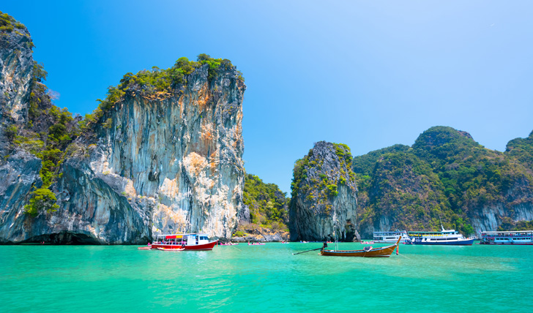
Trip to Thailand
By Angie

Slide 2
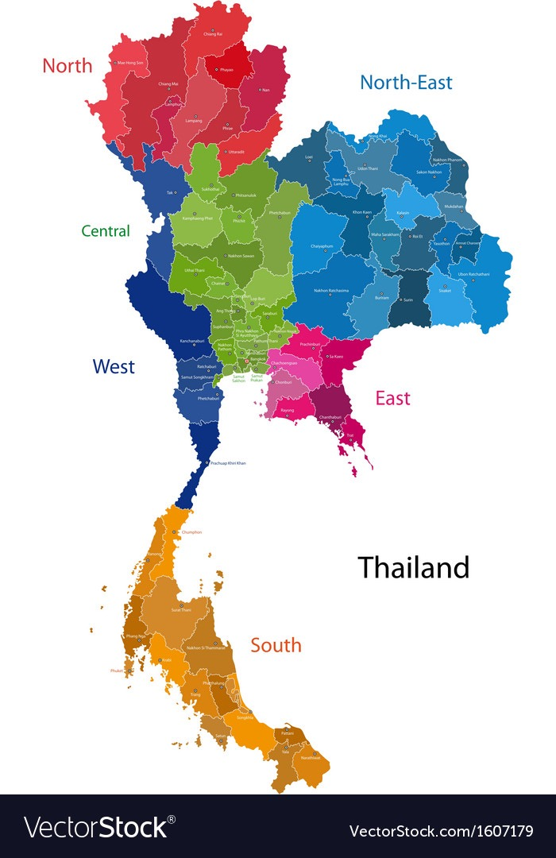
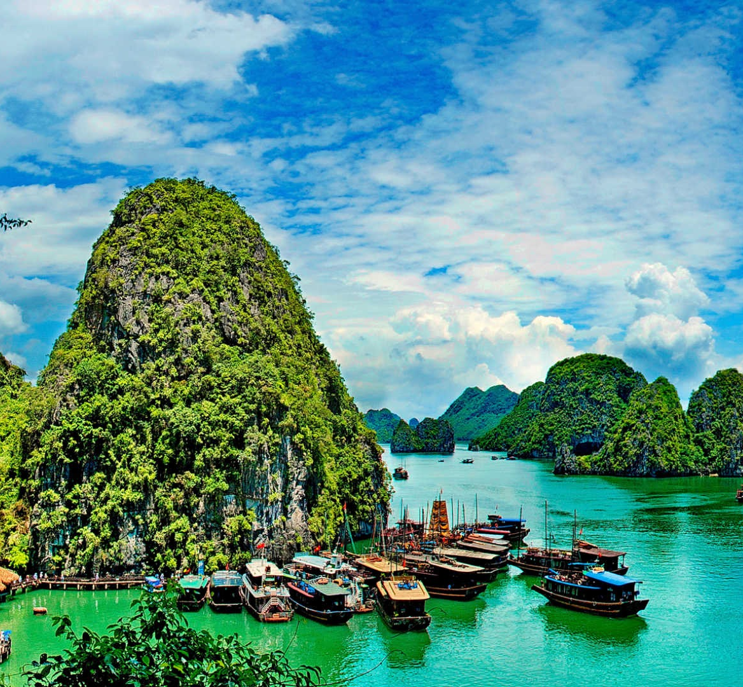
Travel Companions
On this trip I will be traveling with my step mom Amanda and my dad. Neither of them have been to Thailand and so we want to discover the country together.

Slide 3
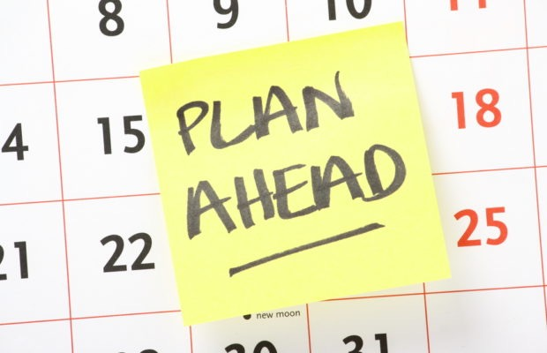
Planning Ahead
In advance I will research the best restaurants and extra places to see while we are there. I will need to save up for this trip and plan to work a reasonable amount to pay for the trip.
Physical preparation: This trip does not require very much physical preparation but I will be kayaking on this trip so I will make sure to be physically prepared by kayaking a few times before hand.
This trip does not require any necessary equipment that will be needed other than our personal belongings.

Slide 4
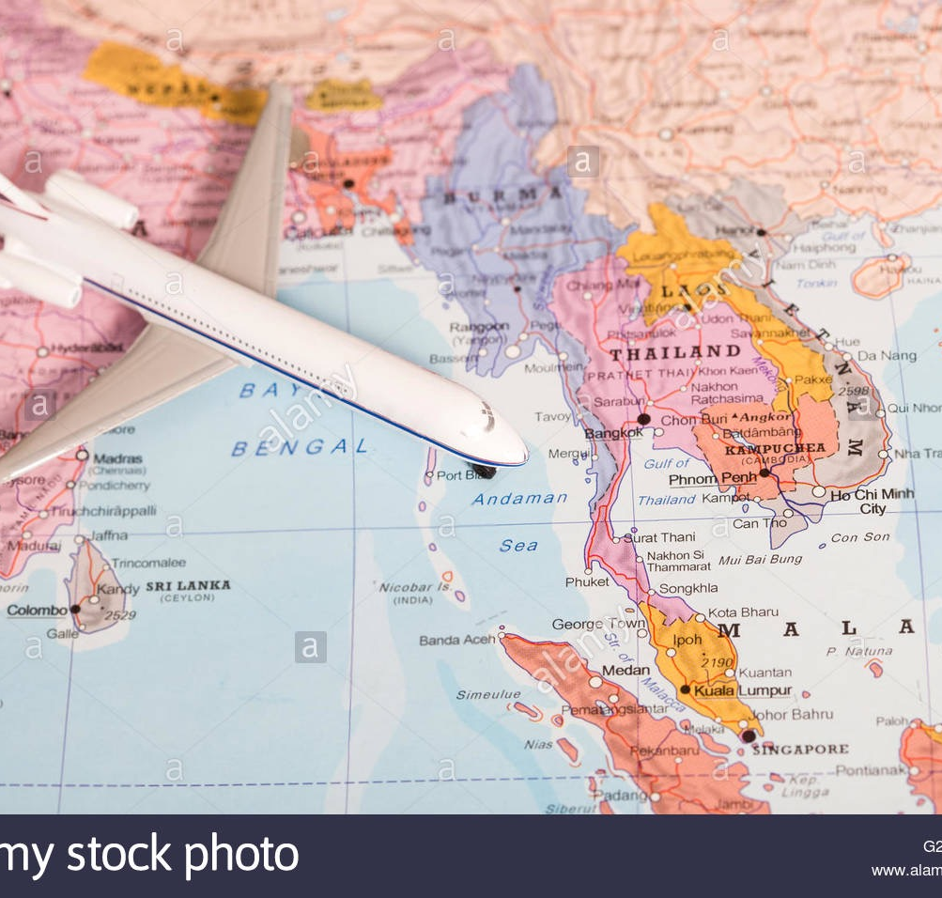
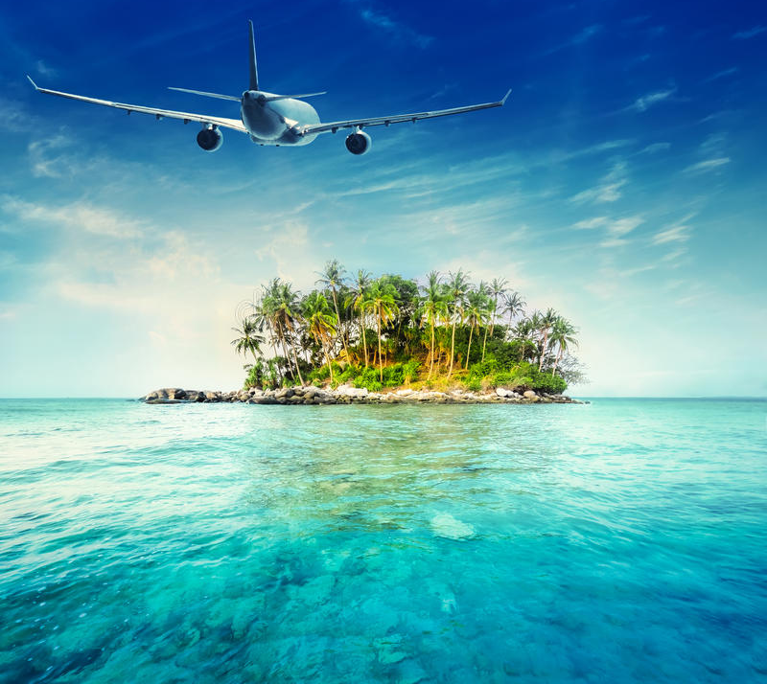
Flight Plan
Date of departure: March 11th 2021 from YVR Vancouver Airport going to Bangkok Thailand(BKK)
Date of return: March 31st 2021 | We will be traveling on these dates because I will be out of school and March is a good time to travel to Thailand because the temperatures will not be to hot.
Airline: We will be flying Air Canada
The tottal cost to fly to Bangkok will be $1,728 x 3 = $5,184

Slide 5
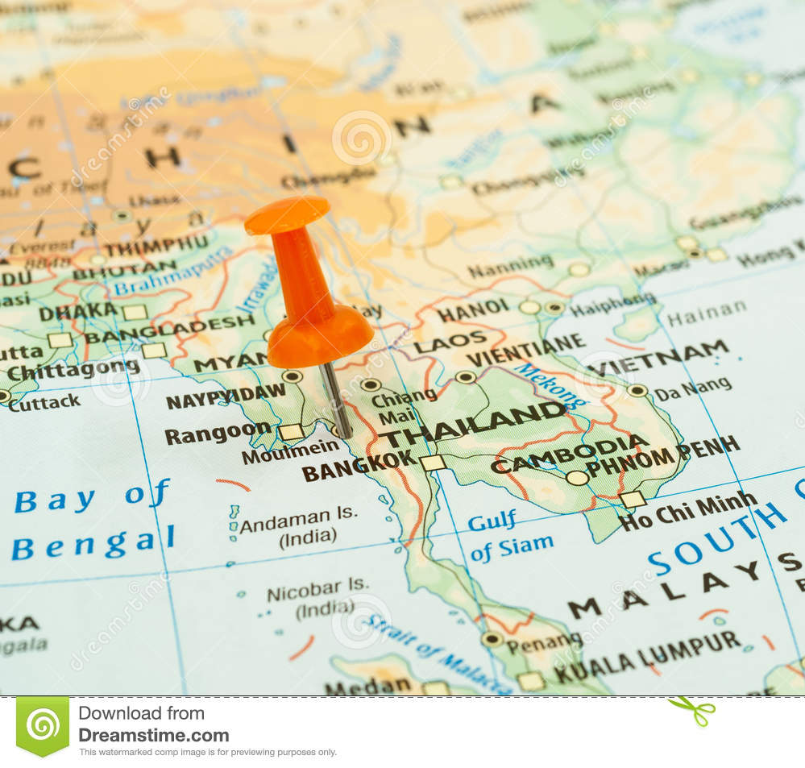
Flight plan
Our flight from YVR will be leaving at 2:50pm
At 4:40pm after 9 hours and 50 minutes of flying we will stop at Narita International Airport (NRT) Tokyo for a 50 minute layover
At 5:30 we will depart from (NRT) we will then have transferred over from Air Canada to the airline Thai
After 7 hours of fling from NRT we will arive in Suvarnabhumi Airport BKK at approximatly 10:30pm but the flight is often delayed by 30 minutes so we may land in Bankok at 11:00pm.

Slide 6
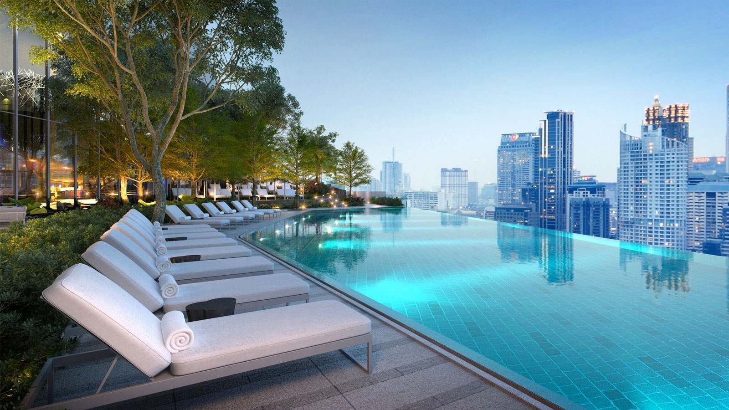
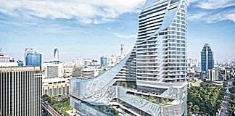
First Night in Thailand
Bangkok
We will be staying at the Bangkok Park Hyatt Hotel
Date: March 11th-13th
Cost: $366 a night

Slide 7
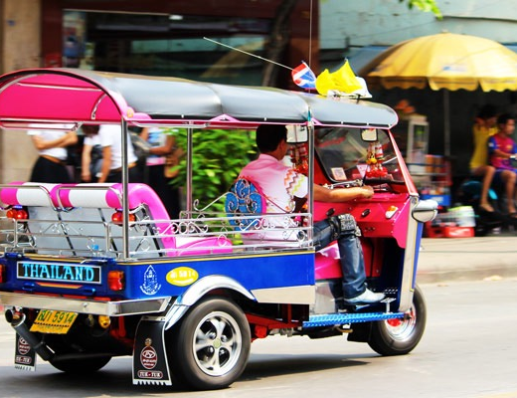
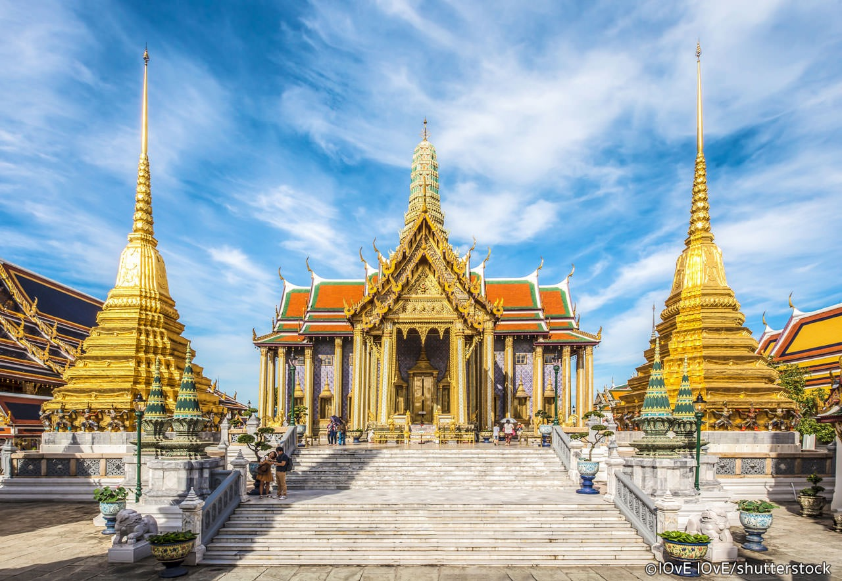
First day in Bangkok March 12th 2021
For our first day in Thailand we are going to visit the Grand Palace, the Grand Palace is a castle where the King lived (since 1782) and is still sometimes used for official events.
Later that evening we will take a night light Tuk Tuk tour at 7pm around the city. This tour will cost a total of $241.62 for the three of us to go.
Meals: We will be eating out at a restaurant.

Slide 8
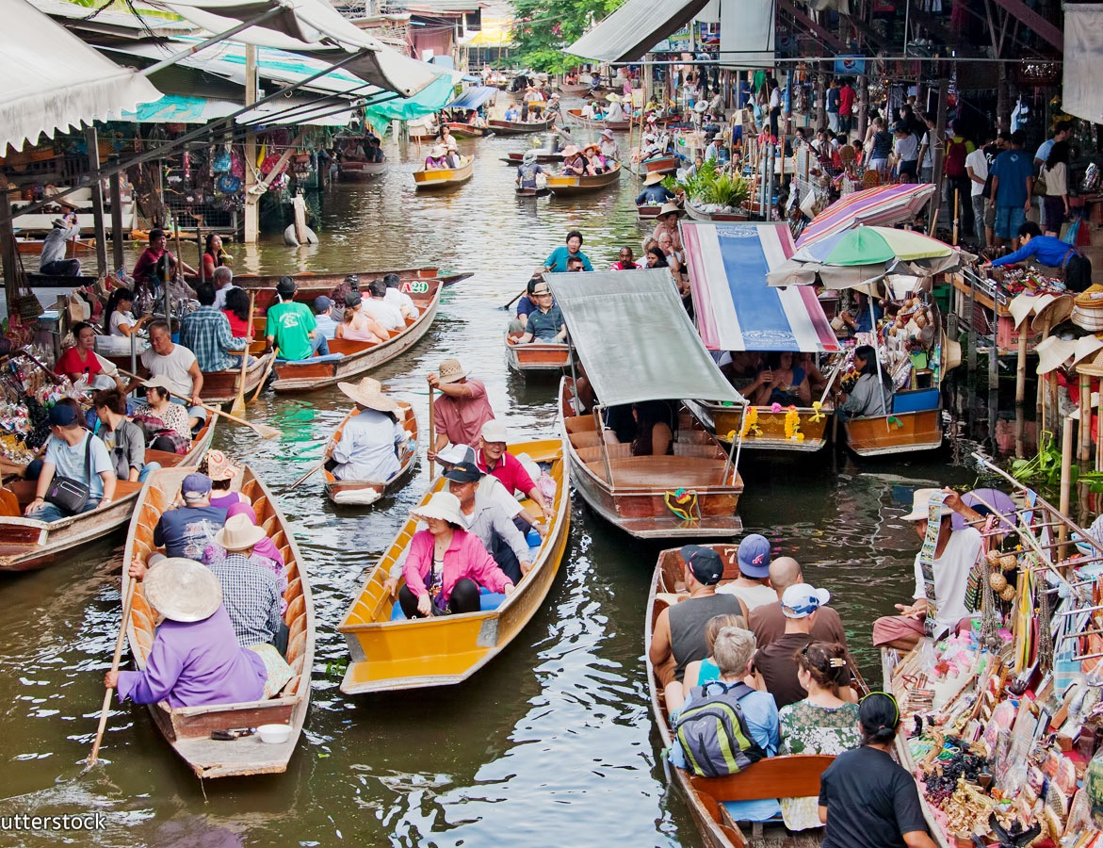
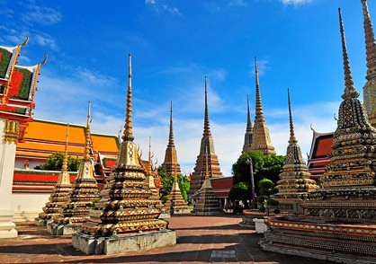
Second day in Bangkok March 13th 2021
We will be visiting Wat Pho which is a famous Buddist temple that is known to be a royal temple due to its connections with King Rama.
After we visit Wat Pho, we will be exploring the floating markets and trying new foods.
Meal: We will be eating at the market and at the hotel.

Slide 9
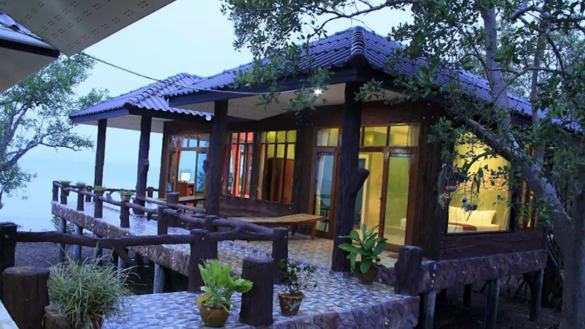
Flight from Bangkok to Krabi
We will take a 9:45am flight from the Thai Lion Airline.
Cost: $135 CAD for the three of us.
We will land in Krabi at 11:o5am and drive to our hotel.
Plans for Krabi: spend the next three nights at Talay Lanta Room 3 Beach House. The total cost for three nights will be $241 CAD.

Slide 10
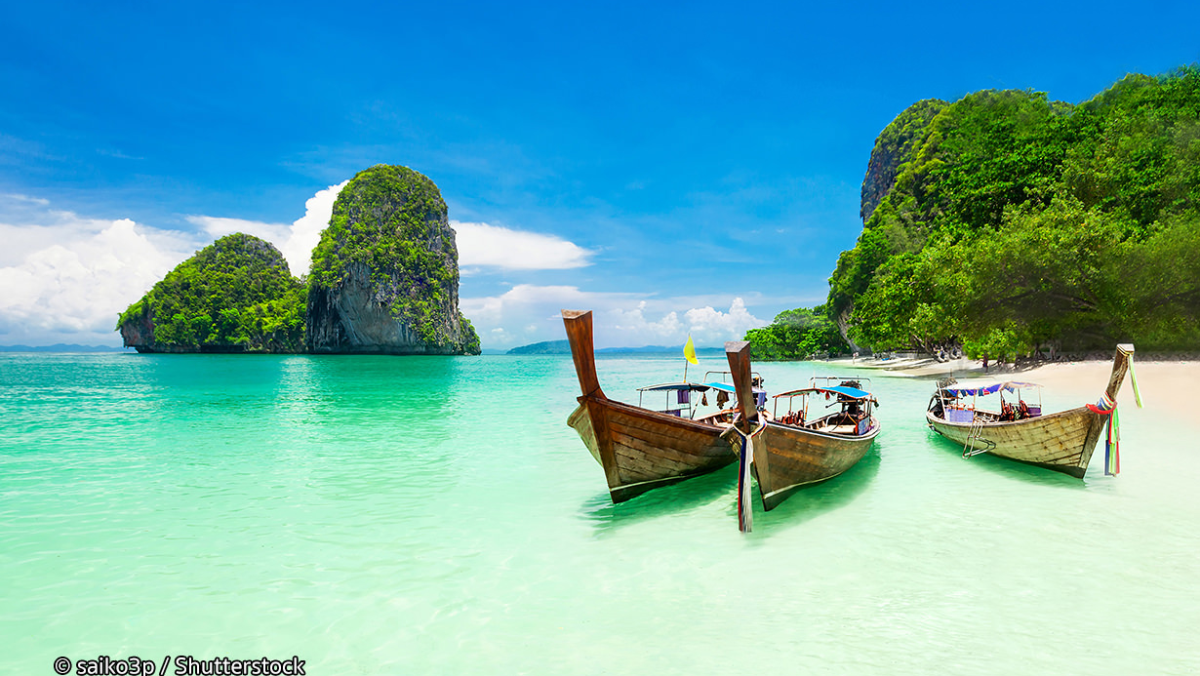
March 14th 2021
Spend the day at Phra Nang Beach
-Kayak around the islands
Meals: - Pack a lunch on the beach
- Make our own meal for dinner

Slide 11
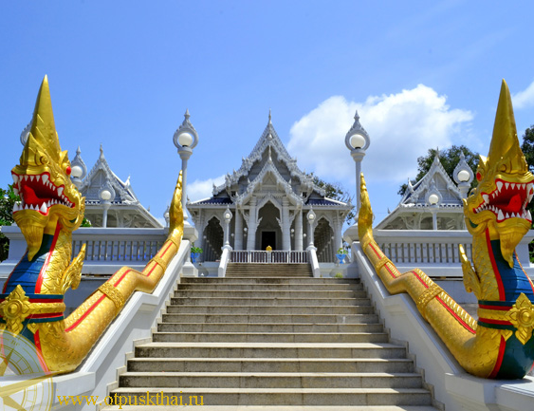
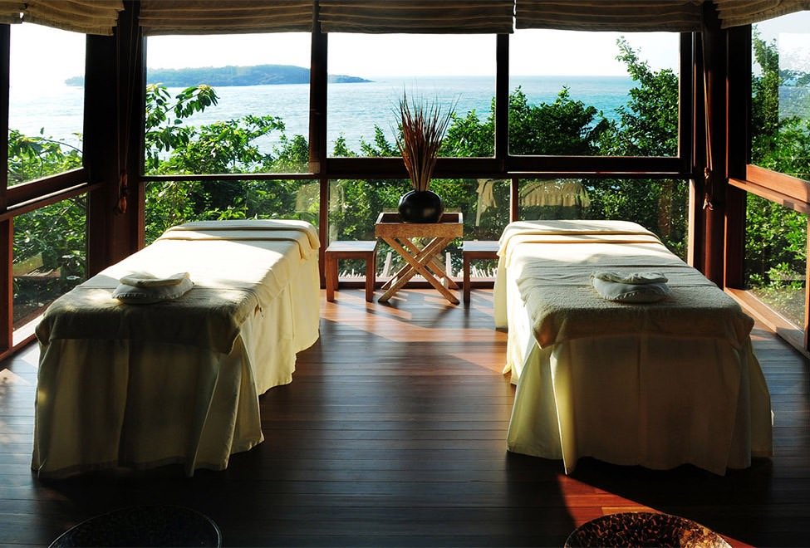
March 15th 2021
Visit the Wat Kaew Temples in the mid morning/ afternoon
Spa day:
It will cost $244.57CAD for a 4 hour spa day in Krabi
Includes: Thai Rice “Sang yod” Body Scrub, Thai Cooling Herbs Body Wrap, Thai Nora Massage, Thai Rice “Sang yod” Oil Nora Massage, Aloe Facial Treatment or Hair wash and Blow Dry, Herbal Tea and Healthy Snack /Aromatherapy Cold Towel
Meals: We will make our own breakfast lunch and dinner at our beach house

Slide 12
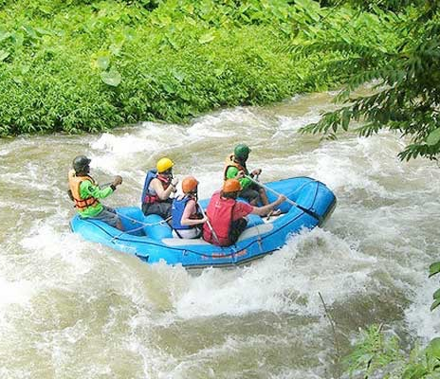
March 16th 2021
Wight water river rafting
Spend the rest of the day at the beach
Meals: We will be buying food from markets and making our own meals at our beach house

Slide 13
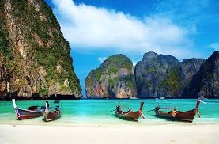
March 17th 2021
On March 17th we will be exploring the 6 Phi Phi islands
Walk the beaches
Kayak around the islands
Meals: We will be going out for breakfast at a nearby restaurant and packing a lunch for the beach, then we will go out for dinner.

Slide 14
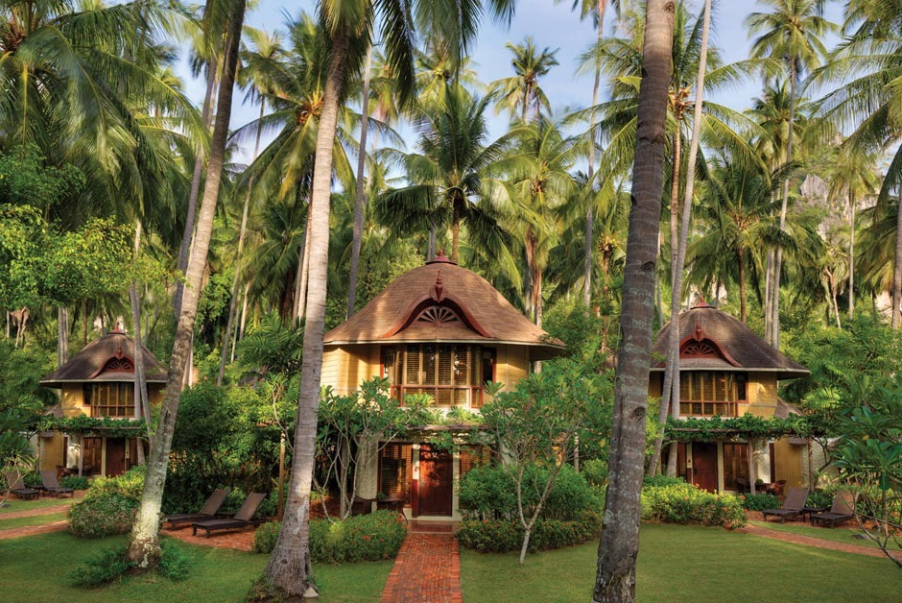
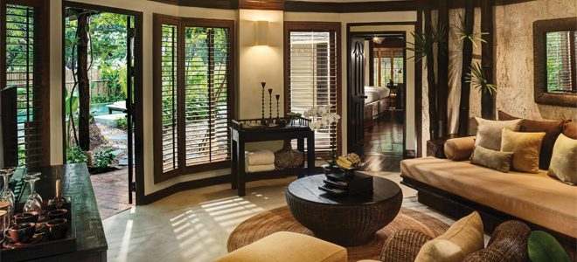
March 18th 2021
From the 18th – 21st we will be staying at the Deluxe Pavilion Rayavadee in Krabi.
I have decided to spend our time in Krabi in two different resort locations so that we can have the hotel luxury as well as a homey feel at the Talay Lanta Beach house where we get the experience of living in Thailand.
Cost: For one night it costs $703.19CAD and the total cost for our stay at the Deluxe Pavilion is $2109.58CAD.

Slide 15
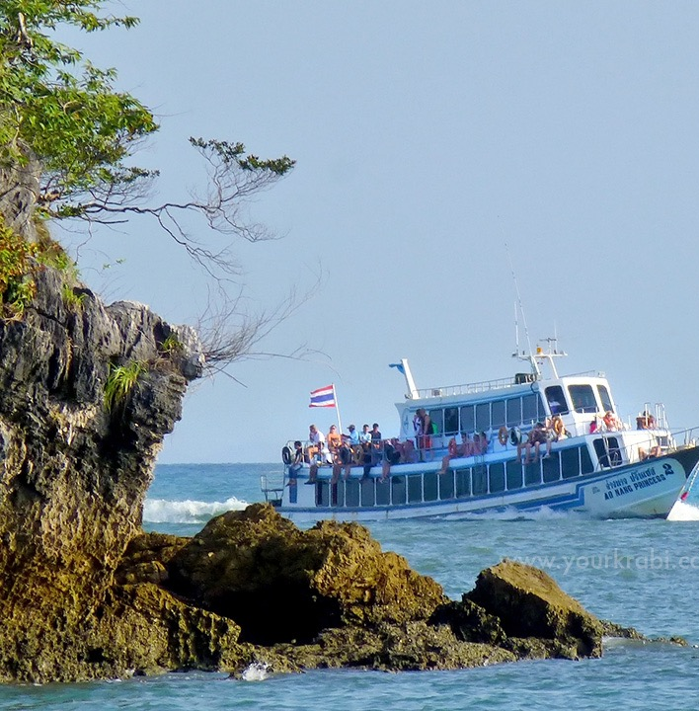
Phuket City
We will be staying in Phuket from the 19th-23rd
We will take a ferry travels between Rassada Pier (south of Phuket) and Nopparat Thara Pie (Krabi). The ferry ride will cost $480 CAD per person and we will be leaving Krabi at 9:30am and arriving at 11:00 am in Phuket.

Slide 16
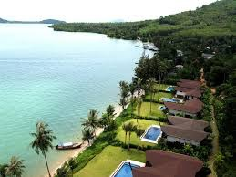
Coconut island
We will be staying at the Coconut island resort for $492 a night from the 24nd – 27th
Things to do on Coconut island:
-Explore the island
-Beach day
-Boat rides

Slide 17
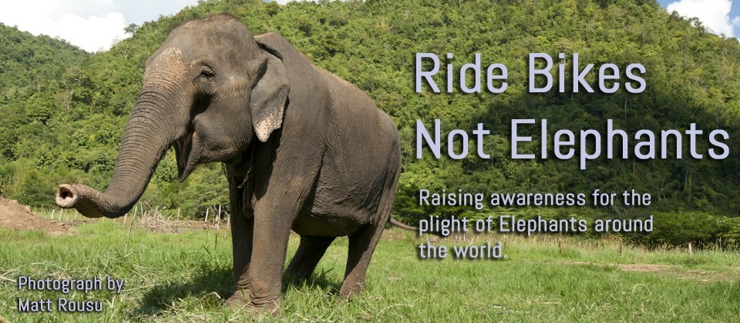
Advise from someone who has already been to Thailand
I spoke with Mr. Almalish who has been to Thailand five times. He told me that their beaches are beautiful and I should definitely take a few days to enjoy them. He also brought awareness to me about the elephants that are taught to poorly there. I had always wanted to go to Thailand to ride and elephant but Mr. Almaish assured me that the abuse in Thailand for elephants is extremely bad and no one should support it.

Slide 18
When will I complete this journey?
I am planning to go on this trip one year after I graduate from Riverside Secondary school in March of 2021 from the 11th – 30th.

Slide 19
Flight Plan going back to Vancouver
We will be leaving from the Phuket international Airport at 1:30am from the Asiana Air Canada airline.
After 6 hours and 5 minutes of flying we will land in Seoul ICN Airport at 9:35am.
At 3:20 PM we will depart from Incheon International Airport ICN at fly for 9 hours and 50 minutes.
Finaly we will land at the Vancouver International Airport YVR at 9:10am

Slide 20
Sources
Thailand map Royalty Free Vector Image - VectorStock
Top 7 Ideal Places To Take Photograph in Thailand - Thailand Travel
https://www.google.ca/flights/#flt=/m/080h2./m/0fn2g.2019-03-11.YVRNRT0AC3~NRTBKK1TG677*/m/0fn2g./m/080h2.2019-03-31.BKKHKG0CX700~HKGYVR0AC8;c:CAD;e:1;sd:1;t:f;sp:.CAD.172711*.CAD.172771
Miniature of a passenger airplane flying over the map of Thailand ...
Airplane Flying Over Tropical Ocean Landscape. Thailand Travel Stock ...
Park Hyatt Bangkok Archives - Thailand-Property
Park Hyatt Bangkok Review - Bangkok.com Magazine
https://www.expedia.ca/things-to-do/en/bangkok-night-lights-tuk-tuk-tour.a481635.activity-details?regionId=201&semcid=CA.MULTILOB.GOOGLE.AT-c-EN.TSHOP&semdtl=a11332459290.b153101579573.r1.g1dsa-430111358621.i133896540358.d1270395648606.e1c.j19001495.k1.f11t2.n1.l1g.h1b.m1&gclid=CjwKCAjw3cPYBRB7EiwAsrc-uTQ_C3gIAKu8Sr_6LM9Bj1eOJqZc-FFPN9n9r_3Kj4fw4BUYmQ7GcRoCkRAQAvD_BwE
Tuktuk tour exploring Bangkok at night - Private Tour
The Grand Palace in Bangkok - Bangkok Attractions
Bangkok: 10 Things to Do — 8. Wat Po - TIME
5 Floating Markets Around Bangkok - Which One is Best?
https://goasiadaytrip.com/tour/tuktuk-tour-exploring-bangkok-at-night-private-tour.html
https://12go.asia/en/travel/bangkok/krabi
https://goasiadaytrip.com/uploads/Destination/bangkok/bkk-tuktuk-750x400.jpg
https://www.airbnb.ca/rooms/9070112?locale=en
THAILAND KRABI BY DRONE !! Railay beach, Phra Nang beach, Ao nang ...
Samui Spa, Samui Luxury Villa - Six Senses Samui, Thailand
Phi Phi Islands Tours
Rayavadee Krabi Accommodation - Deluxe Pavilion
Rayavadee Krabi | Thailand Holidays | Luxury Holidays | Pure ...
Welcome March Wallpapers | Free Calendar Template
Planning Ahead for Success | Club Solutions Magazine
The Village Coconut Island Beach Resort - izsales
https://www.yourkrabi.com/krabi-ferry-schedules/
https://www.viator.com/tours/Phuket/4-hours-Spa-Package-Charming-Shirodhara-Package/d349-26842P92

