Slide 1
Angie's Career Path
How to become an architect

Slide 2
My Career Goals
I want to become an architect by 2025.
To get there I will need to:
Graduate by June 2020
A goal I have: To become an architect by taking my bachelors degree one year after I graduate. An obstacle might have would be finding the time to study. To make sure I can get past this obstacle, I will organize my time and make specific times to study.

Slide 3
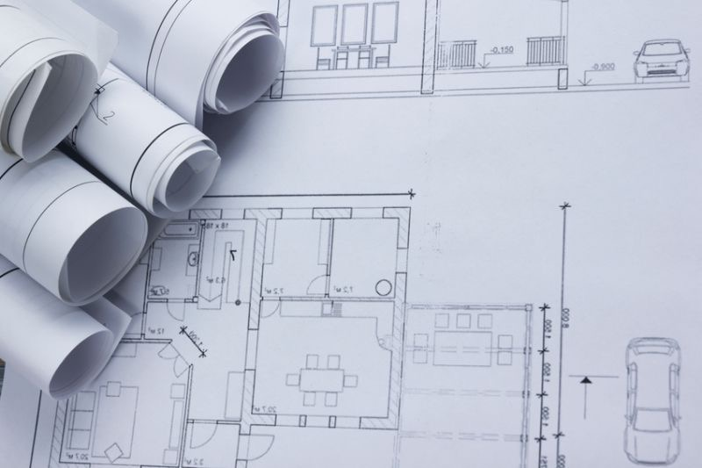
What is an Architect?

Architects design outdoor or indoor spaces for public or private projects. Architects can design something as big as a building or even small room. Architects also design home renovations offices, retail stores, and other structures.

Slide 4
About my future career

Architects spend most of their time in a office where they make their designs and meet with clients. They also visit construction sites to make sure the project is going well and their clients are satisfied.
An average wage for an architect is about 42,986 - 89,289.
Most architects work full time and additional hours depending on their project. Self employed architects might have more flexible hours.

Slide 5
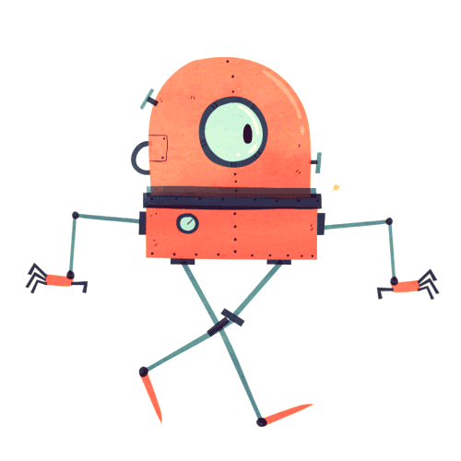
My job has a 1.8% chance of becoming automated

I do not think the job of an Architect will become automated because architects have to be creative with their designs and discuss with the clients on what they want done. I don't think robots would be able to be creative and come up with new ideas.
Robots also would not be very good at designing the layout of a project, a human can draw and make changes to their plan but it would be harder for robots to do that.

Slide 6
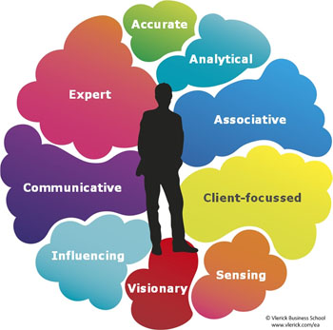
My Compatibility

I am 83% compatible for this job
The skills this job requires are:
Analytical skills.
Communication skills.
Creativity.
Organizational skills.
Technical skills
Visualization skills.

Slide 7
Being an architect would be great for me because...

I already have these skills for this career:
Creativity
Communication skills
Organization skills
Visualization skills

Slide 8
I am not quite ready for this career, but I will get there!
These are skills for the job I still need: | This is how I will get those necessary skills:
Analytical skills | I will practice in analysis-based student projects
Technical skills | I will read technical books and take classes.

Slide 9
Job Outlook

In BC, the job outlook is 3 of 3 stars.
Here are two reasons why:
Employment growth is expected to be strong.
A large number of people are expected to retire.

Slide 10
This is what appeals to me with this career…

Architects get to be creative, I think it is a unique job that they get to make and design something the way they want it to be.
The effect the job has on other people. Architects are important and have an impact on people by helping their customers choose what they want their house or office to look like.

Slide 11
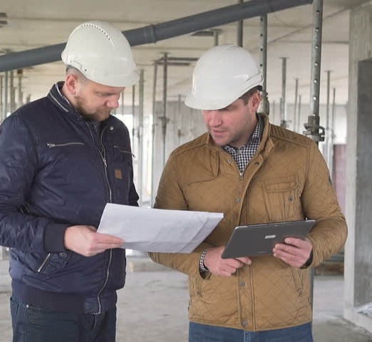
These are some things I find less appealing about this career…

The hours can be long and you might have to work overtime. It will be hard to find free time.
I wouldn't be designing all the time, architects have other tasks too. Something I would not want to do is convert file types. It can be very boring and time consuming.

Slide 12
Potential obstacles to getting this career
The possible obstacles: | My plan to overcome them:
An obstacle might be finding a place where the company would be willing to have me as an intern. | Send my resume out to different companies and keep my options open.
Beating the competition for the job | Apparently it can be hard to get a job because there are a lot of other candidates so I plan to make myself familiar to the other companies and make sure I know about the job and their company.

Slide 13
Potential obstacles to being successful within this career
The possible obstacles: | My plan to overcome them:
It might be hard to find clients | Put out flyers and make adds to grab peoples attention
Having to change my design to fit exactly what the client wants | It might be hard to do exactly what the client wants but to overcome this obstacle I will draw out different design and try my best to fit the clients expectations.

Slide 14
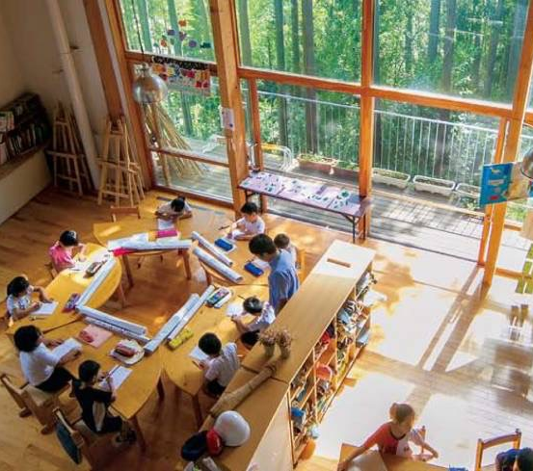
The training/education required for my career is:

Completing a 5 year Bachelor of Architecture degree
Generally 3 years of experience in an internship
A master's degree in architecture may be required.
passing the Architect Registration Examination.

Slide 15
I intend to go to University of British Columbia for that career
The University of British Columbia is in Vancouver, BC Canada.
I would take the Master of Advanced Studies in Architecture
The program is 16 months long
Master of Advanced Studies in Architecture

Slide 16
High school courses required
Grade 11 courses: | Grade 12 courses:
Industrial Design 11 | Industrial Design 12
Pre-Calculus 11 | Pre-Calculus

Slide 17
Additional admission requirements
Final grade of 70% in Grade 11 or Grade 12 English (or equivalent course, including provincial examinations where applicable).
Graduation from high school with a minimum average of 70% (or higher for many programs).
UBC is known for

Slide 19
Financial Plan
The program cost $5,075.52 per year and my program is one year and four months long. My total cost for the program will be 6,767.36
I am going to pay for my program:
I will get a starter job and my parents will help out with the cost and if I can I will also try to get scholarships.

Slide 20
Some related occupations:

Urban and Regional Planners
Industrial Designer

Slide 21
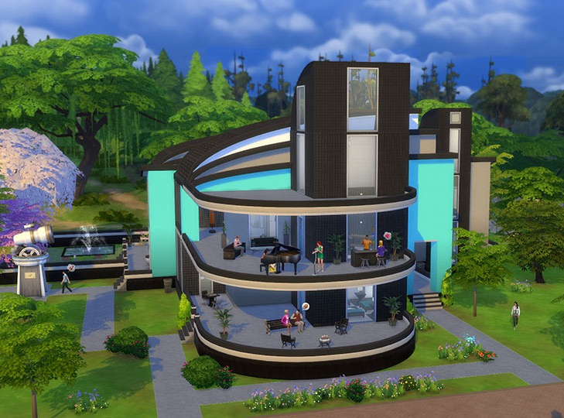
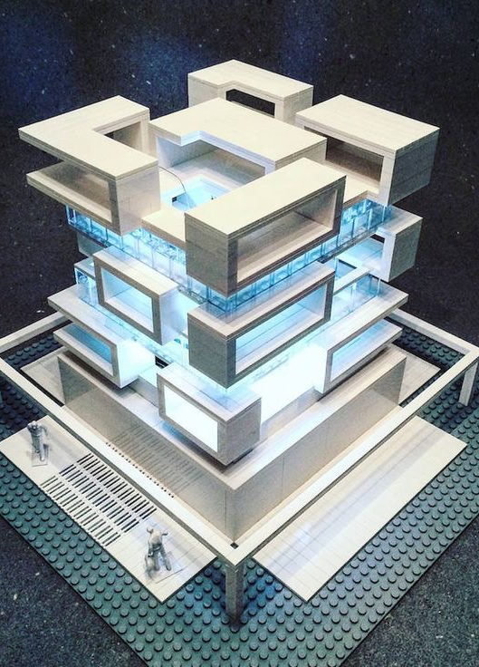
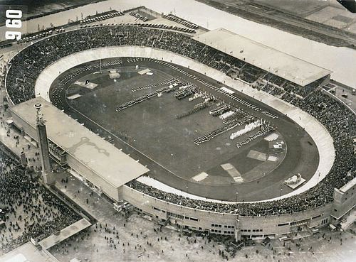
Architects are Awesome!!!

I think it is really cool that architects get to design buildings
Architects get to build 3D models of their design
I like that architects get to work with their clients
Fun Facts
Architecture Was Once an Olympic Sport
"The Sims" Was Originally Designed as an Architecture Simulator
LEGO Used to Make Special Bricks for Architects

