Slide 1
Foods 12 Cooking Showcase
Alhan Zarei

Slide 2
The dish I decided to make Is called tahchin
I decided to make this dish because it was a dish I ate growing up in Iran and I still enjoy it very much. This dish gives me a feeling of comfort.
The dish could be made with either chicken, lamb, fish or vegetables depending on preference and or what region of Iran you are from.
Also known as Persian Baked Rice Cake

Slide 3
Preparing the dish- Materials
For this dish I needed some eggs, cooked rice, cooked chicken, plain yogurt, saffron and salt.
You have to mix the eggs together then add in yogurt and saffron and keeps mixing and then shred or cut the chicken into little cubes and put them into the mixture. Then add salt to add flavor and then mix in the rice. After you move the mixture into a dish and put into a preheated oven of 375 for 20-25 mins.

Slide 4
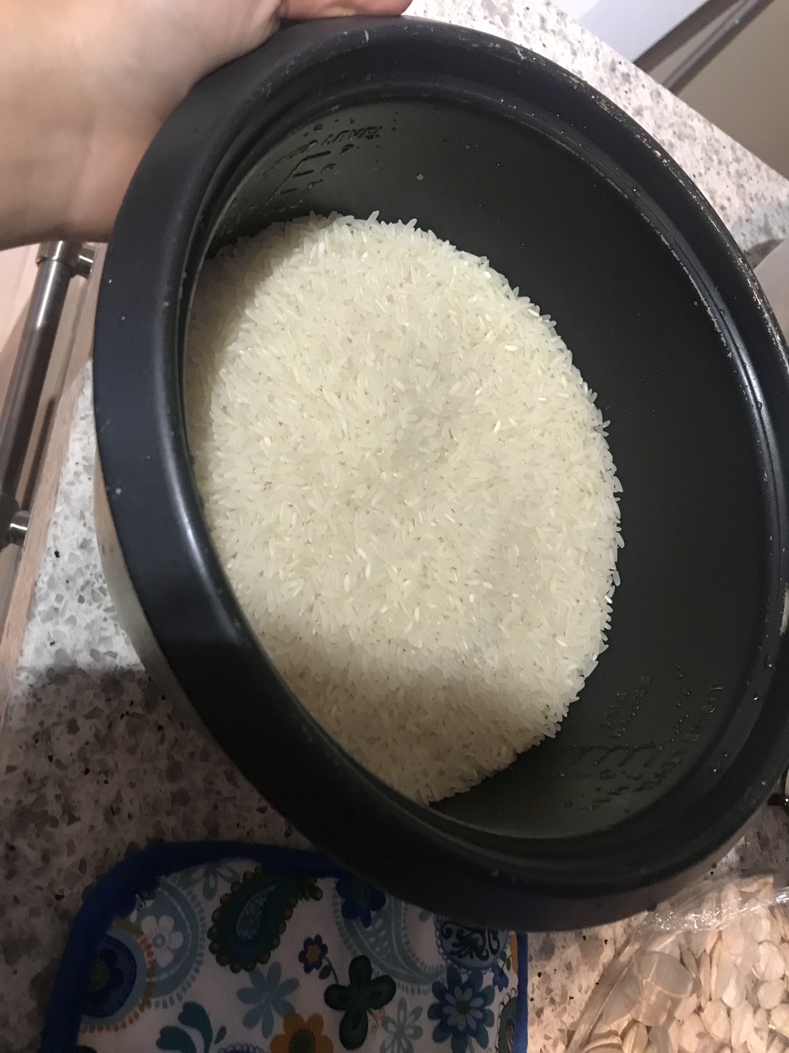
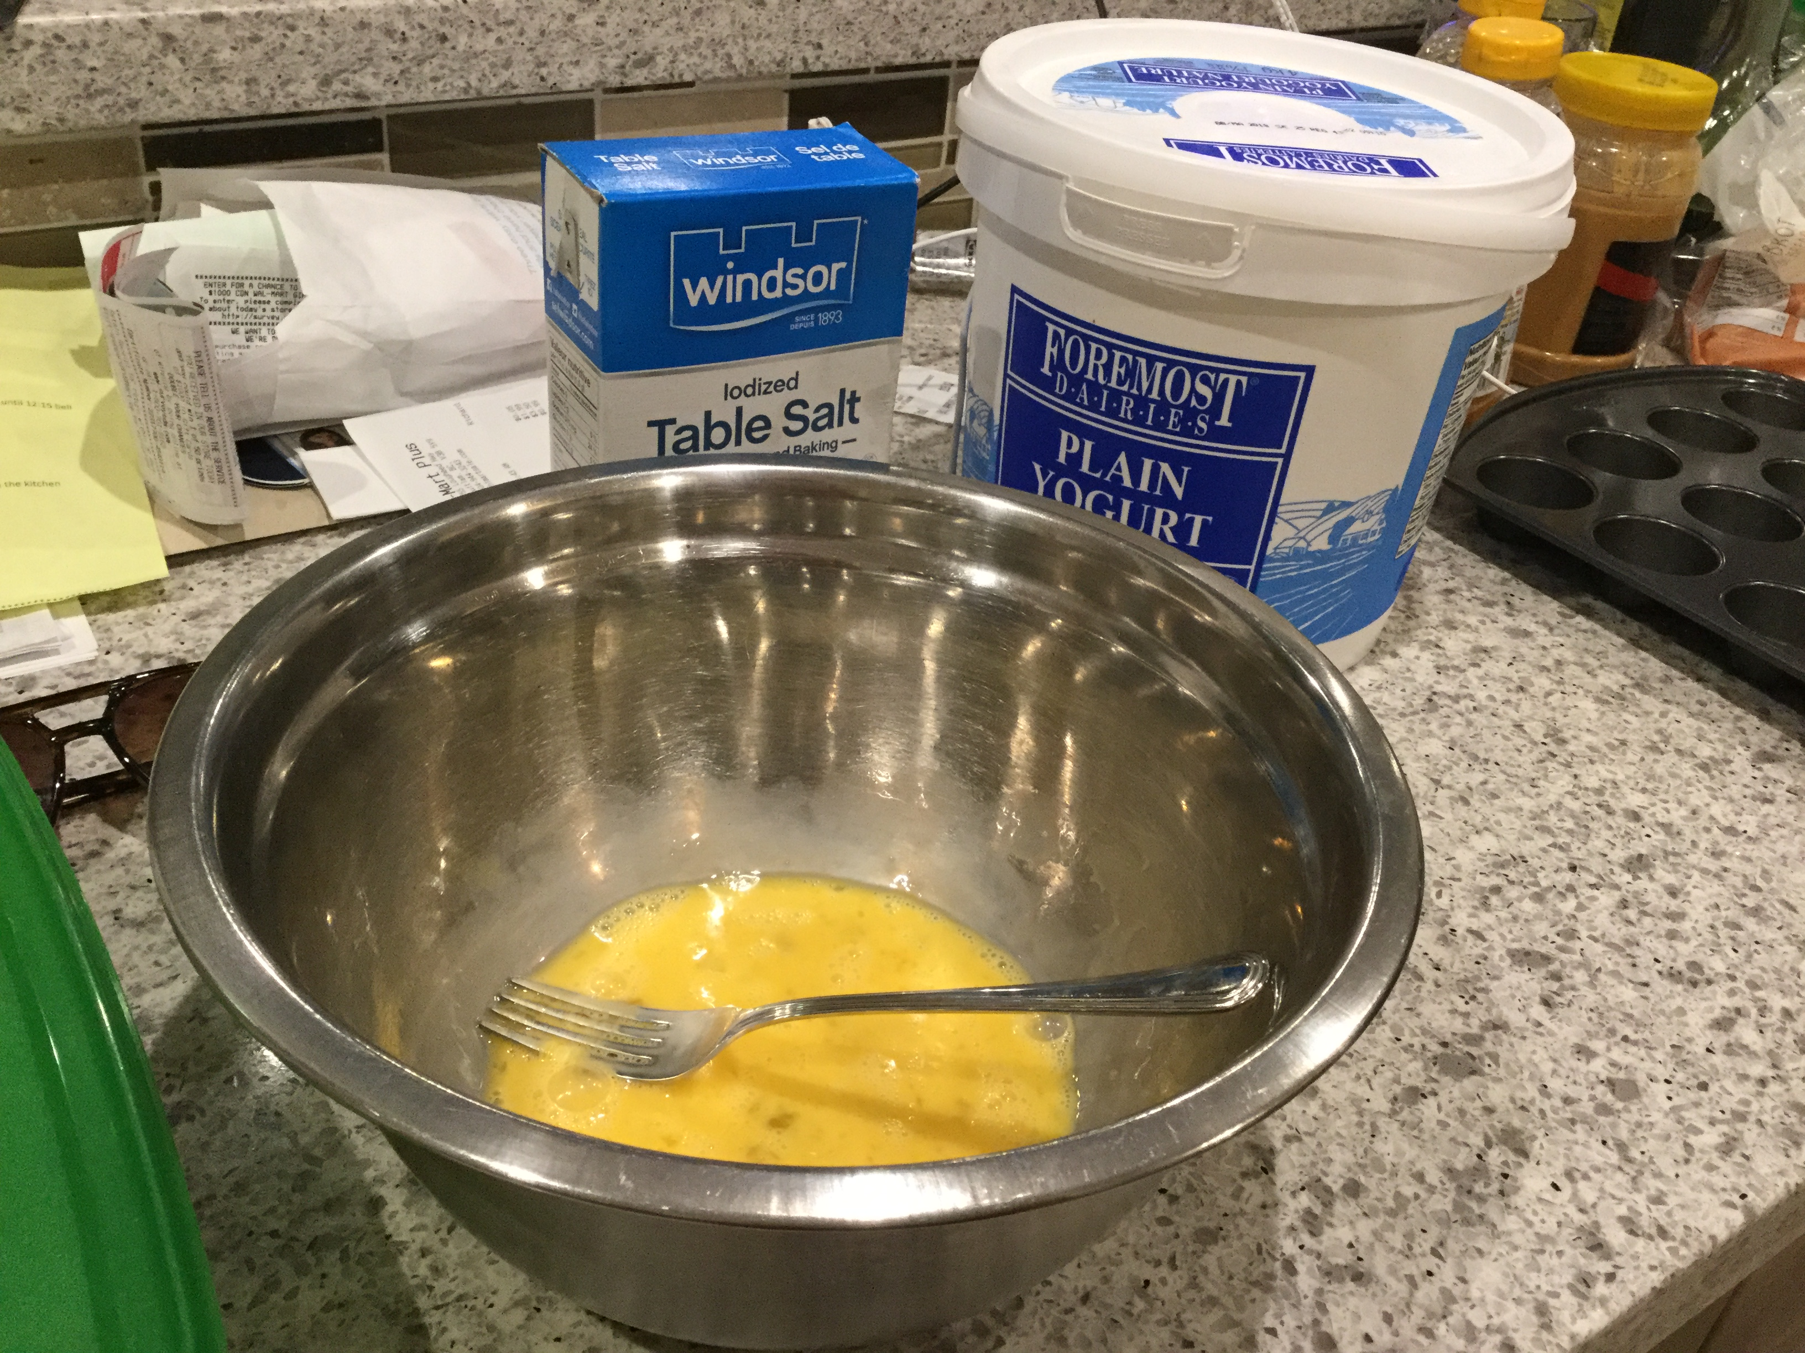
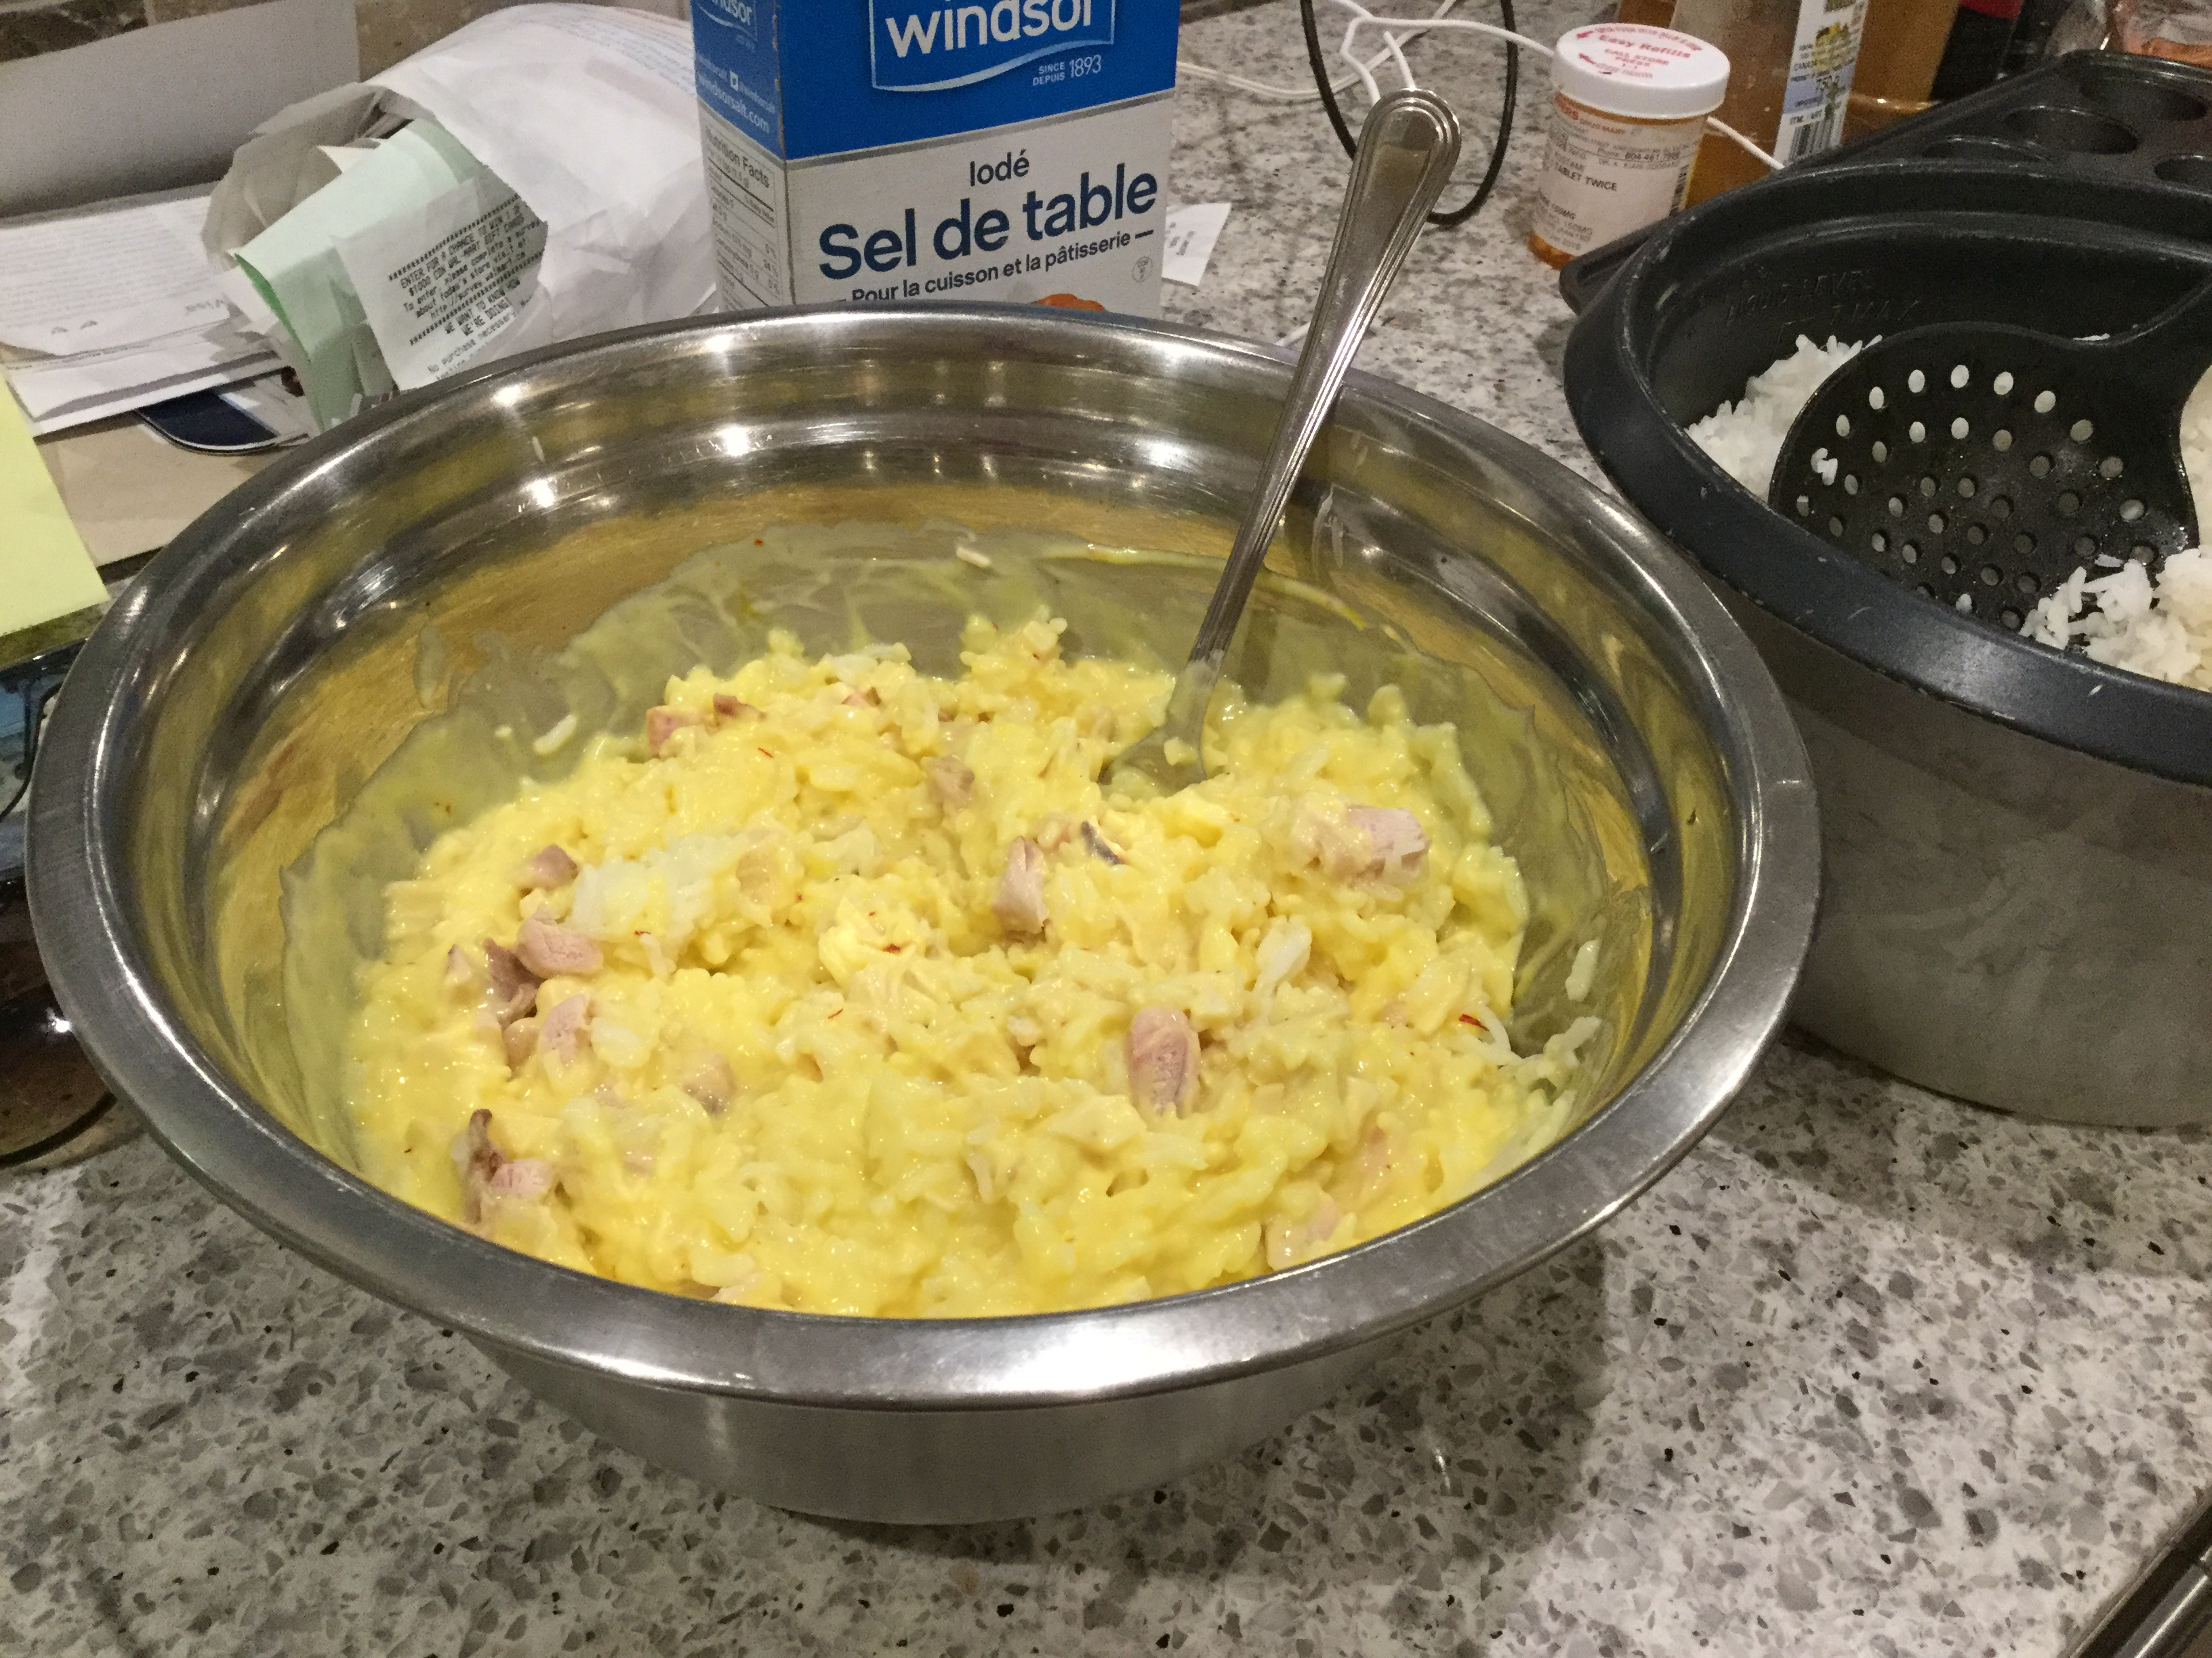
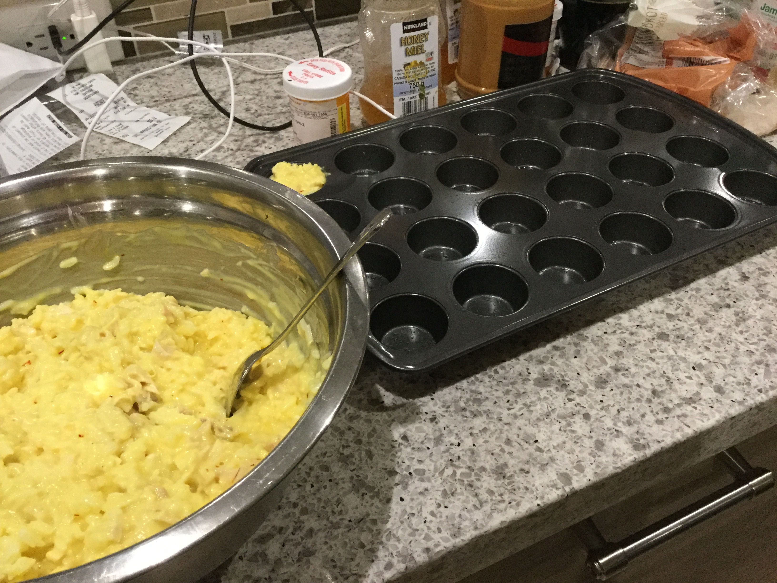
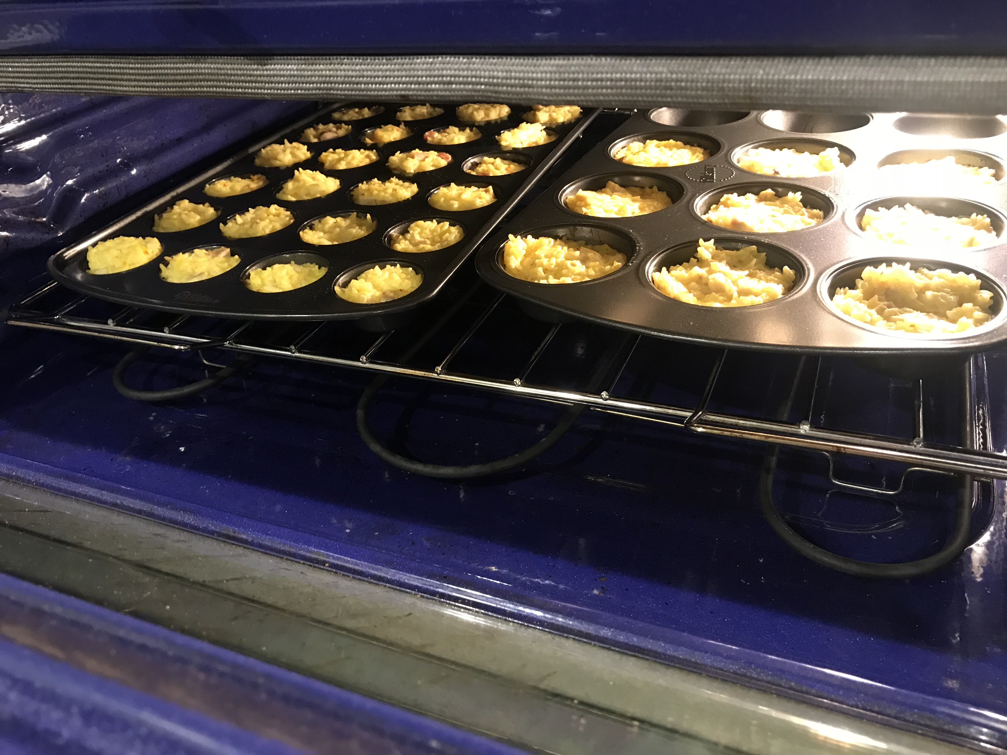
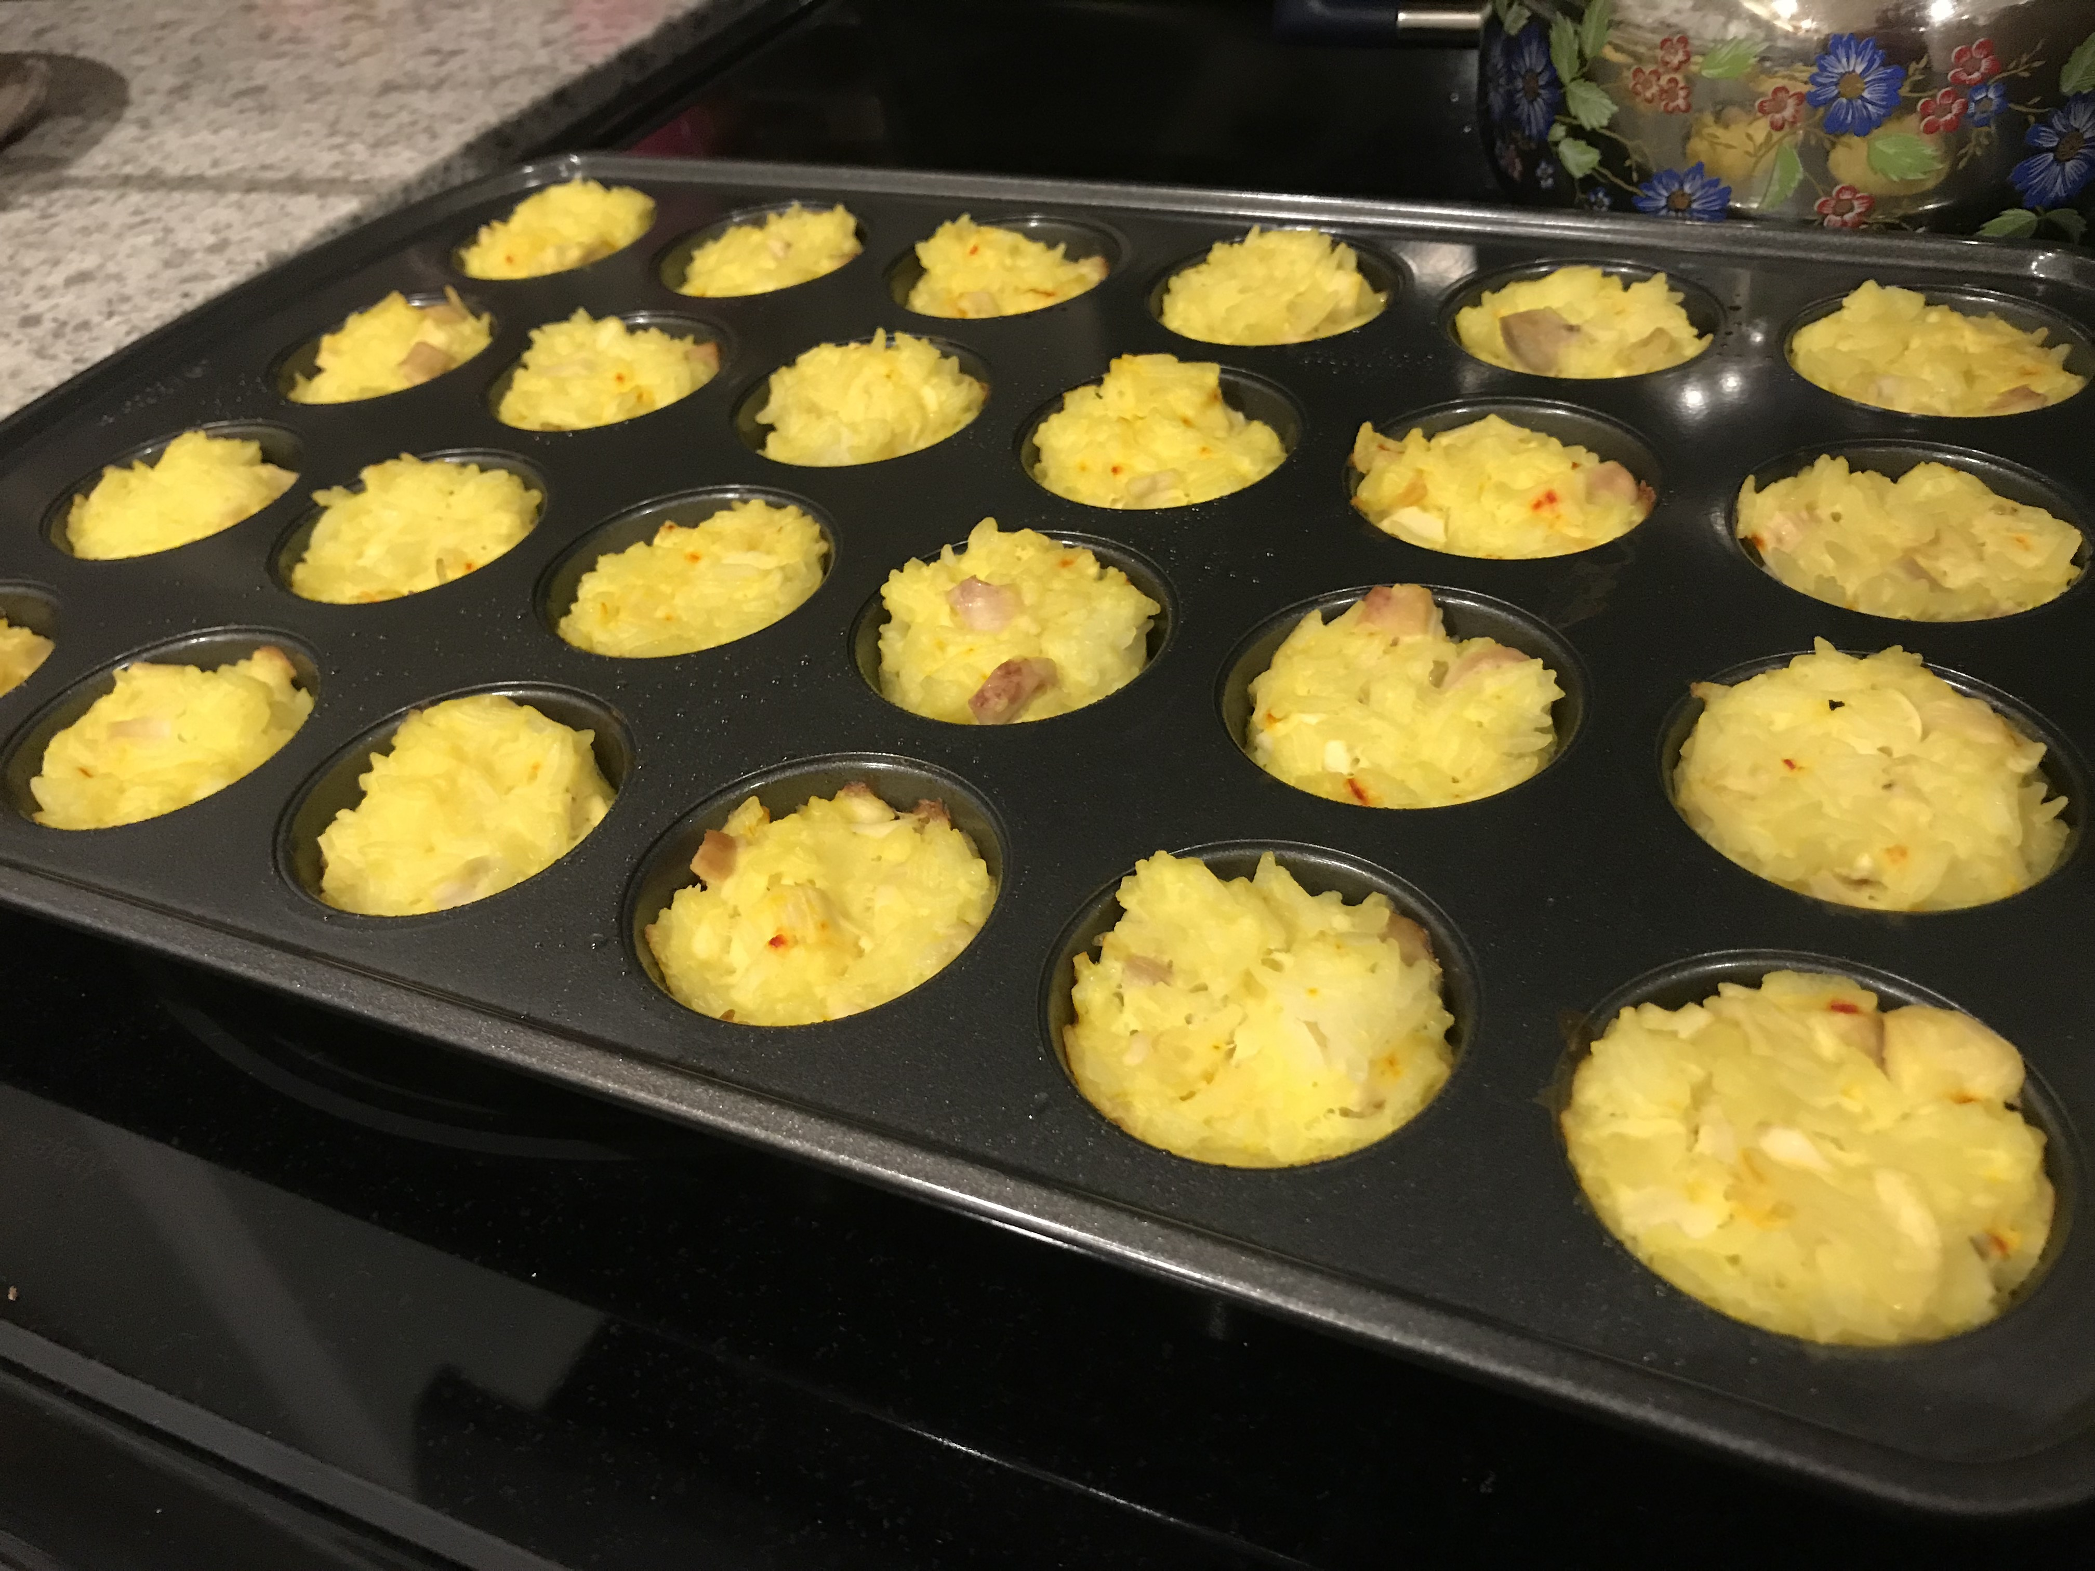
Preparing the dish- other pictures

Slide 5
The End- Hope you enjoyed!

