Slide 1
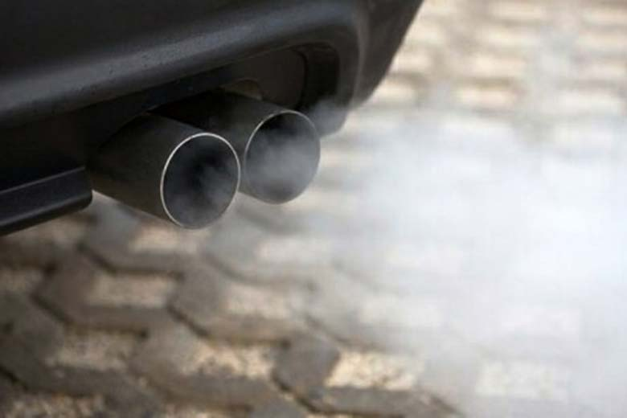
Emission Control Systems

Slide 2
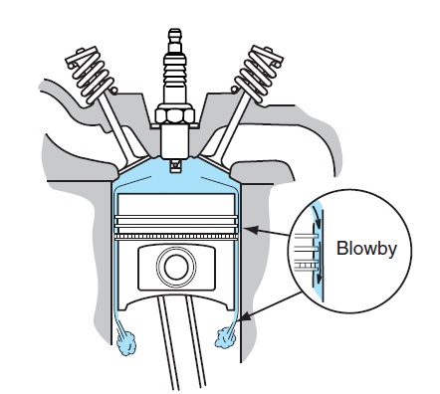
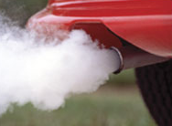
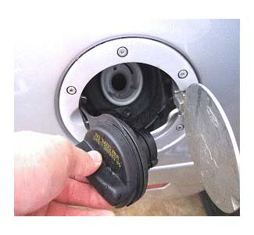
Vehicle Pollution Sources
3 areas of a vehicle that can pollute…
tailpipe emissions
fuel tank vapors (and fuel vapors from the carburetor, if equipped)
crankcase blow-by gases
Notes:
A little history on vehicle emissions…
By 1967 the State of California created the California Air Resources Board, and in 1970, the EPA was established. Both agencies, as well as other state agencies, now create and enforce emission regulations for automobiles in the United States. Similar agencies and regulations were contemporaneously developed and implemented in Western Europe, Australia, and Japan.
The first legislated exhaust (tailpipe) emission standards were publicized by the State of California for 1966 model year for cars sold in that state, followed by the United States as a whole in model year 1968. The standards were progressively tightened year by year, as mandated by the EPA.
By the 1974 model year, the emission standards had tightened such that the de-tuning techniques used to meet them were seriously reducing engine efficiency and thus increasing fuel usage. The new emission standards for 1975 model year, as well as the increase in fuel usage, forced the invention of the catalytic converter for after-treatment of the exhaust gas. This was not possible with existing leaded gasoline, because the lead residue contaminated the platinum catalyst. In 1972, General Motors proposed to the American Petroleum Institute the elimination of leaded fuels for 1975 and later model year cars.

Slide 3
Engine Pollutants
hydrocarbons: produced when some or all of the fuel does not get burned during combustion, or from raw gasoline vapors
tailpipe emission
fuel tank vapor & carburetor fuel vapor
carbon monoxide: produced when there is insufficient oxygen to support combustion
tailpipe emission
oxides of nitrogen: produced when combustion temperatures exceed 1400°C / 2500°F
tailpipe emission

Slide 4
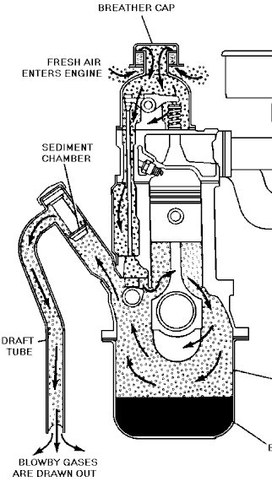
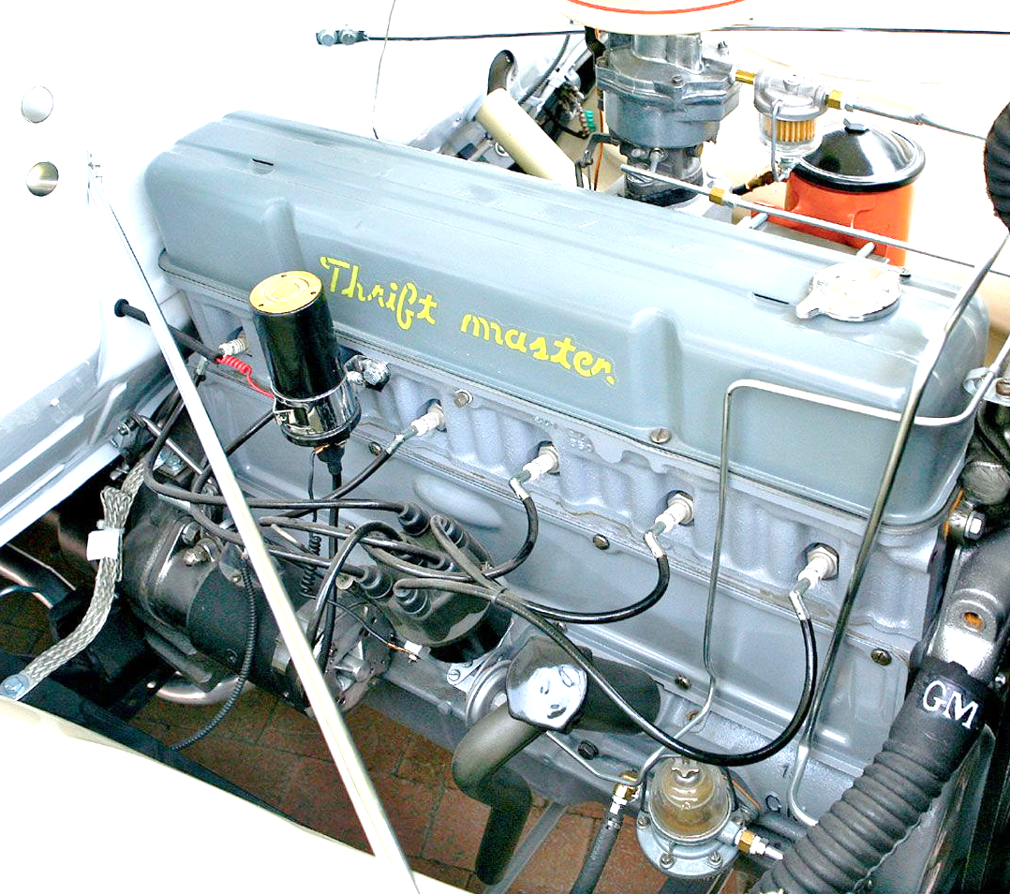
Blow-by Emission Control
crankcase ventilation system handles blow-by gases
blow-by gases: combustion gases that leak past the compression rings
road-draft tube used until 1962

Slide 5
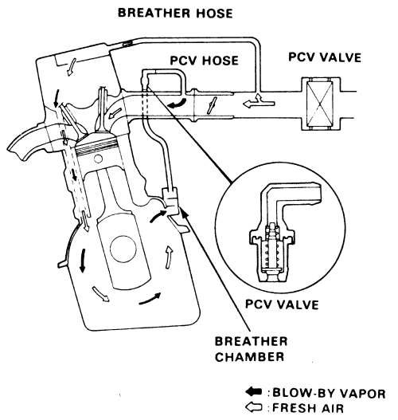
Blow-by Emission Control
Positive Crankcase Ventilation system (PCV system) in use since 1963…

Slide 6
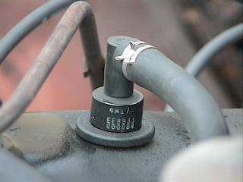
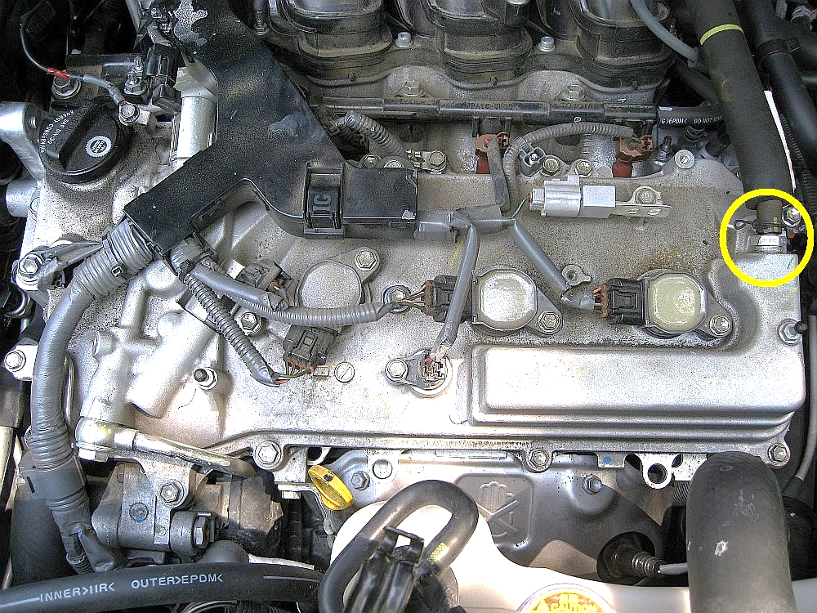
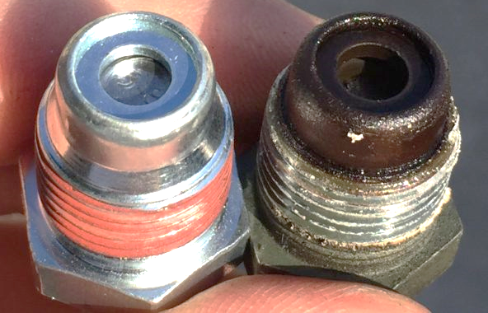
Checking PCV System
pull the PCV valve out of the engine (leave its hose attached)
start the engine
place your finger under the valve
you should feel and hear suction & the valve should snap
replace the PCV valve (inexpensive)

Slide 7
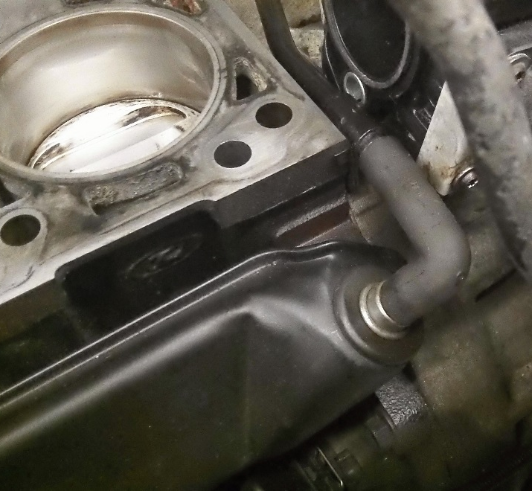
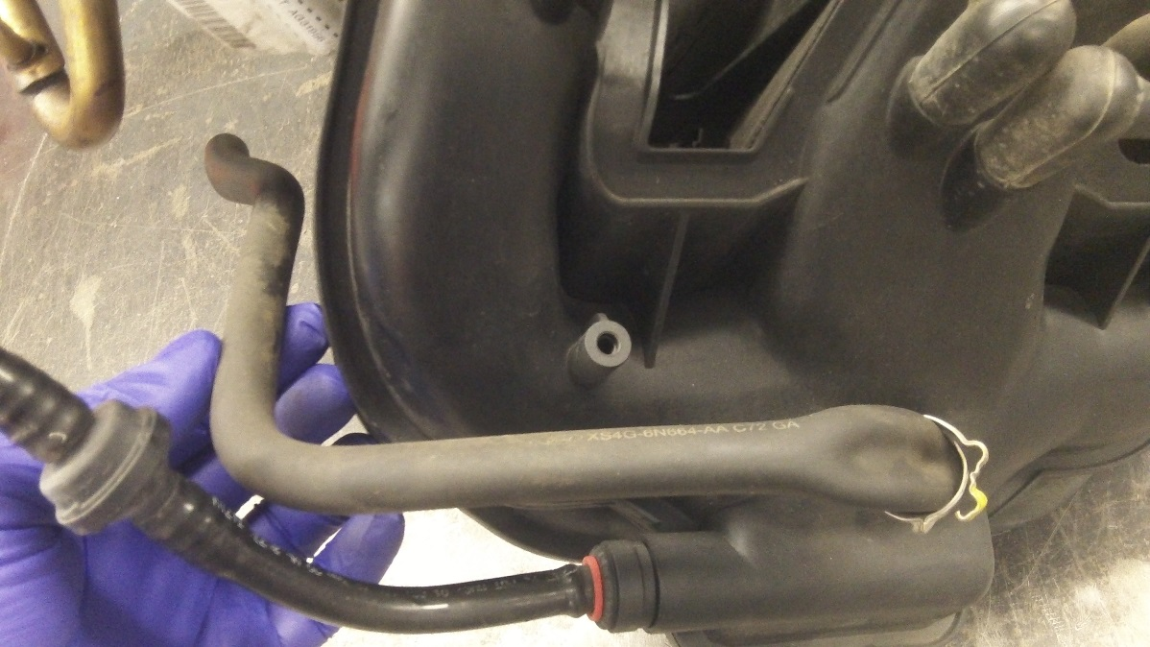
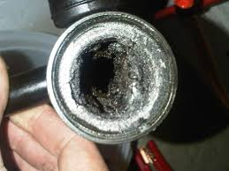
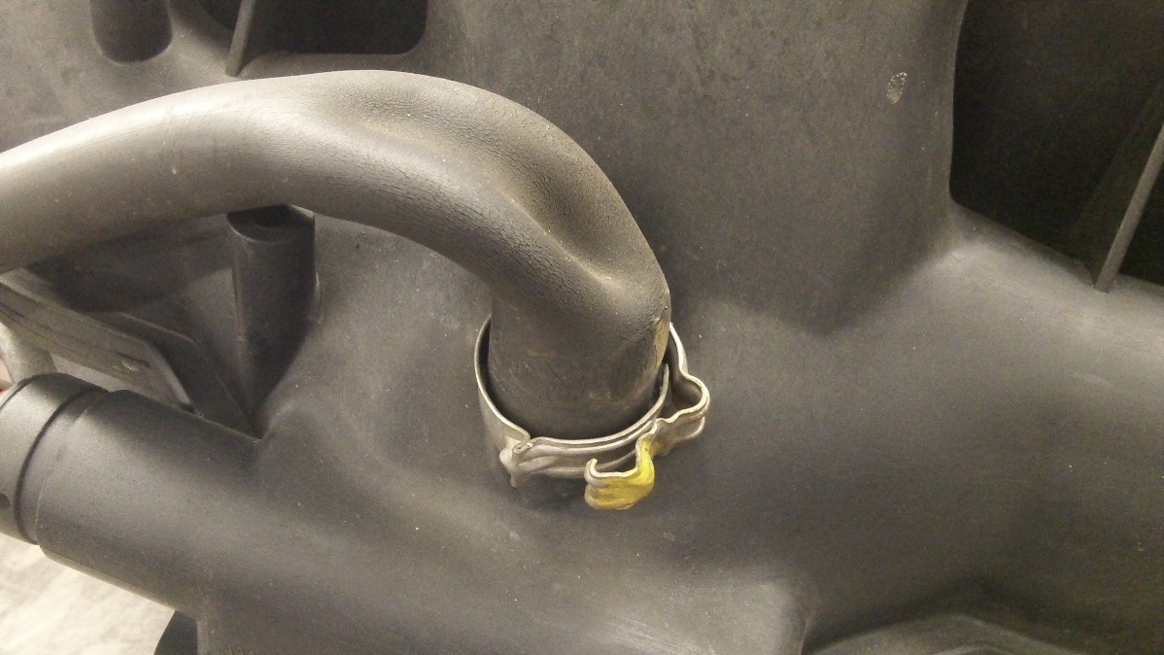
Checking PCV System
check the connecting PCV hoses carefully
plugged passages are common as well

Slide 8
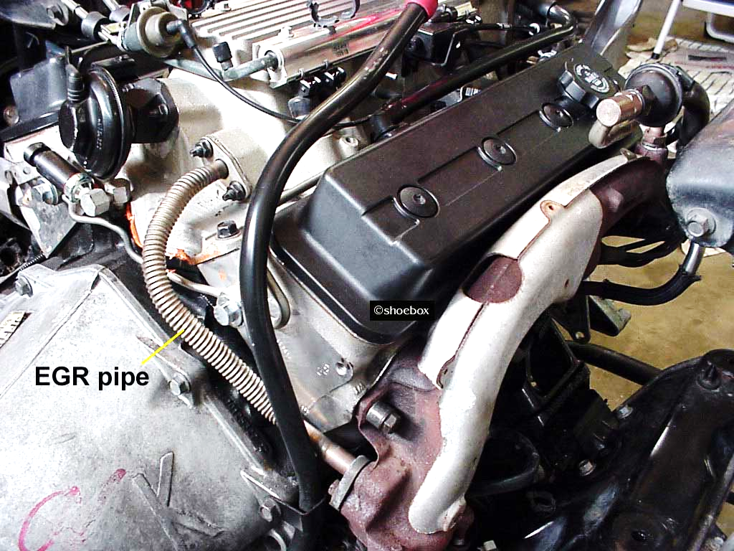
Reducing NOx Tailpipe Emissions
Exhaust Gas Recirculation valve (EGR) routes some exhaust gas back into the intake air stream
used on most engines since mid-1970’s but not all
EGR dilutes/displaces fresh, incoming AFM which drops combustion temperature = < NOx
EGR Valve
EGR Pipe
Notes:
AFM: air-fuel-mixture
the volume sent to the intake manifold via the EGR valve can be around 6% - 10% of the exhaust gas volume
the exhaust gas is inert and does not affect combustion process

Slide 9
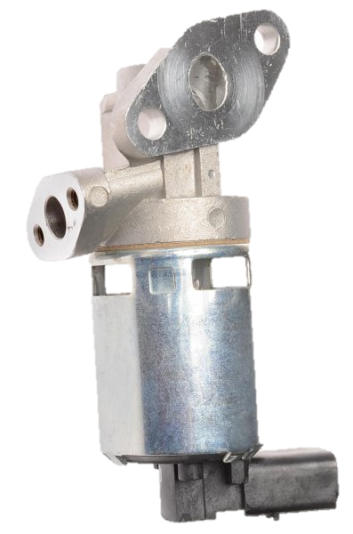
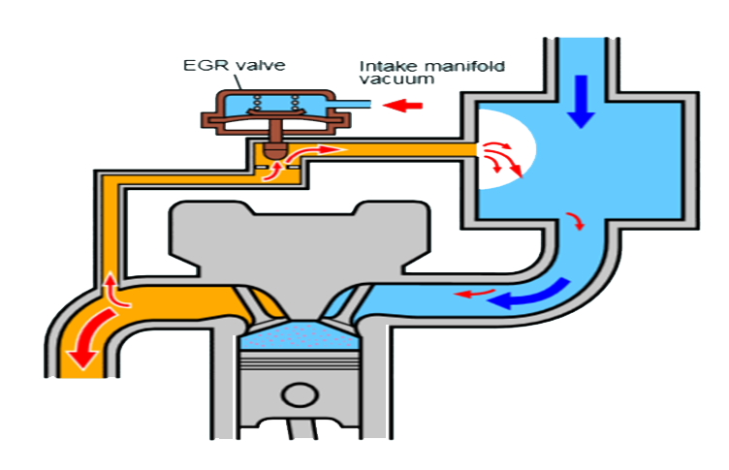
EGR typically operates during:
light throttle
cruising conditions
on a warmed up engine
it does not operate during warm up, wide open throttle & at idle
Notes:
WOT: wide open throttle

Slide 10
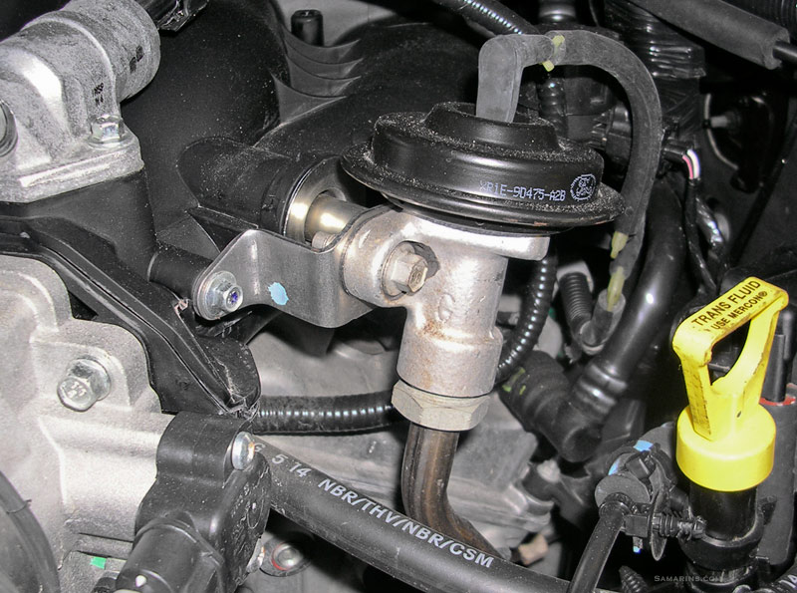
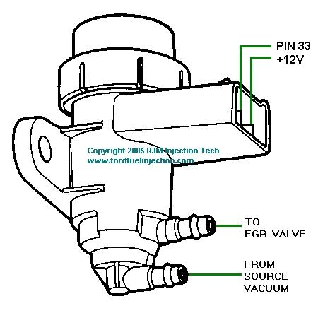
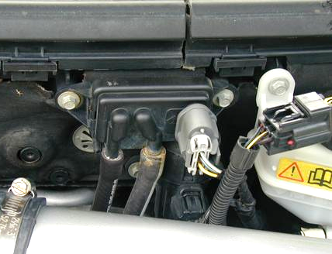
EGR Valve Styles
1. mechanical EGR operated by engine vacuum
vacuum acts on a diaphragm to open the valve (fig. a)
some EGR valves use a computer controlled solenoid to modulate the vacuum signal to the diaphragm (fig. b)
others use an exhaust pressure sensor to help determine rate of exhaust gas flow (fig. c)
fig. a
fig. b
fig. c

Slide 11
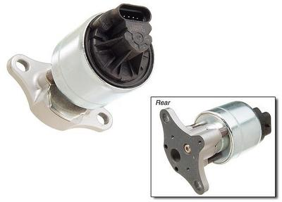
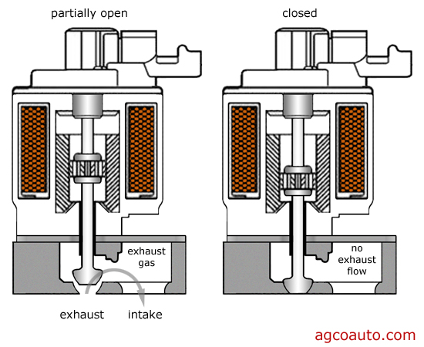
EGR Valve Styles
2. digital / electronic EGR valve
PCM controls 1 or more solenoids to modulate EGR flow
no vacuum diaphragm is used
each solenoid has an integral pintle position sensor
this sensor “tells” the PCM the position of the pintle valve
the solenoids are pulsed on & off by the PCM many times/second when needed

Slide 12
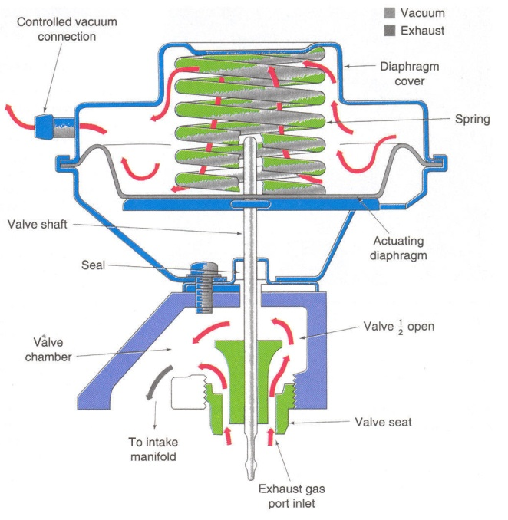
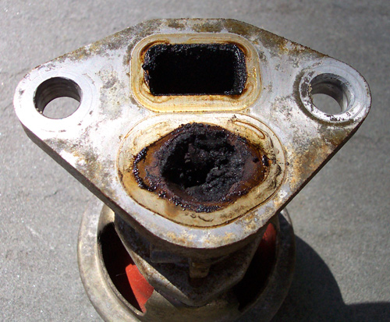
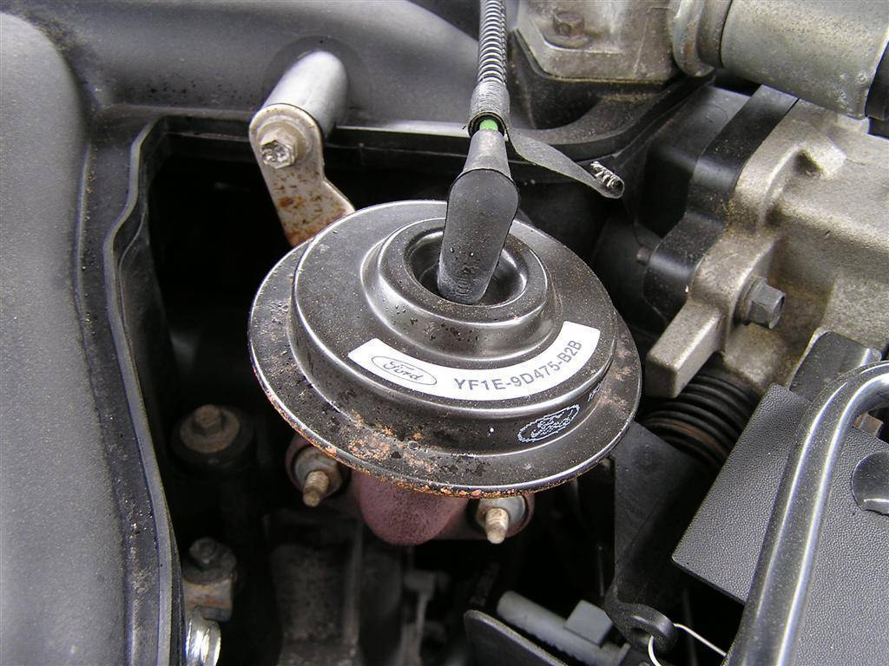
EGR Service
inoperative EGR systems can lead to…
excessive NoX emissions (failure at AirCare)
detonation (knocking & pinging)
caused by…
defective diaphragm
weak vacuum signal
defective or incorrectly routed vacuum hoses
shorted or open solenoid
exhaust passage blocked with carbon

Slide 13
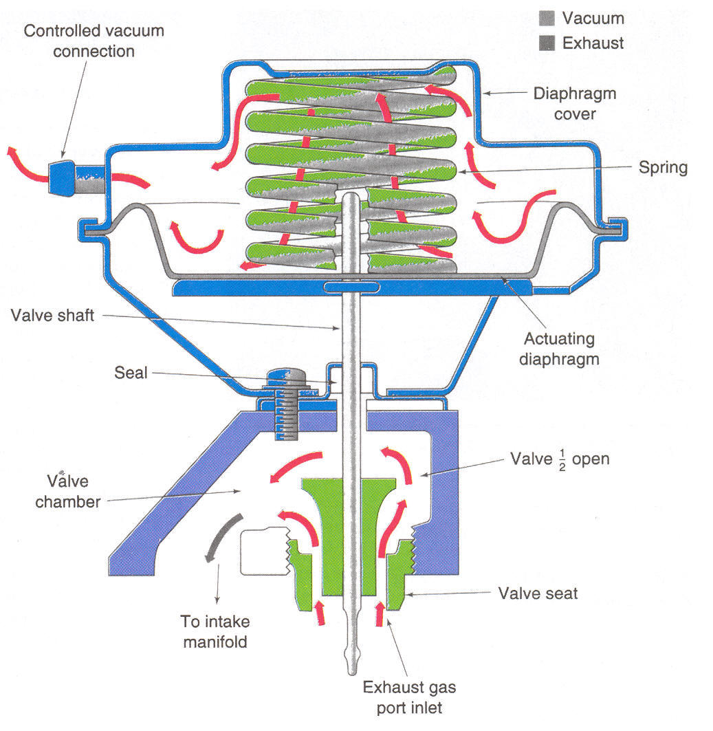
EGR Service
excessive EGR operation can lead to…
rough idle
stalling
caused by…
improperly routed vacuum hoses
carbon on valve seat pintle

Slide 14
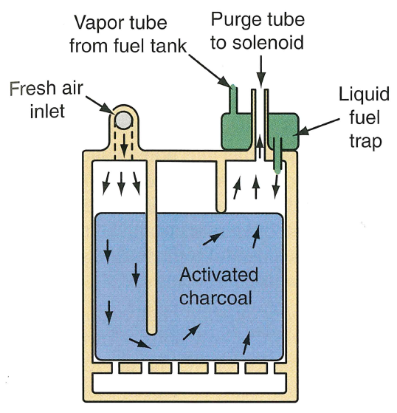
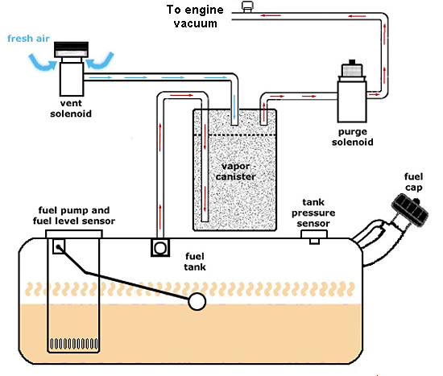
Evaporative Emission Control System
prevents raw HC’s (from gasoline) from being vented into the atmosphere
(in use since 1971)
charcoal canister absorbs fuel vapors when the engine is off
sends the vapors to the intake manifold so they can be burned when the engine is running
test port
Notes:
Charcoal is carbon.
Charcoal is made by heating wood to around a 1000 degrees in a sealed container.
With no oxygen present during the burning of the wood, it really doesn't burn but all the organic compounds are driven off leaving nothing but the carbon itself.
To make it into “activated charcoal“ carbon” is put under pressure with oxygen present.
This expands the pores of the carbon molecules creating “activated charcoal”.
Gasoline vapors adhere to the charcoal granules like static electricity clings to a balloon.
A light breeze across the charcoal pulls the fuel vapors (hydrocarbons) off and cleans the activated charcoal for the next volume of fuel vapors.
Each gram of activated charcoal has a surface area of 1,100 square metres
a typical charcoal canister has 300 or 625 grams of charcoal
the surface area in a canister equates to 80 or 165 football fields!

Slide 15
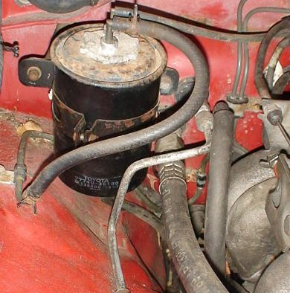
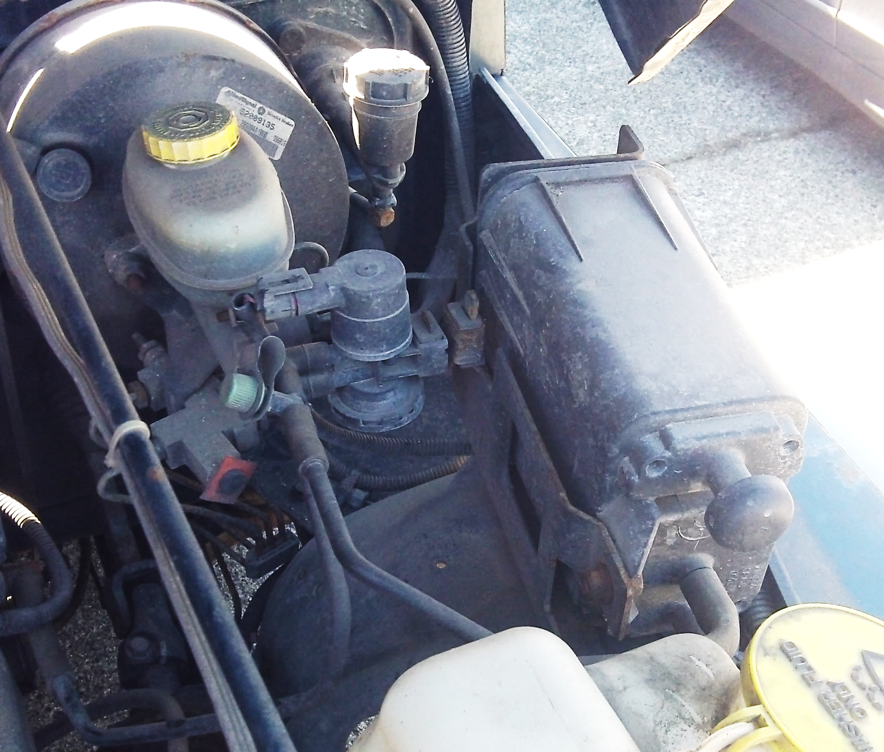
Evaporative Emission Control System
Purge Solenoid

Slide 16
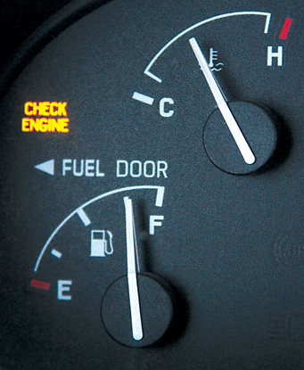
Evaporative Emission Control Systems
on OBD2 vehicles, the PCM…
purges canister vapors via a purge solenoid
monitors vapor flow
monitors the system for leaks
if PCM detects a leak, check engine light will illuminate
Notes:
holes in the connecting lines as small as 0.020” (0.5mm) can be detected on vehicles built since 2000

Slide 17
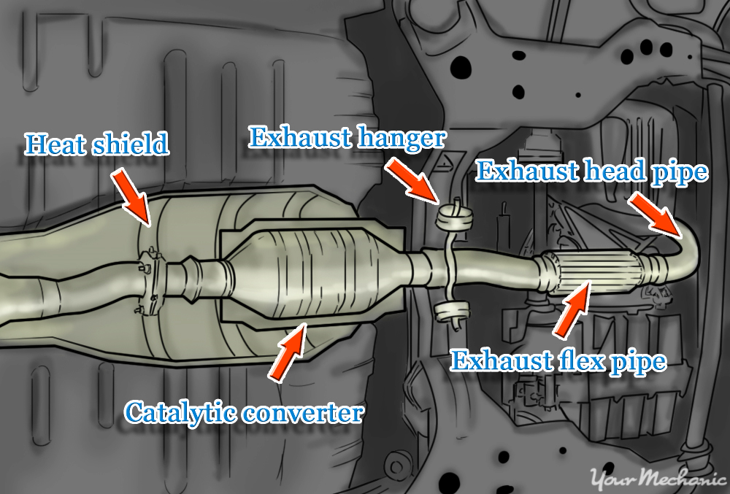
Reducing Tailpipe Emissions
pollutants in the exhaust are treated by the catalyst
catalyst contains platinum & palladium
used on all vehicles since mid-1970’s
vehicles may have 1, 2 , 3 or 4 converters
converters need heat to operate
they begin working at 260°C
full operating temperature is 500-870°C
Notes:
The substrate (backbone) of catalytic converters are commonly made from ceramics containing a large proportion of synthetic cordierite.
The manufacturing process deliberately aligns the cordierite crystals to make use of the very low thermal expansion seen for one axis.
This prevents thermal shock cracking from taking place when the catalytic converter is used.

Slide 18
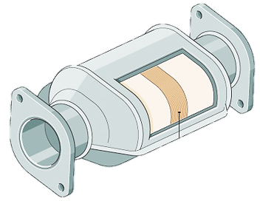
Three-Way Catalysts (TWC)
reduces HC, CO and NOx levels
NOx is separated into nitrogen & oxygen
front ½ controls NOx with platinum & rhodium as the catalysts
back ½ reduces HC & CO
may also contain cerium (has the ability to store oxygen)
the oxygen is used to oxidize HC & CO
in use in Canada since 1988
H2O
CO2
N
HC
CO
NoX
Notes:
two different catalysts in a catalytic converter:
One of them tackles nitrogen oxide pollution using a chemical reaction called reduction (removing oxygen). This breaks up nitrogen oxides into nitrogen and oxygen gases (which are harmless, because they already exist in the air around us).
The other catalyst works by an opposite chemical process called oxidation (adding oxygen) and turns carbon monoxide into carbon dioxide. Another oxidation reaction turns unburned hydrocarbons in the exhaust into carbon dioxide and water.

Slide 19
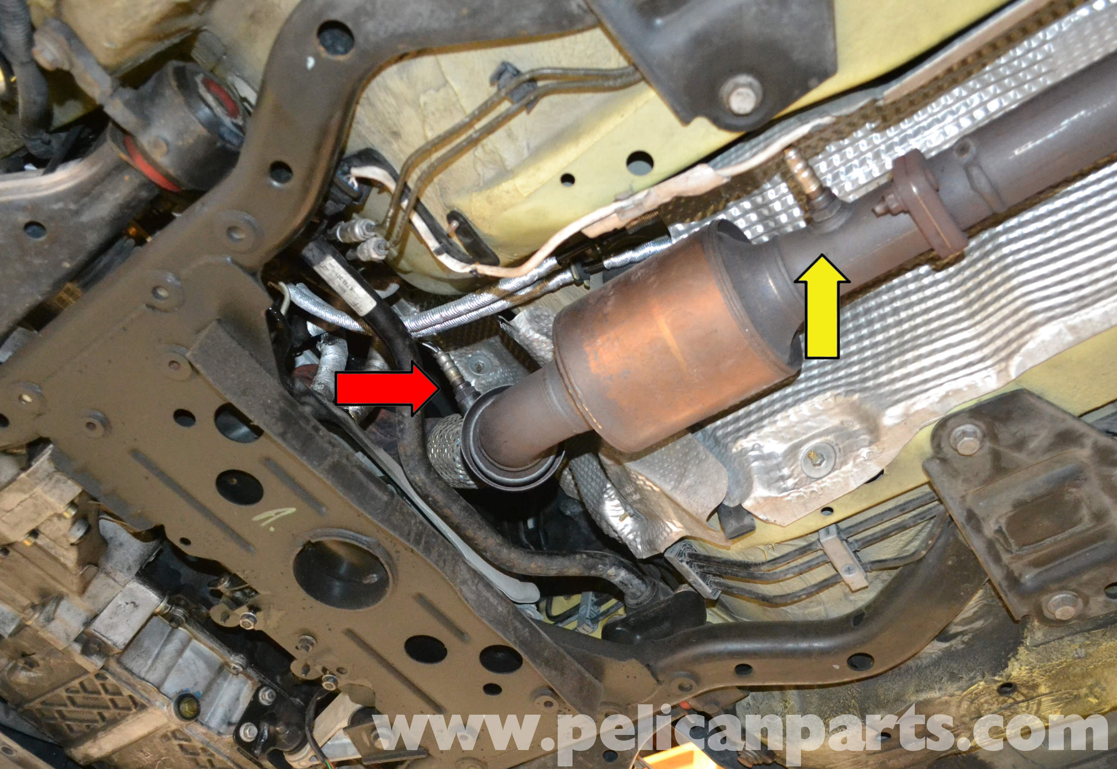
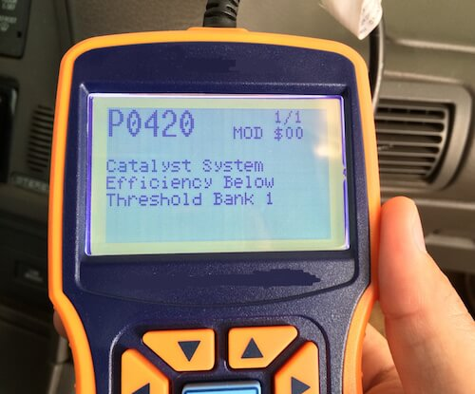
OBD2 Vehicles & Catalyst Monitoring
pre-cat O2 sensor informs the PCM about air/fuel ratio levels
post-cat O2 informs the PCM about how well the cat is converting HC, CO & NoX gasses

Slide 20
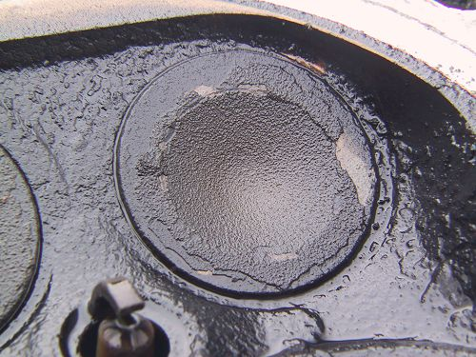
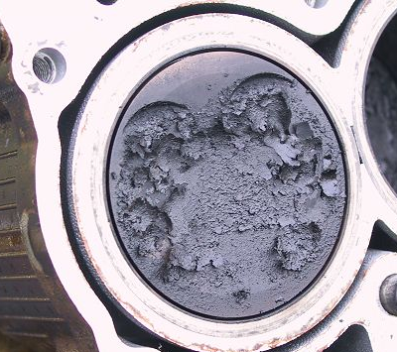
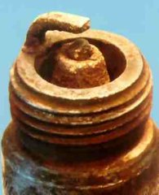
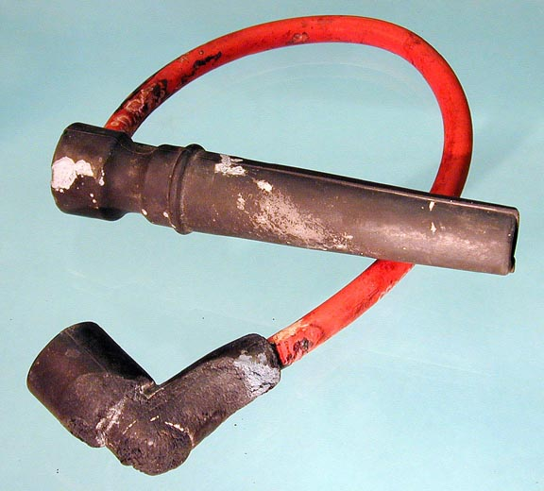
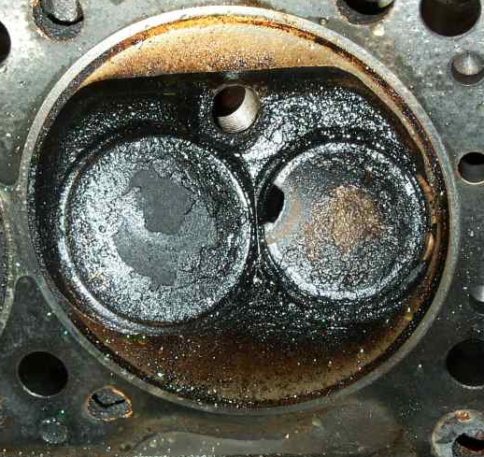
Causes of excessive hydrocarbons…

Slide 21
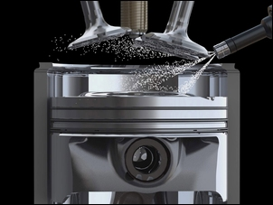
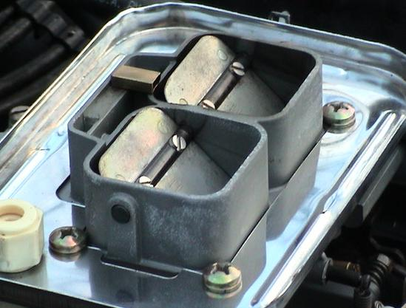
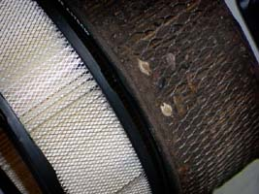
Causes of Excessive Carbon Monoxide…
plugged air filter
high float level
choke not opening
faulty fuel injector
higher than normal fuel pressure
faulty EFI sensor

Slide 22
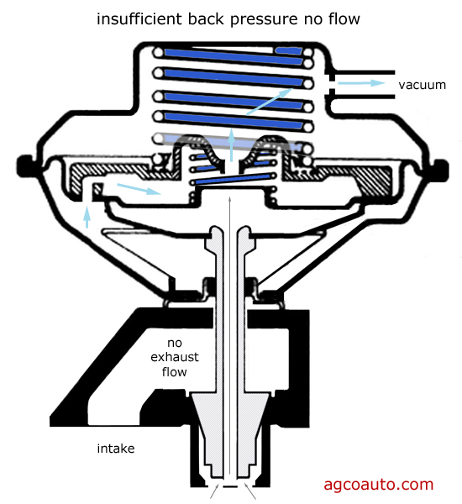
Causes of Excessive NOx…
carbon deposits
inoperative EGR valve
higher than normal coolant temperatures

Slide 23
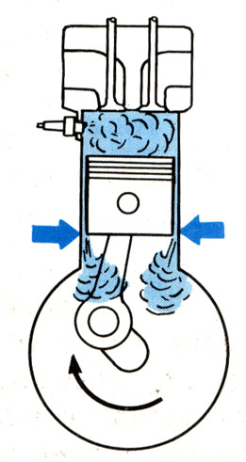
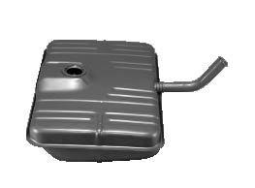
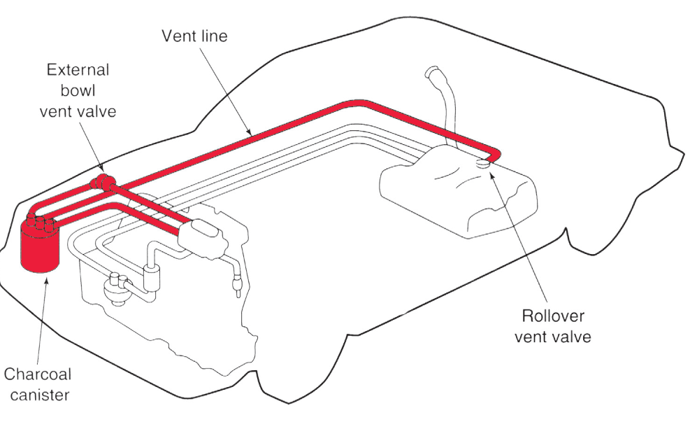
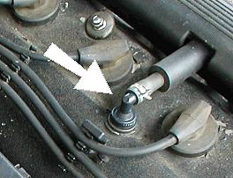
Pollution Sources & What Controls Them – a recap…
3 areas of a vehicle that can pollute…
tailpipe emissions
fuel tank vapors (and carburetor vapors)
crankcase blow-by gases

Slide 24
Emission Standards
Pre-1960:
HC: 529 ppm
CO: 4.64%
NOx: 3807 ppm
1972:
HC: 294 ppm
CO: 3.09%
NOx: 3702 ppm
1982:
HC: 204 ppm
CO: 1.39%
NOx: 2036ppm
2001:
HC: 85 parts per million (ppm)
CO: 0.5%
NOx: 765 ppm
Emissions-related videos in 5050 D2L Lec Module…
catalytic converter function
PCV system
EGR system

