Slide 1
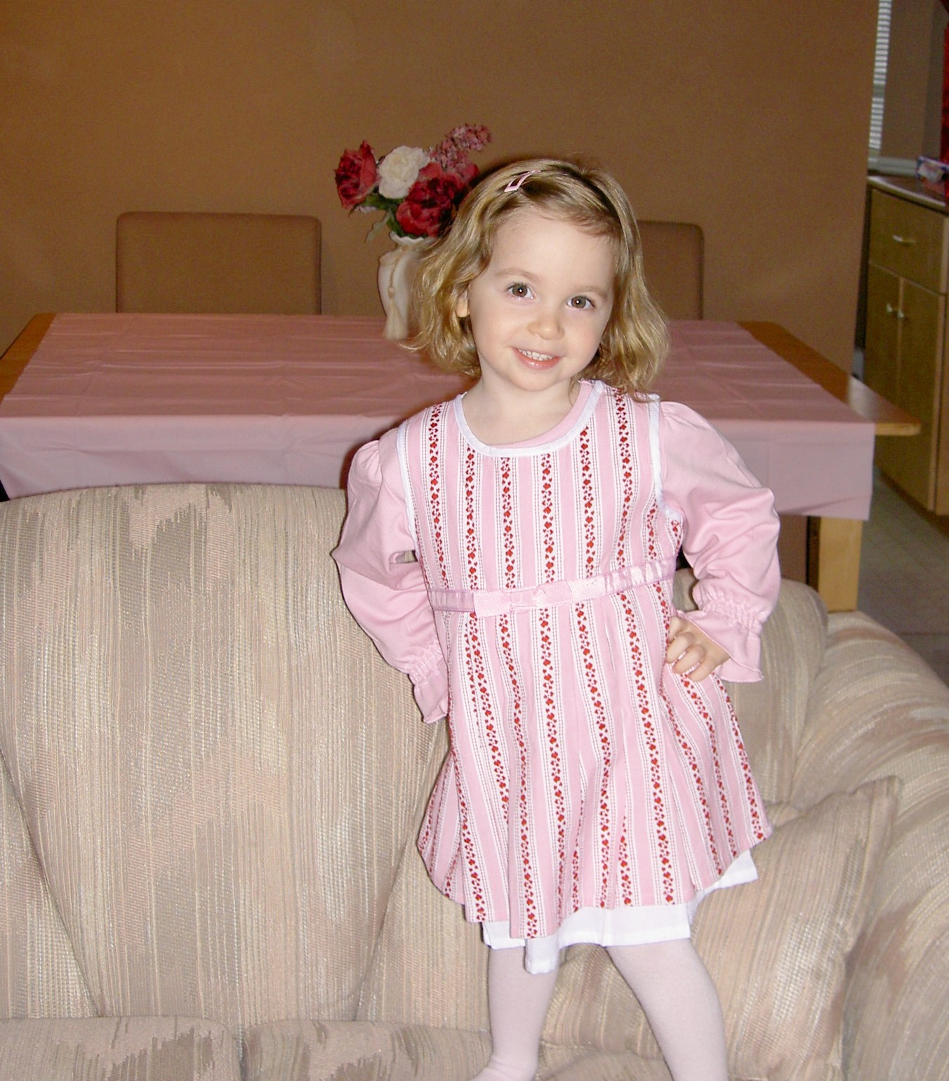
My Life’s Experiences
By Ainsley Enos

Slide 2
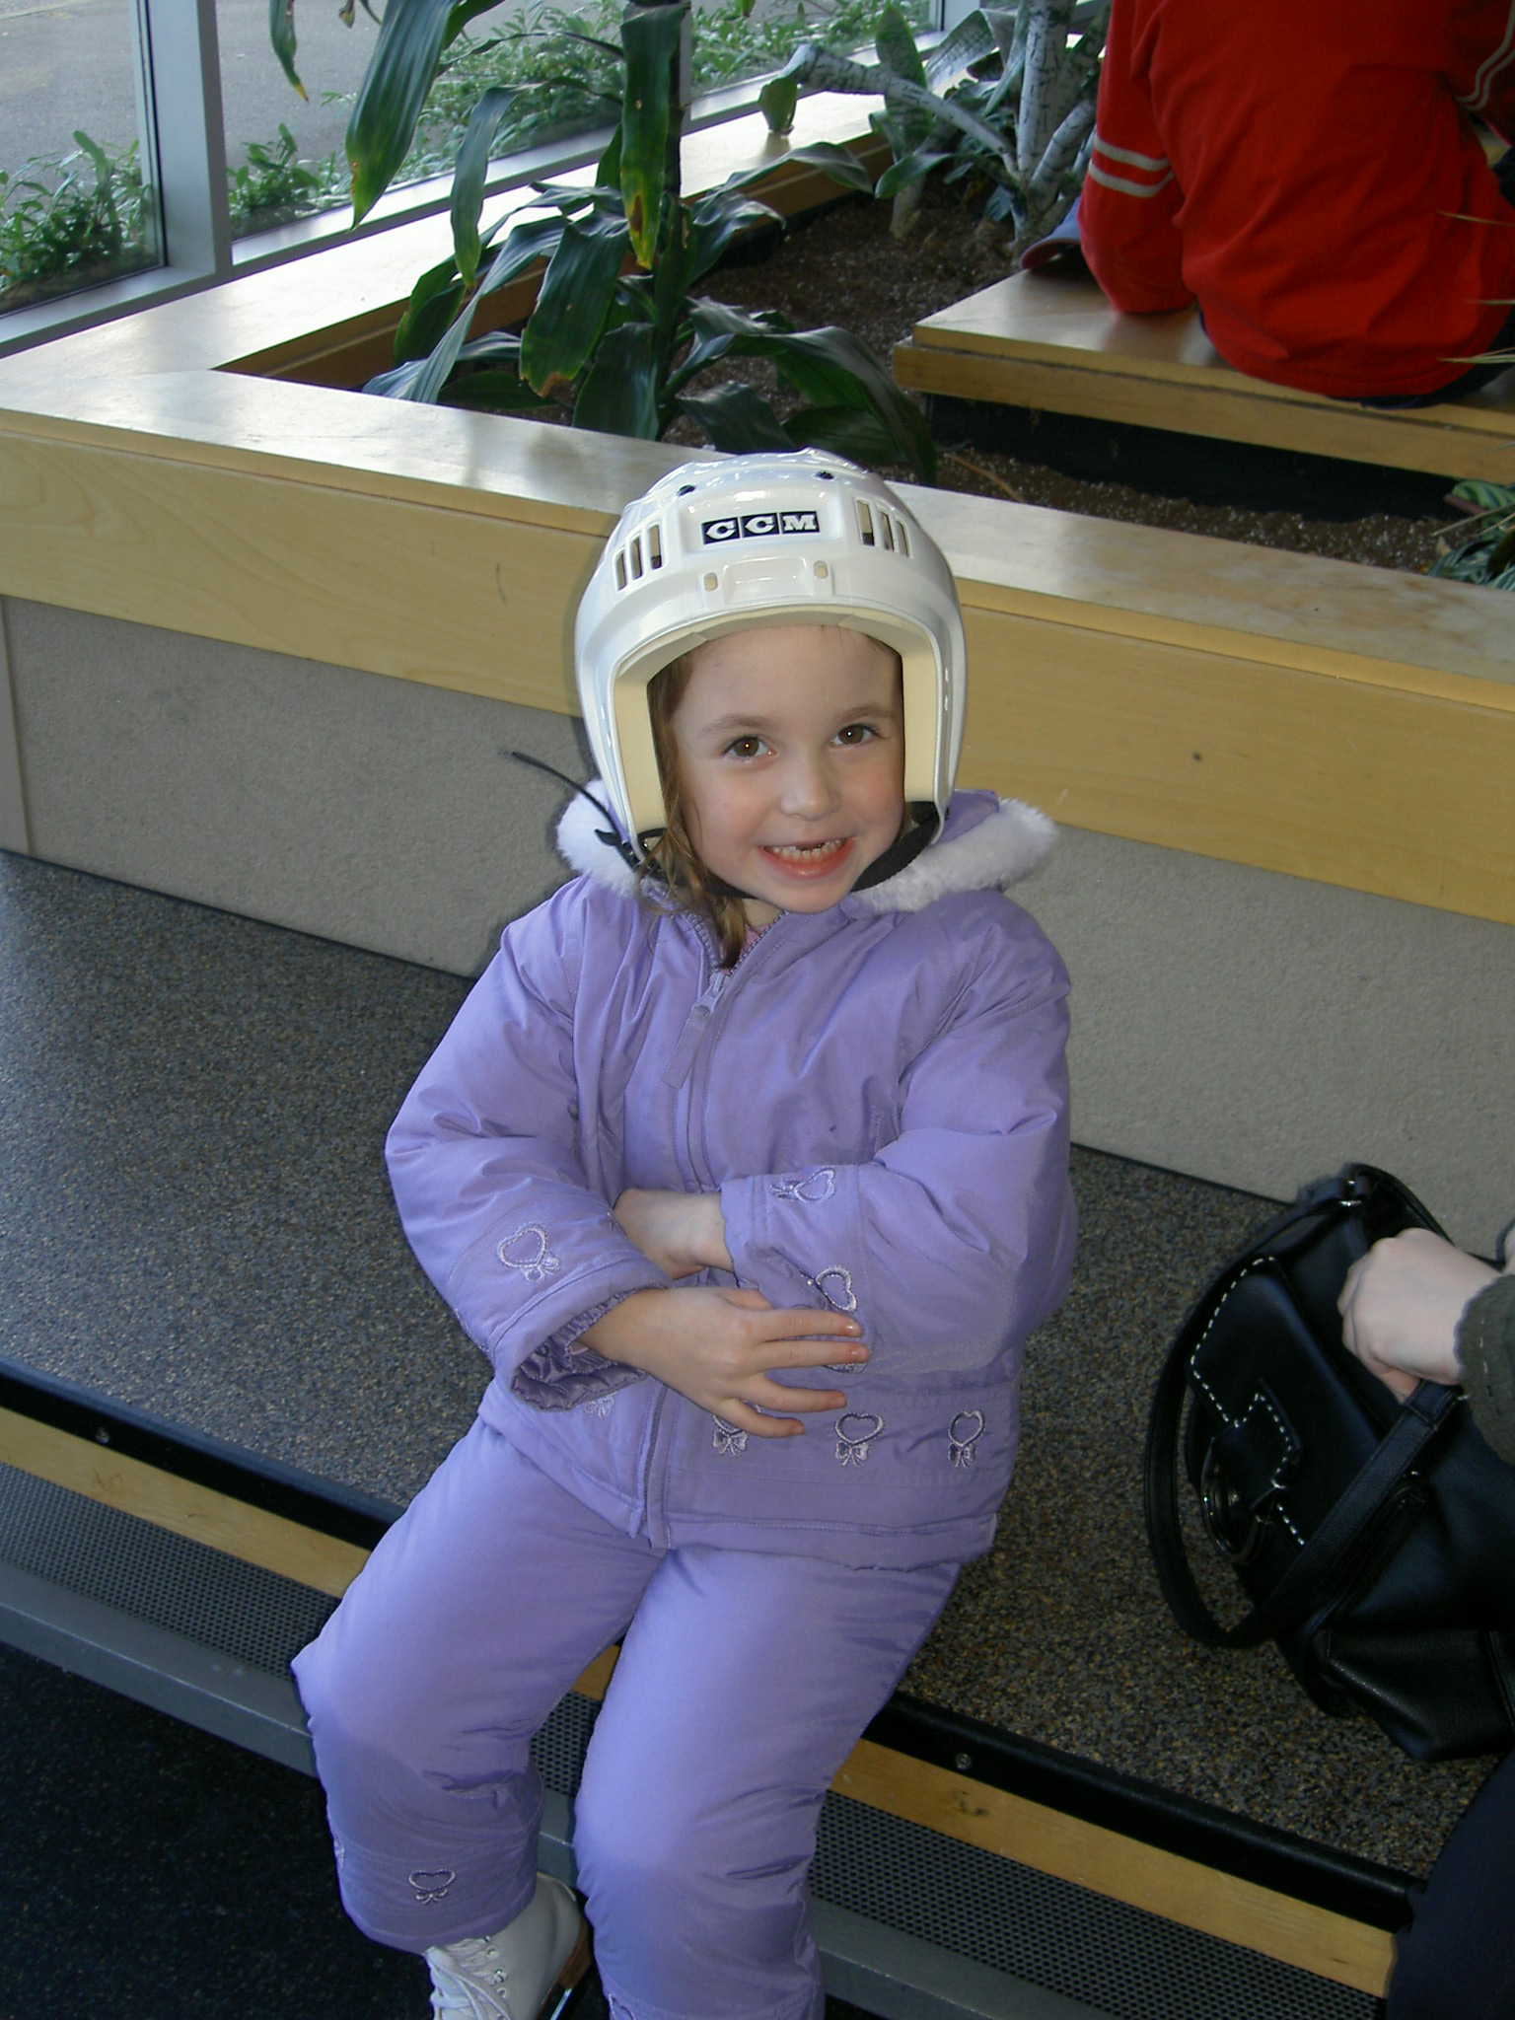
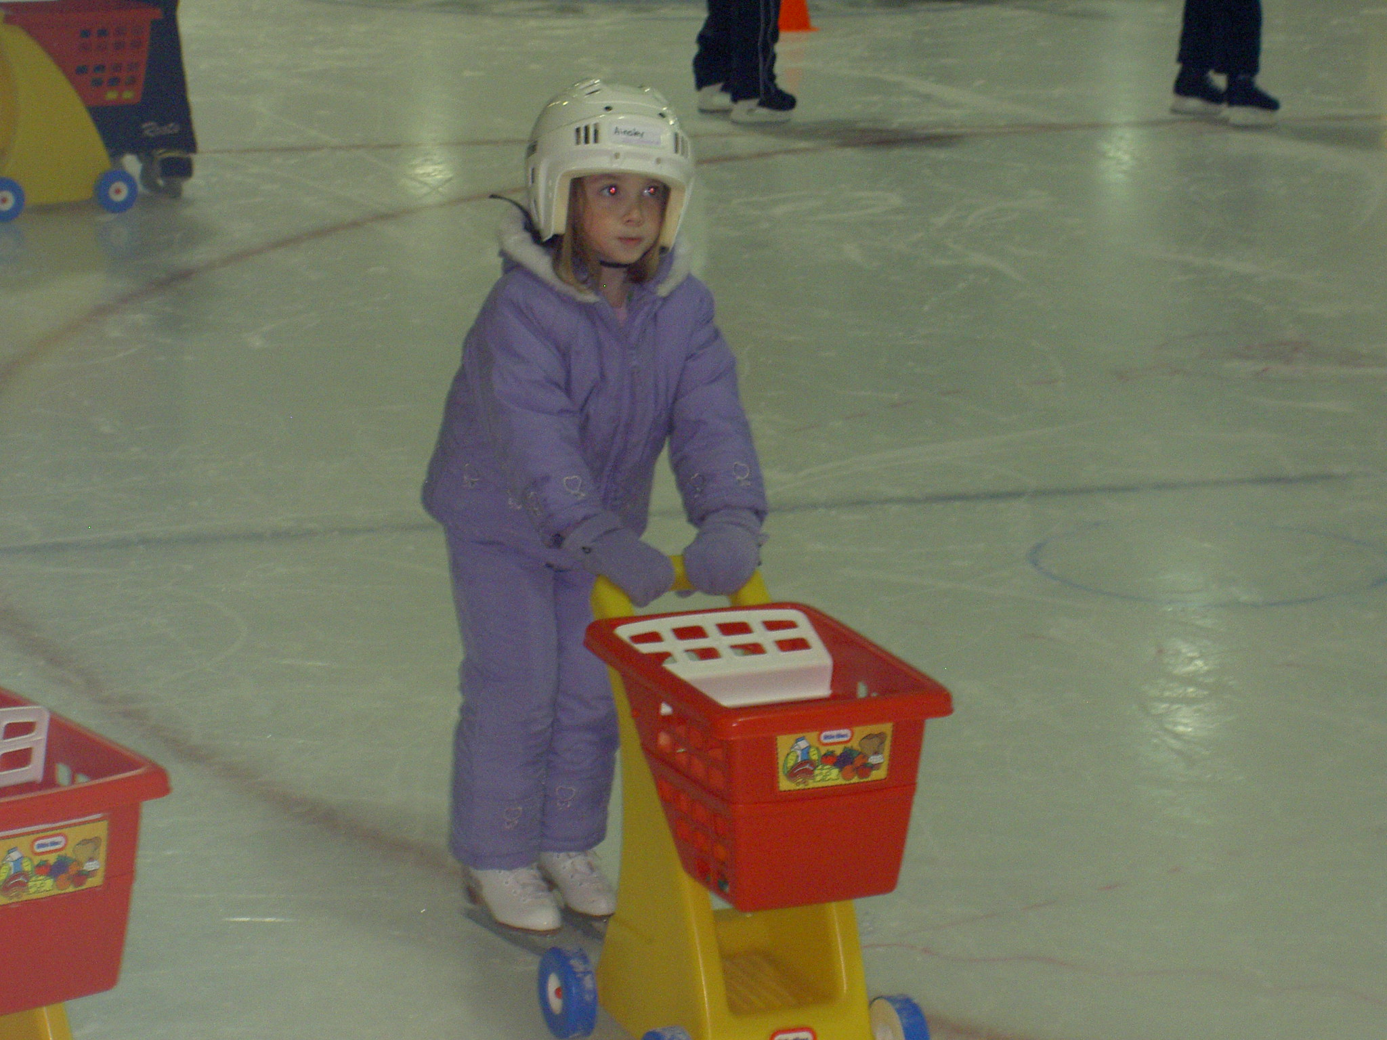
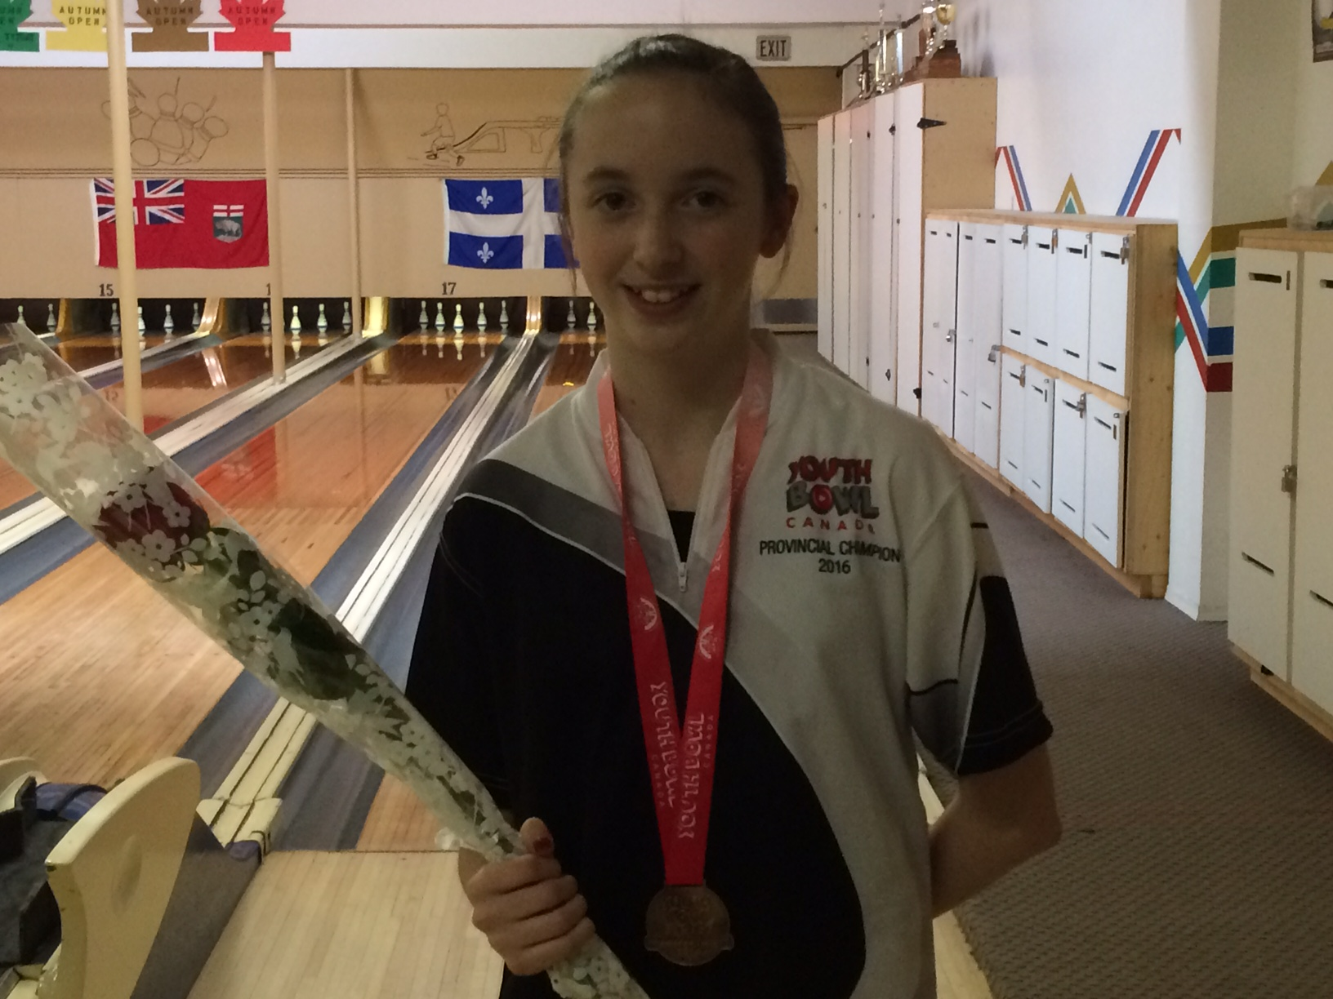
Physical
I am an active person because I tried a lot of different sports when I was younger. Some of these sports include swimming, dance, and ice skating. Surprisingly, I am not very flexible which is weird because I tried gymnastics and cheerleading when I was younger. When I was 7 or 8 years old my Dad put me into 5-pin bowling at Port Coquitlam Bowl and I have now been bowling for 8 years!

Slide 3
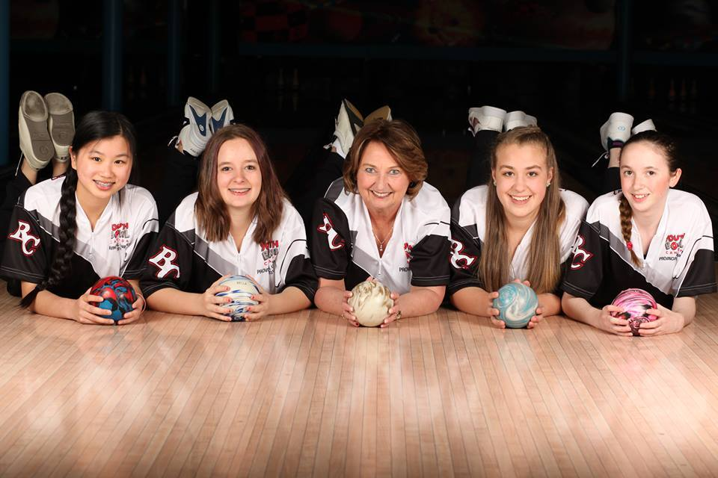
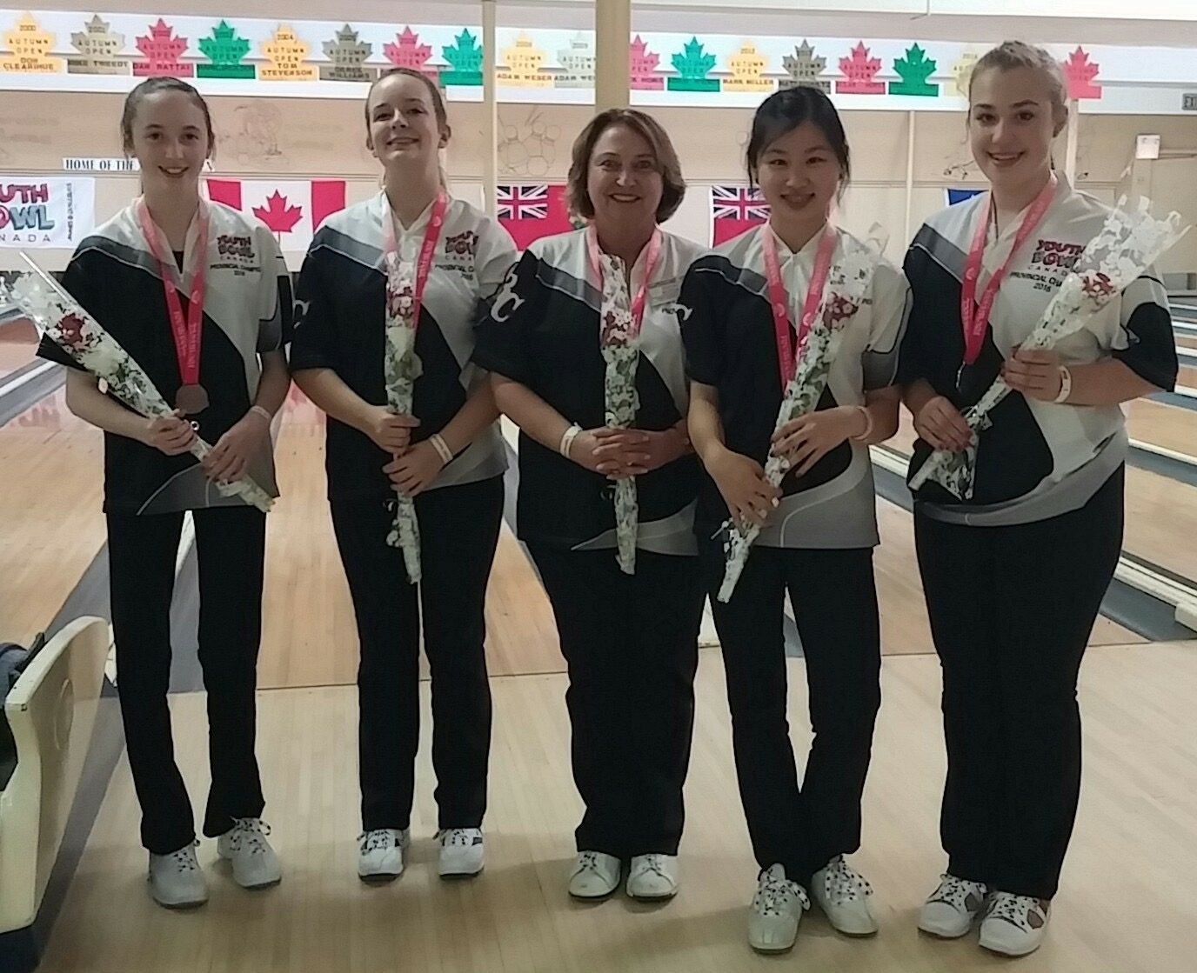
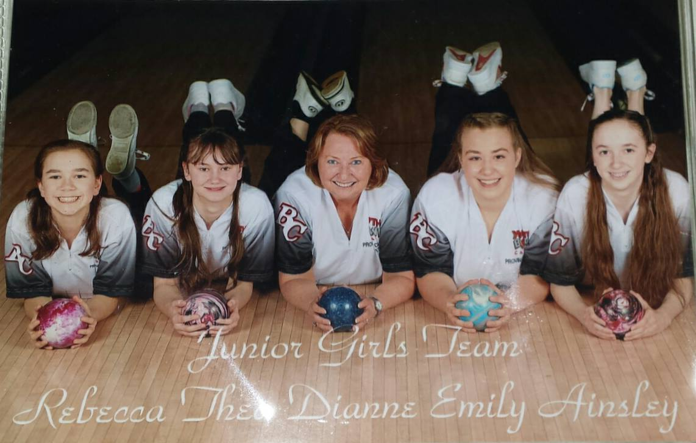
Physical
During my childhood I was very competitive because my Dad played baseball and my older sister played soccer. To this day I am still competitive especially in my sport which is 5-pin bowling.
Nationals 2016
Nationals 2017

Slide 4
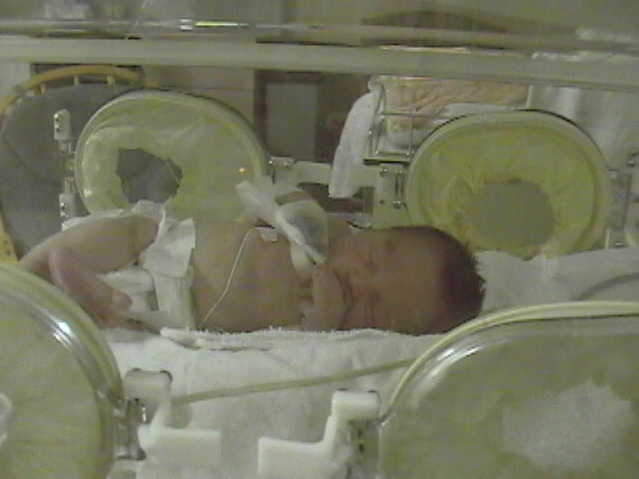
Physical
When I was a baby I was very small because I was born 6 weeks early. Growing up, I have been thin and that is because of family genetics. People sometimes pick on me for being thin but I just try and ignore it.

Slide 5
Social
When I was younger I was put into speech therapy because I was quiet, and would never use my words. Today, I am very shy and I have developed social anxiety. I am social when I hangout with my close friends, but besides that I am quiet.

Slide 6
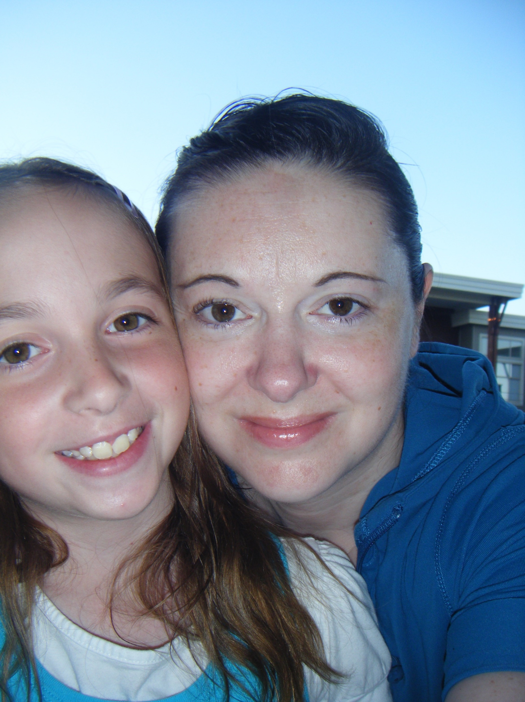
Social
When it comes to going to places or making decisions, I usually am very cautious and overthink things. This is from seeing my Mum suffer with anxiety issues.

Slide 7
Social
I grew up in a family where my Mum was kind, polite and respectful to everyone around her. So growing up as a child I learned to be friendly to everyone and to respect everyone for who they are.

Slide 8
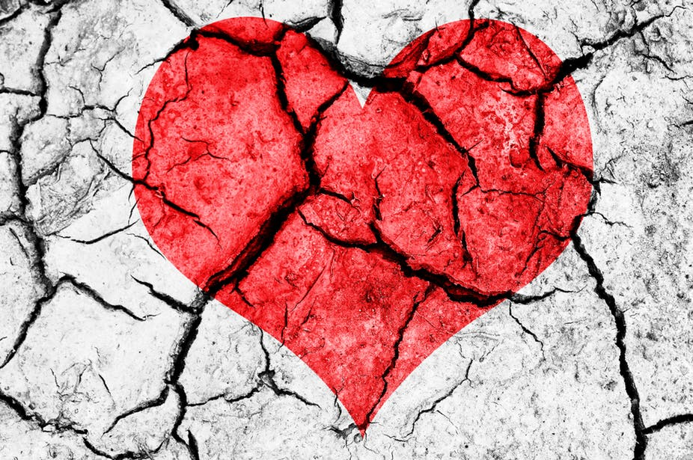
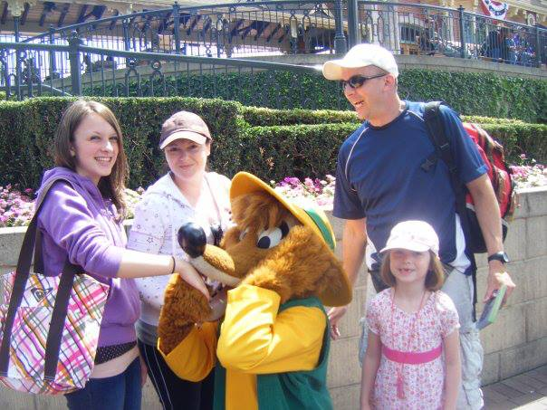
Emotional
My parents separated when I was seven years old and it wasn't that tough on me because I saw my Dad every weekend and he only lived 5 minutes away. My parents separating has taught me to be cautious with relationships, that no one is perfect and lastly it has taught me to be open minded.

Slide 9
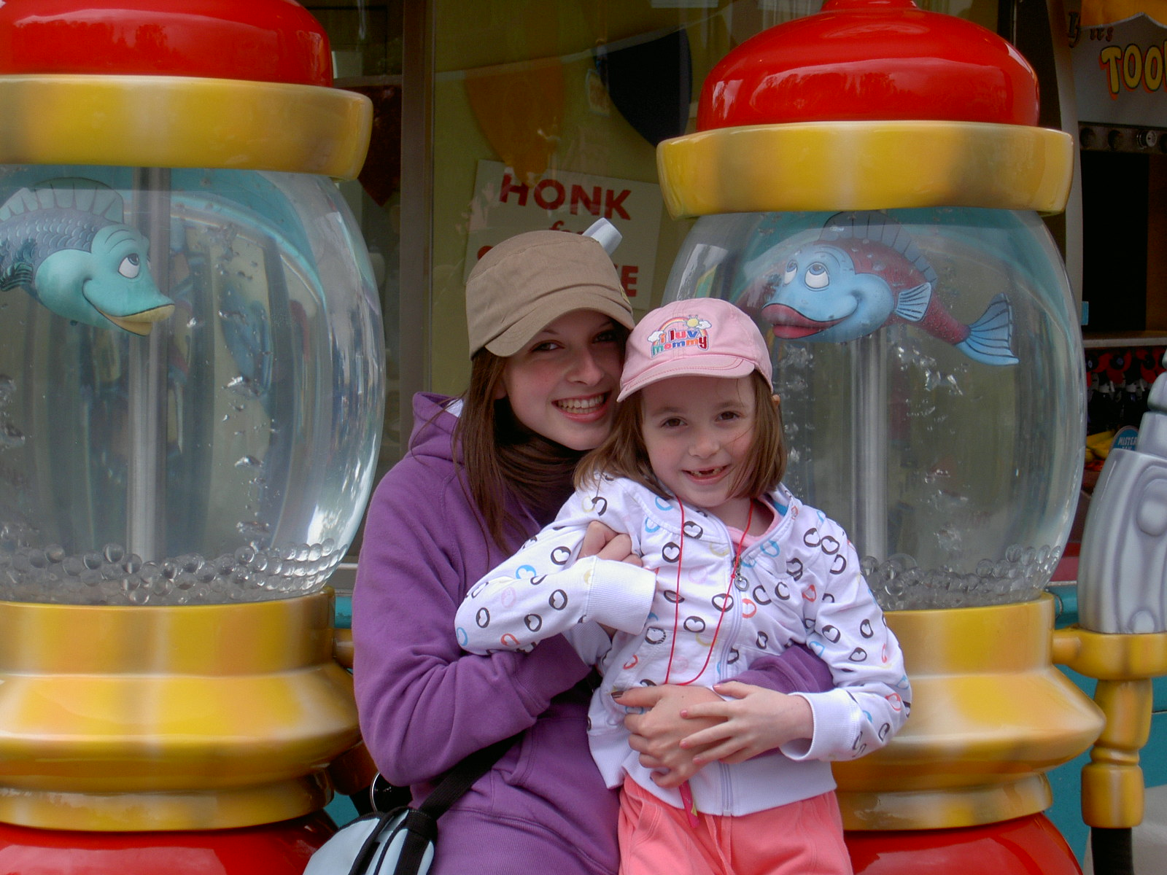
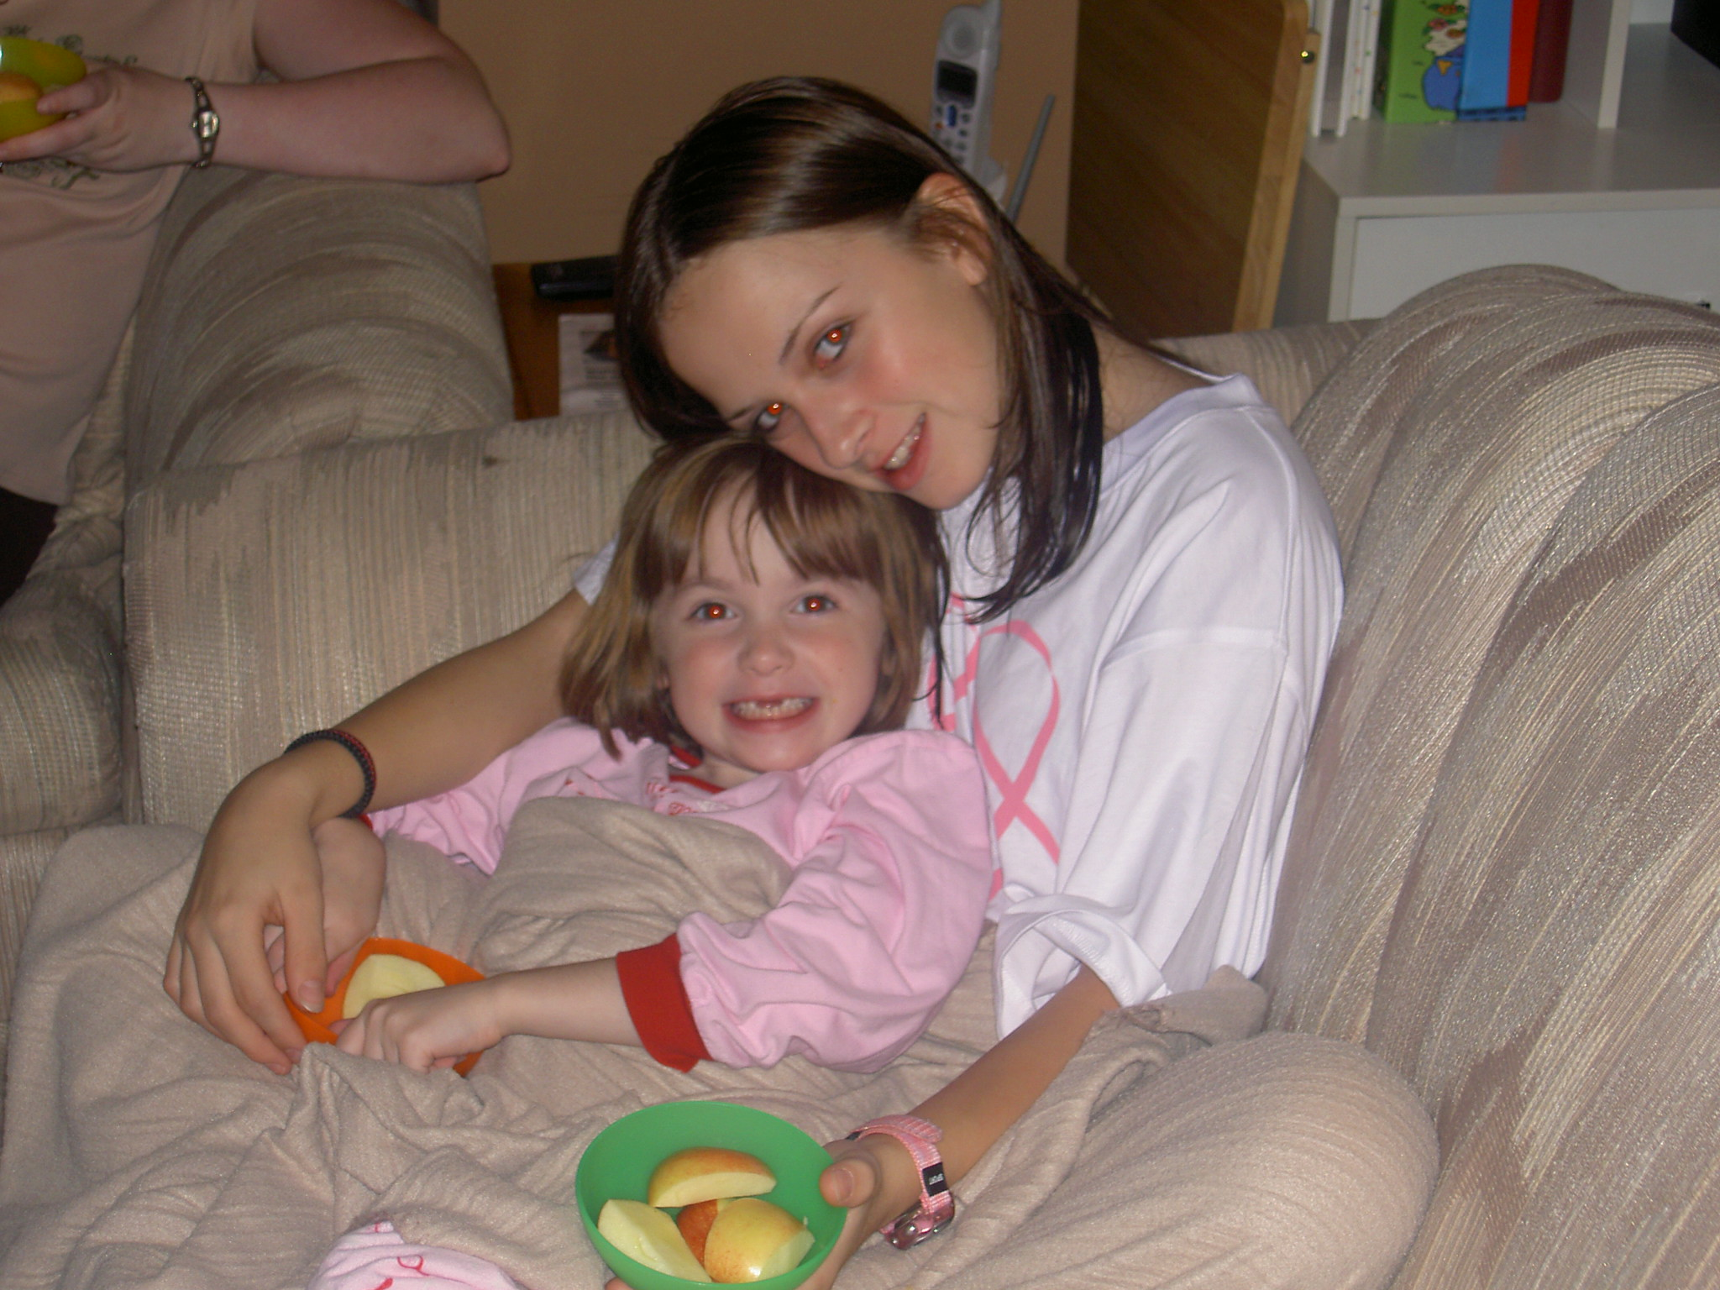
Emotional
I often keep my emotions inside rather than showing them and that is because I had an older sister named Laura and she sometimes overshadowed me.

Slide 10
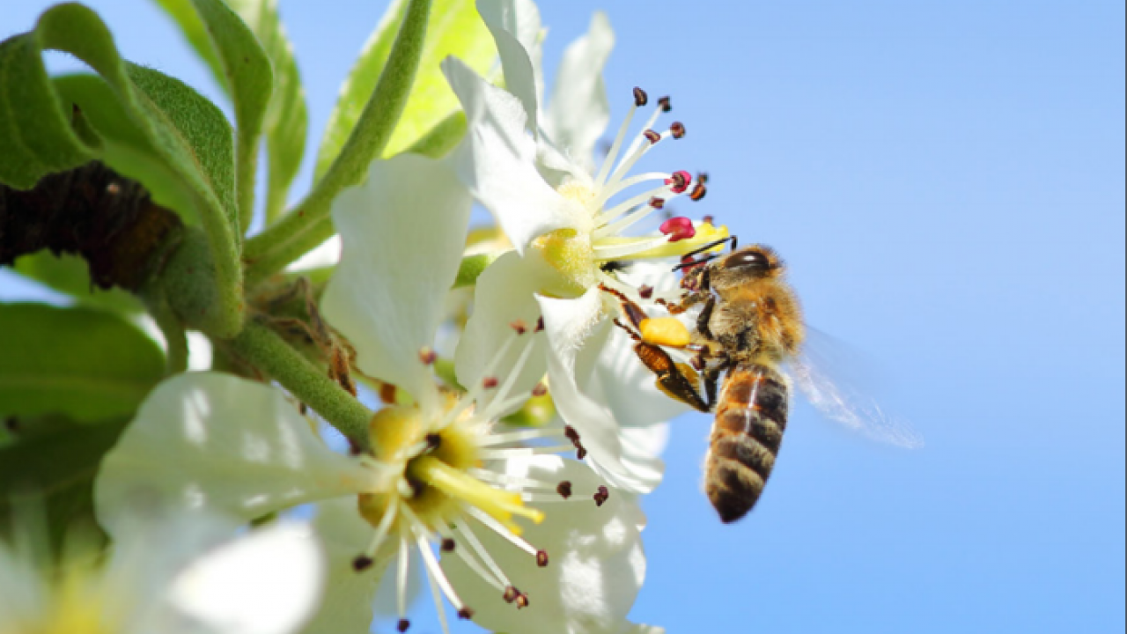
Emotional
When I was younger my friends and I were hanging out on top of a slide, and suddenly a bee came. Well all my friends and I were trying to get down, although I got stuck up there and I got stung by the bee twice. Ever since that day I have been afraid of bee’s.

Slide 11
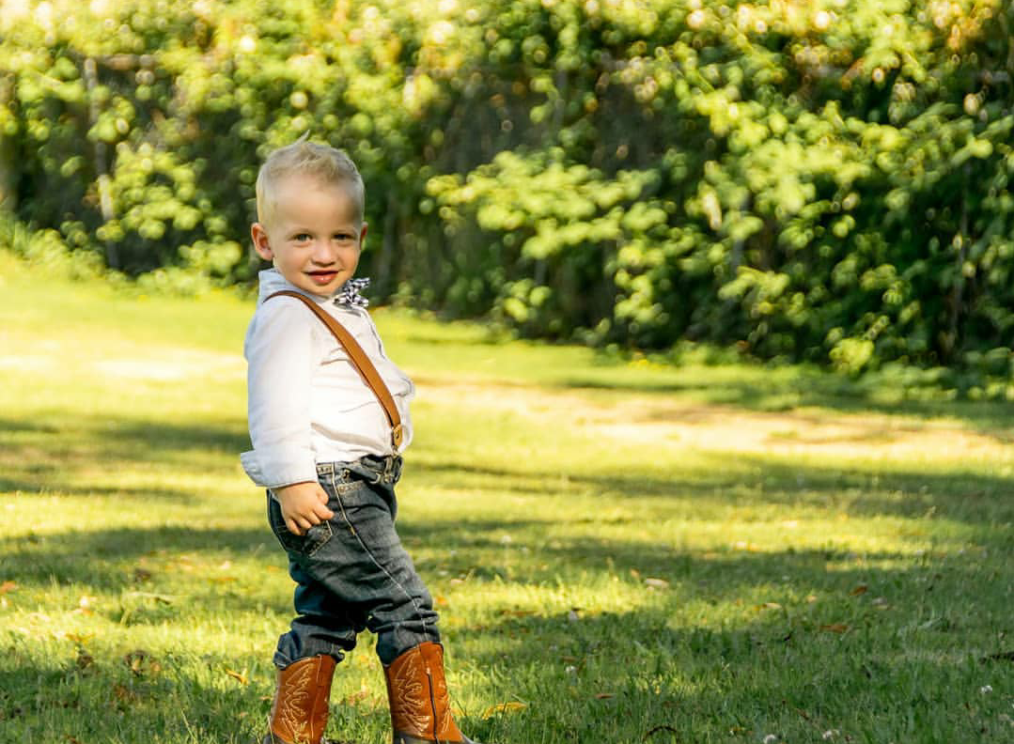
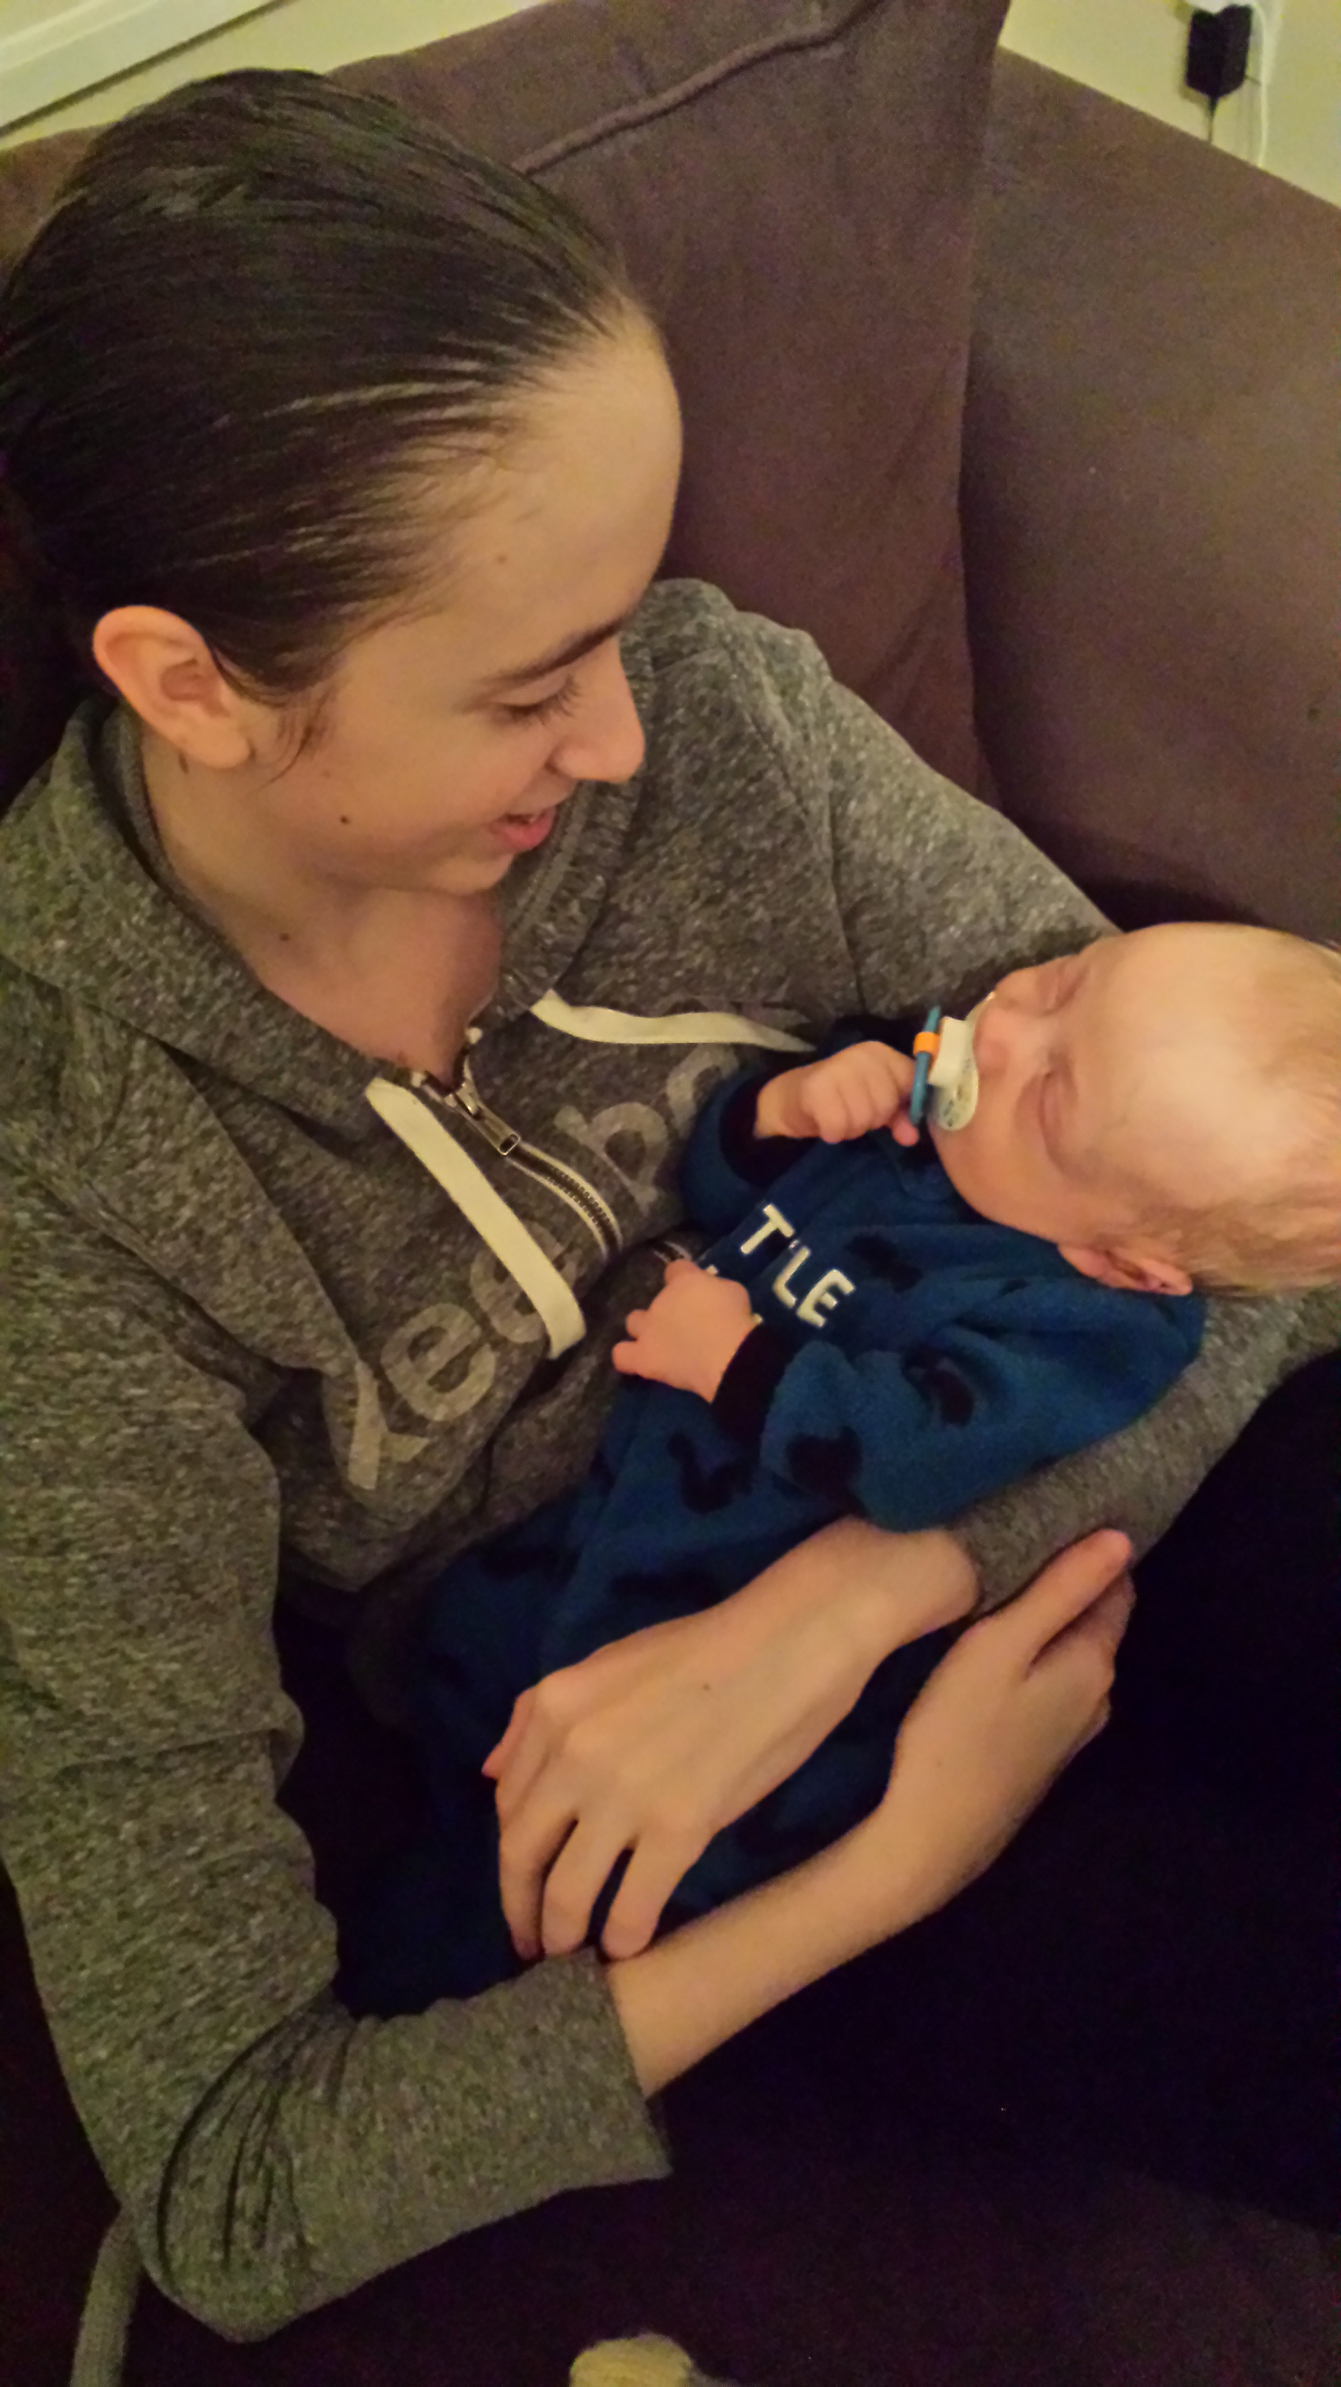
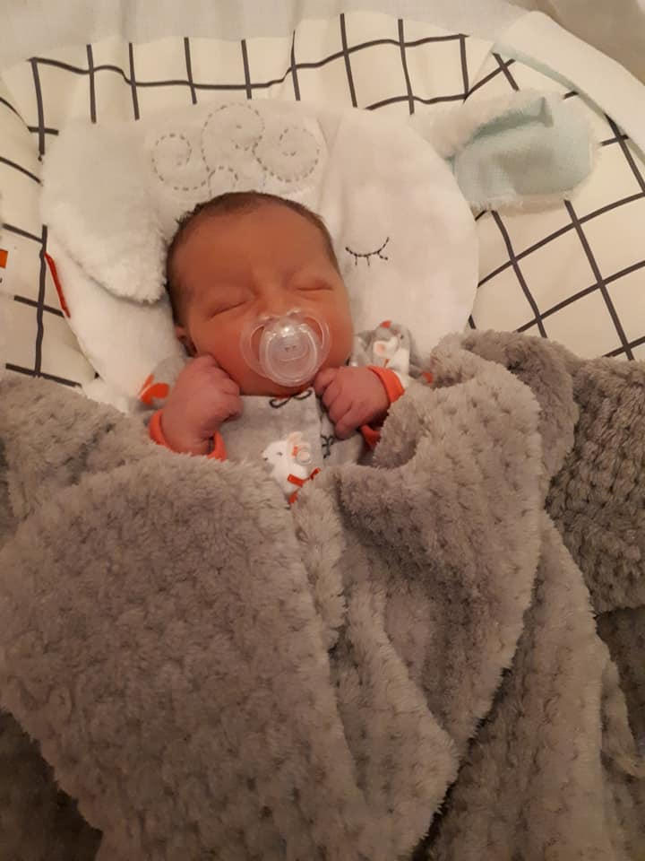
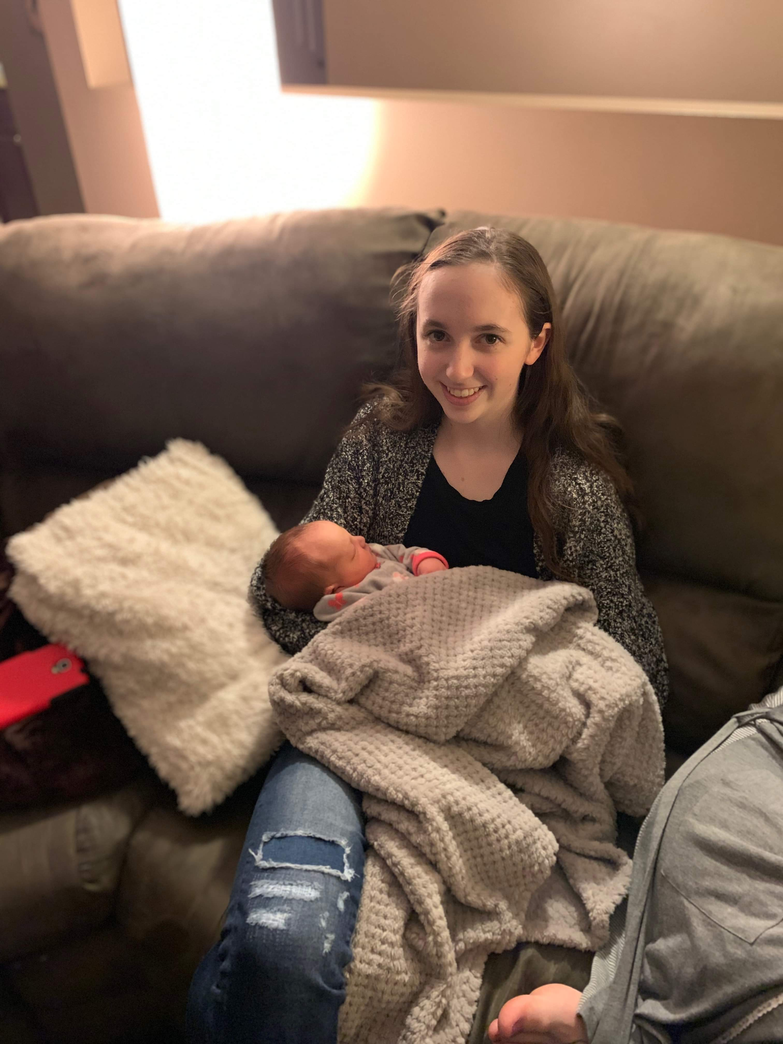
My Nephew
Intellectual
In 2016 I became an Aunt to the greatest nephew in the world named Jace. Being an Aunt has taught me a lot about responsibility and how much joy children can bring into the world. Also, this year 2019 I got to welcome my niece named Cassidy into this world.
My
Niece

Slide 12
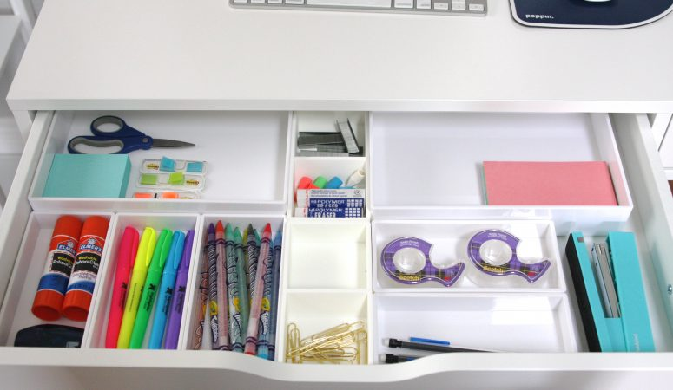
Intellectual
Growing up I have been very organized and have been a perfectionist: Throughout my life my Mum has been very organized, clean and neat. Also, when my parents separated, I had to take my clothes, etc from house to house, so this has had an influence on me being organized and clean.

Slide 13
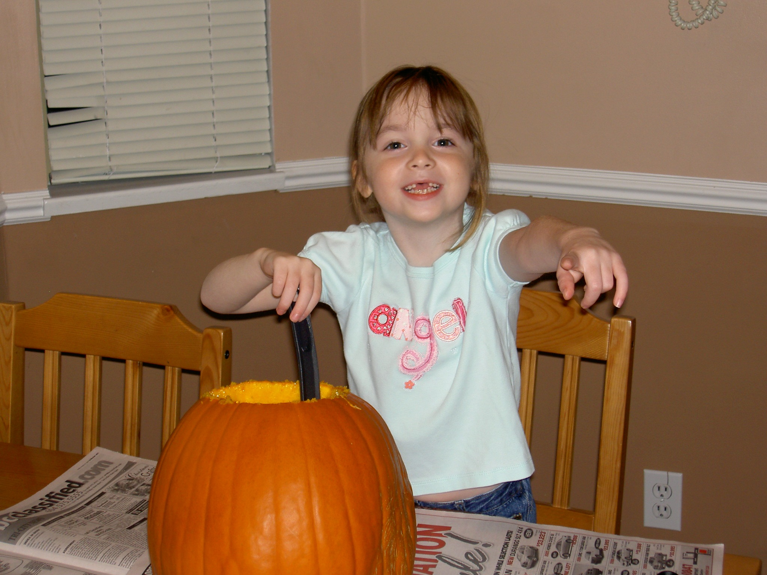
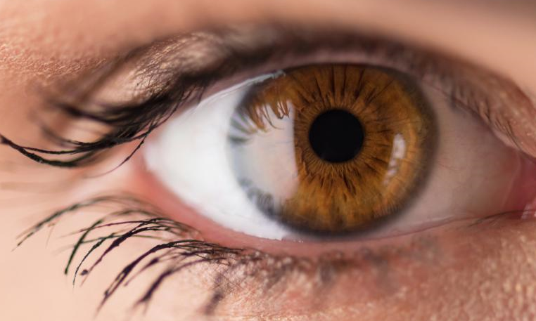
Intellectual
When I was younger I would always sit at the dinner table and look out the window. Later on in my Childhood my parents realized that I am very observant because I could remember what car people would drive or other stuff. Now that I am older, I am still observant just not as good as I was when I was younger. My Dad wants me to pursue a career where it can include my observant skills.

