Slide 1
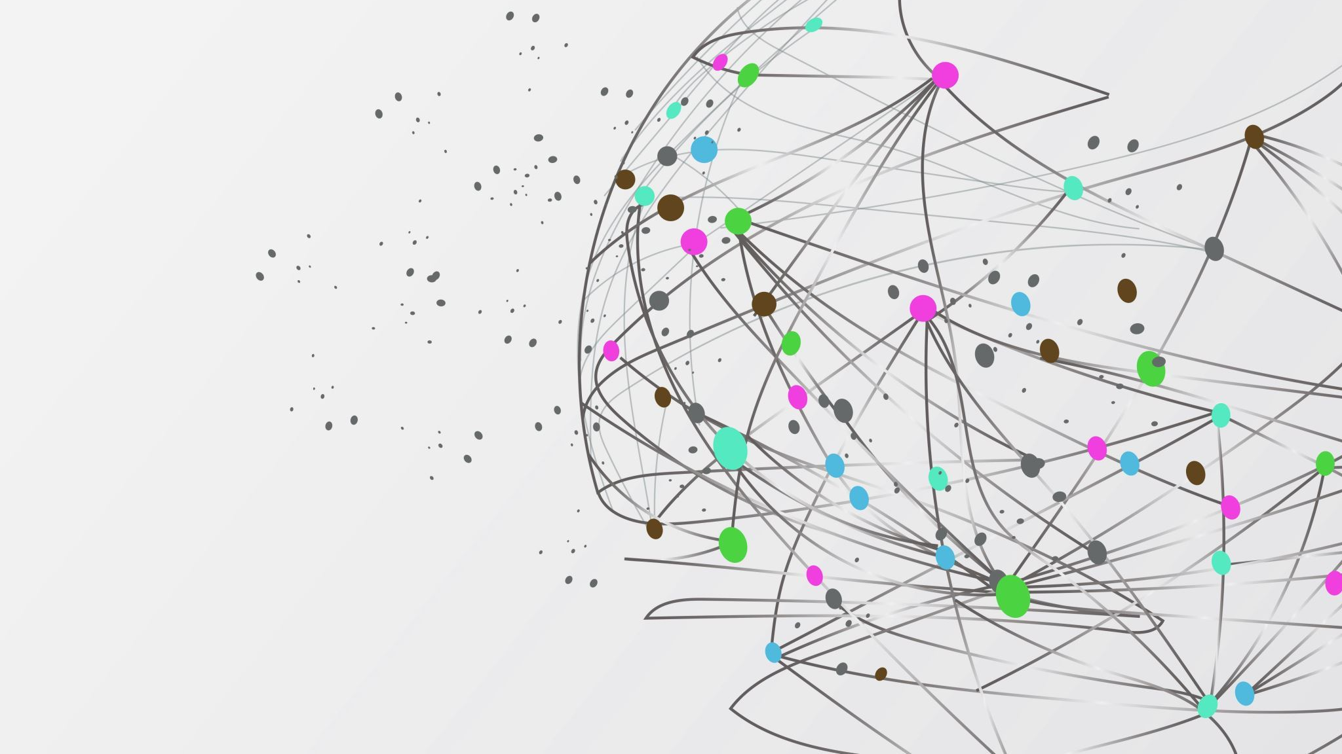
Pygame Project
By: Aaron

Slide 3
What makes the code your own?
The images and debugging were done by me
Product of a lot of trial and error

Slide 4
Key Learnings, hurdles, debugging and what is next?
I learned how to manage my time better
I had some issues with the Sad Monkey movement which kept on getting stuck in one spot so I had to google and watch Youtube tutorials to figure out how to make the movement work.
I wanted to use movement that didn't require me to use math, but I ended up brute forcing it to eventually work.

Slide 5
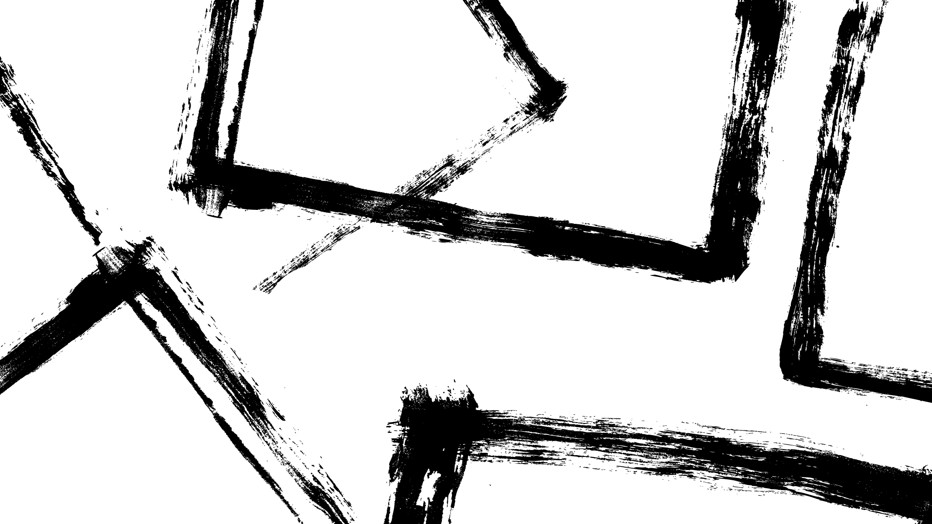
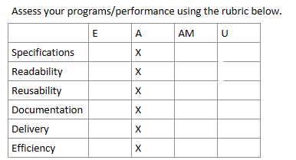
Self Assessment:
I brute forced too much of the code with just trial and error and some of the code might just be pointless or inefficient.

Slide 6
Habits of Mind:
I got confused on how to do certain parts of the project which was frustrating and made it take longer than usual to finish. I tired asking some friends and knowledgeable people on how they did each part even though it was tedious it eventually work. When the program didn't work I tired to look into which part wasn't working and look into the code connected to the issue which worked pretty well for me. I expanding on the health bar along with the score display system.

