Slide 1
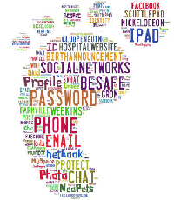
Digital Footprint Project
Tristen Rae

Slide 2
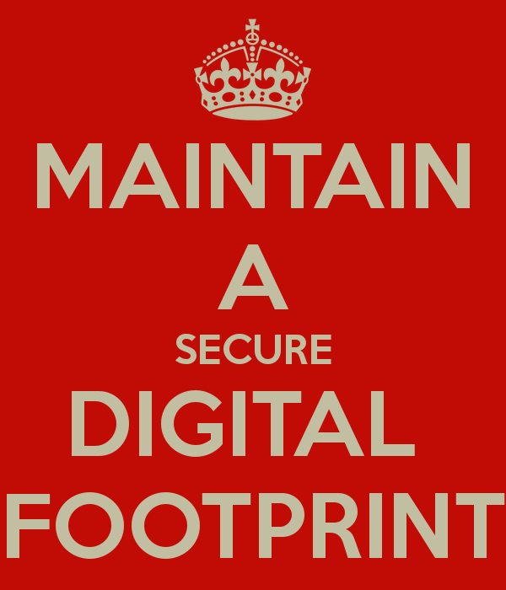
What is a digital footprint
A digital footprint is a collection of information about a person collected without them knowing. Your digital footprint starts even before you are born. Your digital footprint can be viewed by anyone.

Slide 3
How can your digital footprint affect you
Schools and Jobs will normally do a background check and they are able to look at any of your posts on social media, even if that have been deleted. They will do this to see if they would want you to represent the company or school. If someone is always partying it might not be a good idea to hire them because it isn't a very professional look if your always partying.

Slide 4
First strategy to keeping a appropriate digital footprint
To keep a appropriate digital footprint the main strategy in my opinion is to think before you post. Think that if there is one person in the world that you wouldn’t want to see the post don’t post it.

Slide 5
Second strategy to keeping a appropriate digital footprint
The second strategy to keeping a appropriate digital footprint is to check your privacy settings and make sure they are set to my followers only.

Slide 6
Third strategy to keeping a appropriate digital footprint
Make sure all your followers all people that you know and trust. Make sure that you aren’t accepting random friend request from people you don’t know.

Slide 7
What information would you tell another student?
That you should always watch what you post, keep your privacy settings on friends only and make sure every one that follows you is someone that you know.

Slide 8
How would you tell them?
I would just ask them if they knew every one that follows them and if they don’t tell them that it would be a good idea to go through and block anyone he/she doesn’t know. And before you hit send or post think if you don’t want anyone in the world to see it don’t hit send/post.

Slide 9
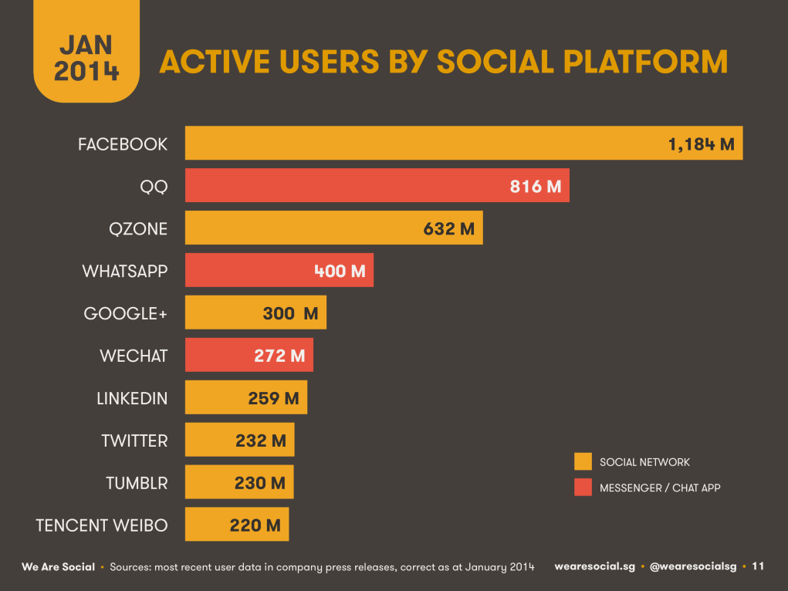
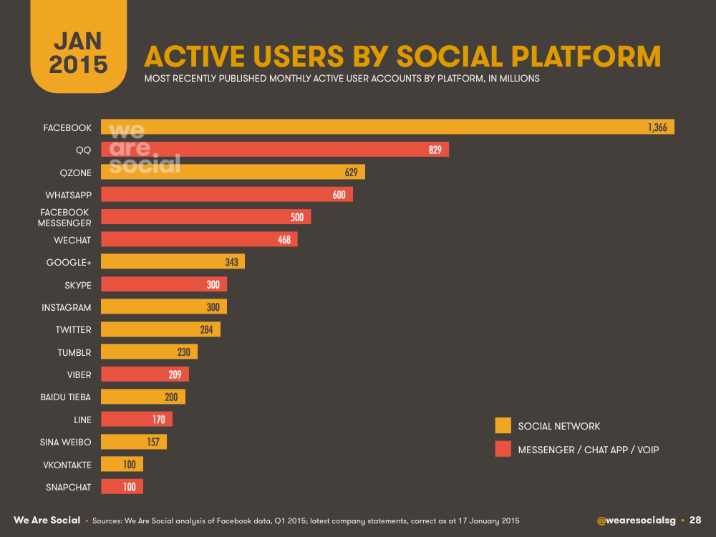
Social Media Statistics 2014 and2015
There were 1.184 million Facebook, 232 million twitter users, 400 million WhatsApp users and 230 million Tumblr users in January 2014.
There were 1.4 billion Facebook users, 284 million twitter users, 300 million Instagram users and 100 million snapchat users in January 2015.

Slide 10
7 facts about social media
1. 23% of Face book users check it at least 5 times a day.
2. 80% of Pinterest pins are re-pins.
3. 51% of users say that social media has changed their life in a negative way.
4. 73% of people would worry if they lost their cellphone.
5. 189 million accounts of Facebook are mobile only.
6. 46% of people look toward social media when making a purchase.
7. 71% of women have a social media and 62% of men have a social media.

