Slide 1
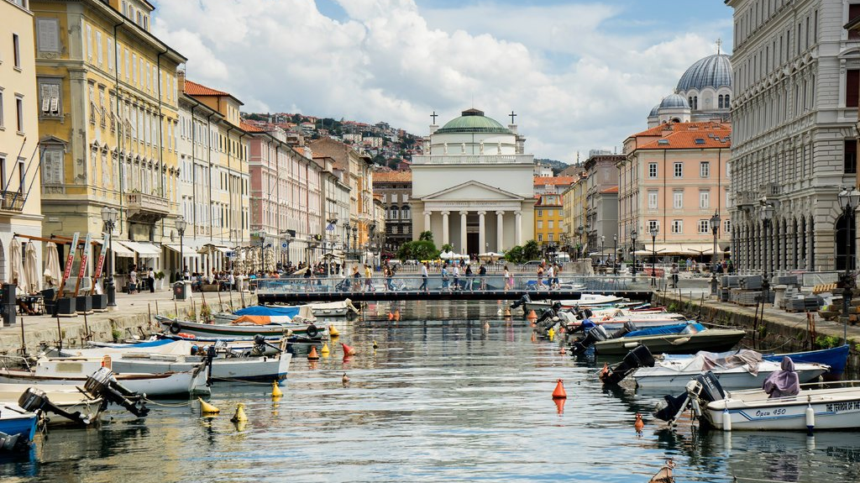
Trieste
By: Tristan Romani

Slide 2
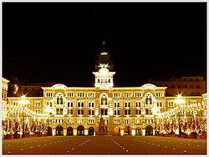
Piazza dell’Unita d’Italia
This vast public space Italy's largest sea-facing piazza is an elegant triumph of Austria Hungarian town planning and contemporary civil pride. Flanked by the city’s grandest palazzi including Palazzo del Municipio, Trieste's 19th-century city hall it's a good place for a drink or a chat or simply for a quiet moment staring out at ships on the horizon.

Slide 3
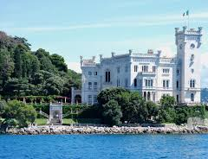
Castello Di Miramare
Sitting on a rocky outcrop 7km from town Castello di Miramare is Trieste's elegiac bookend the fanciful neo-Gothic home of the hapless Archduke Maximilian of Austria Maximilian originally came to Trieste in the 1850s as the commander in chief of Austria's imperial navy an ambitious young aristocrat known for his liberal ideas But in 1867 he was shot by a republican firing squad in Mexico after briefly and rather foolishly taking up the obsolete crown.

Slide 4
Buffet Da Pepi
The counter here is a site of porcine carnage legs, necks, bellies, tongues and testicles, all awaiting a slap of relish from the huge ceramic mustard jars and a final grate of snowy horseradish At lunchtime there are hot, takeaway brisket or pork rolls best devoured by the nearby waterfront.

Slide 5
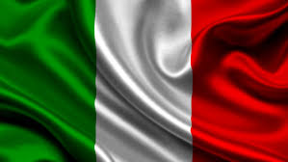

Slide 6
Trieste
Population -

Slide 7
Biblography

