Slide 1
Get to know me

Slide 2
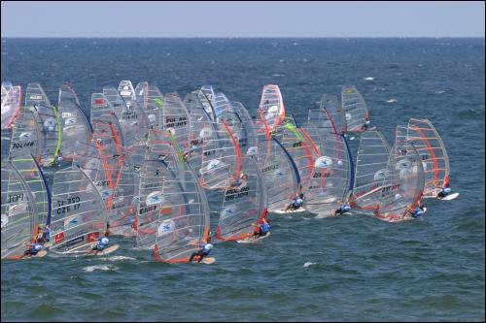
Windsurfing

Slide 3
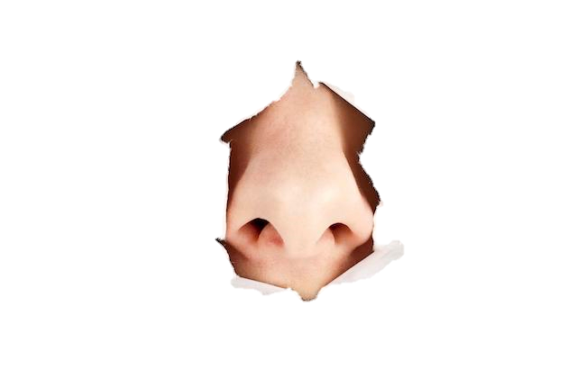
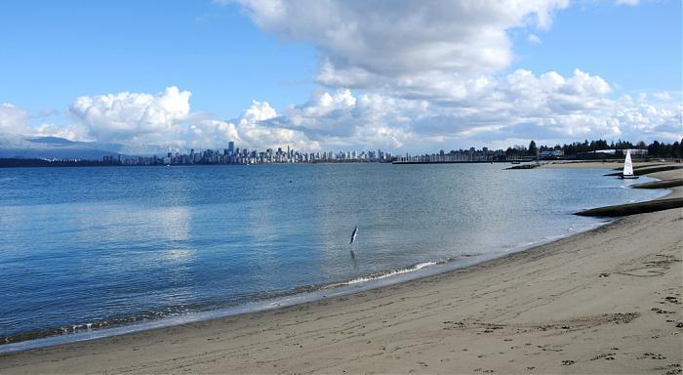
Smell
As I step onto the bleach white sand of Jericho beach I could smell all the fun all the other windsurfers are having and the smell of the salty water hits my nose like an arrow. We go to rent out a wetsuit from windsure and as I get ready to put it on the chlorine wash smell creates a war in my nose. As I get ready to go into the board I can smell the wonderful smell of bacon and burgers in the morning.

Slide 4
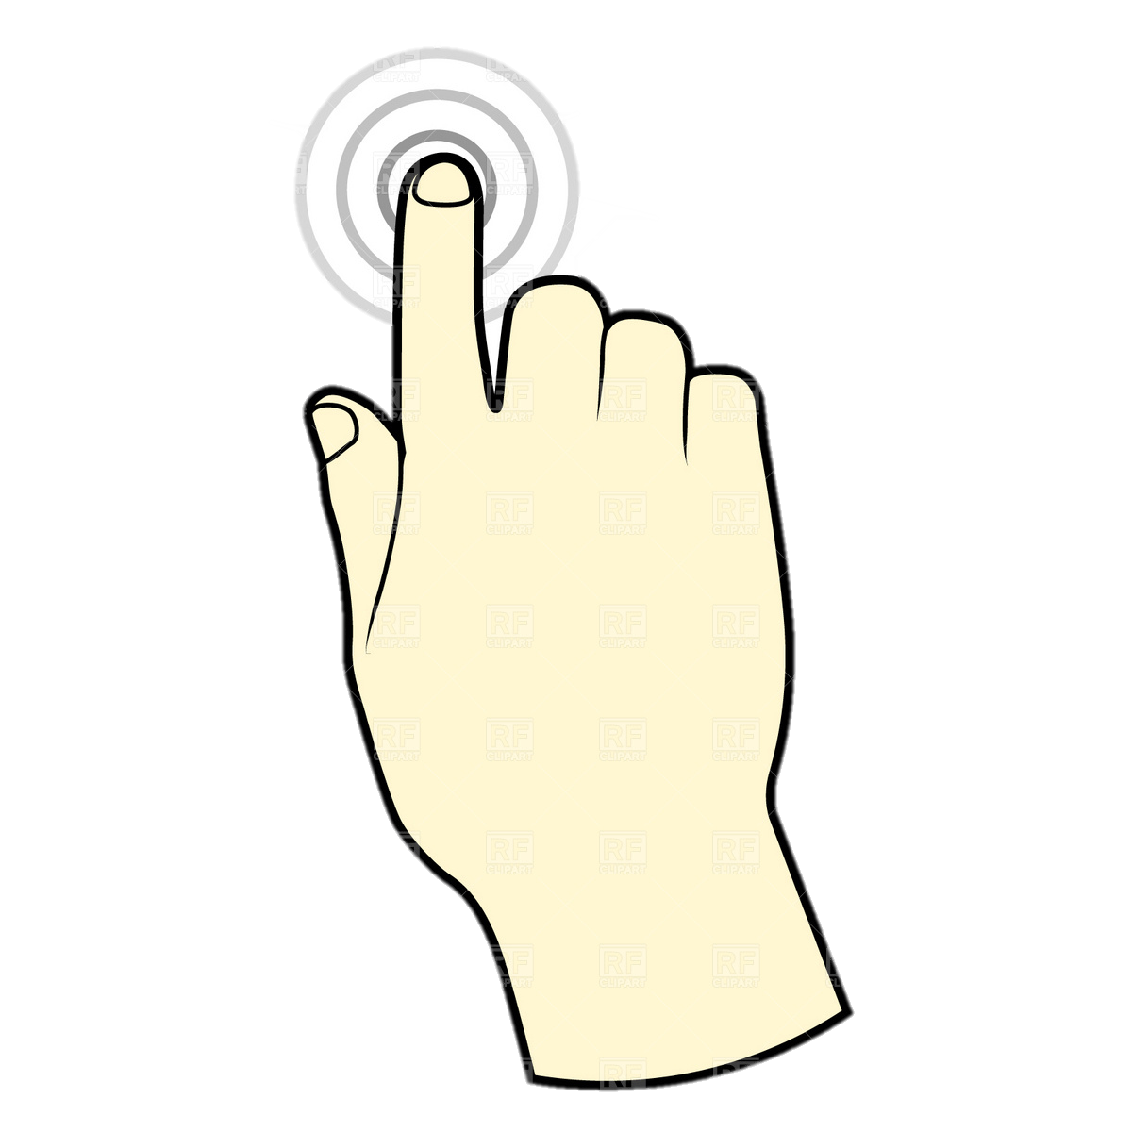
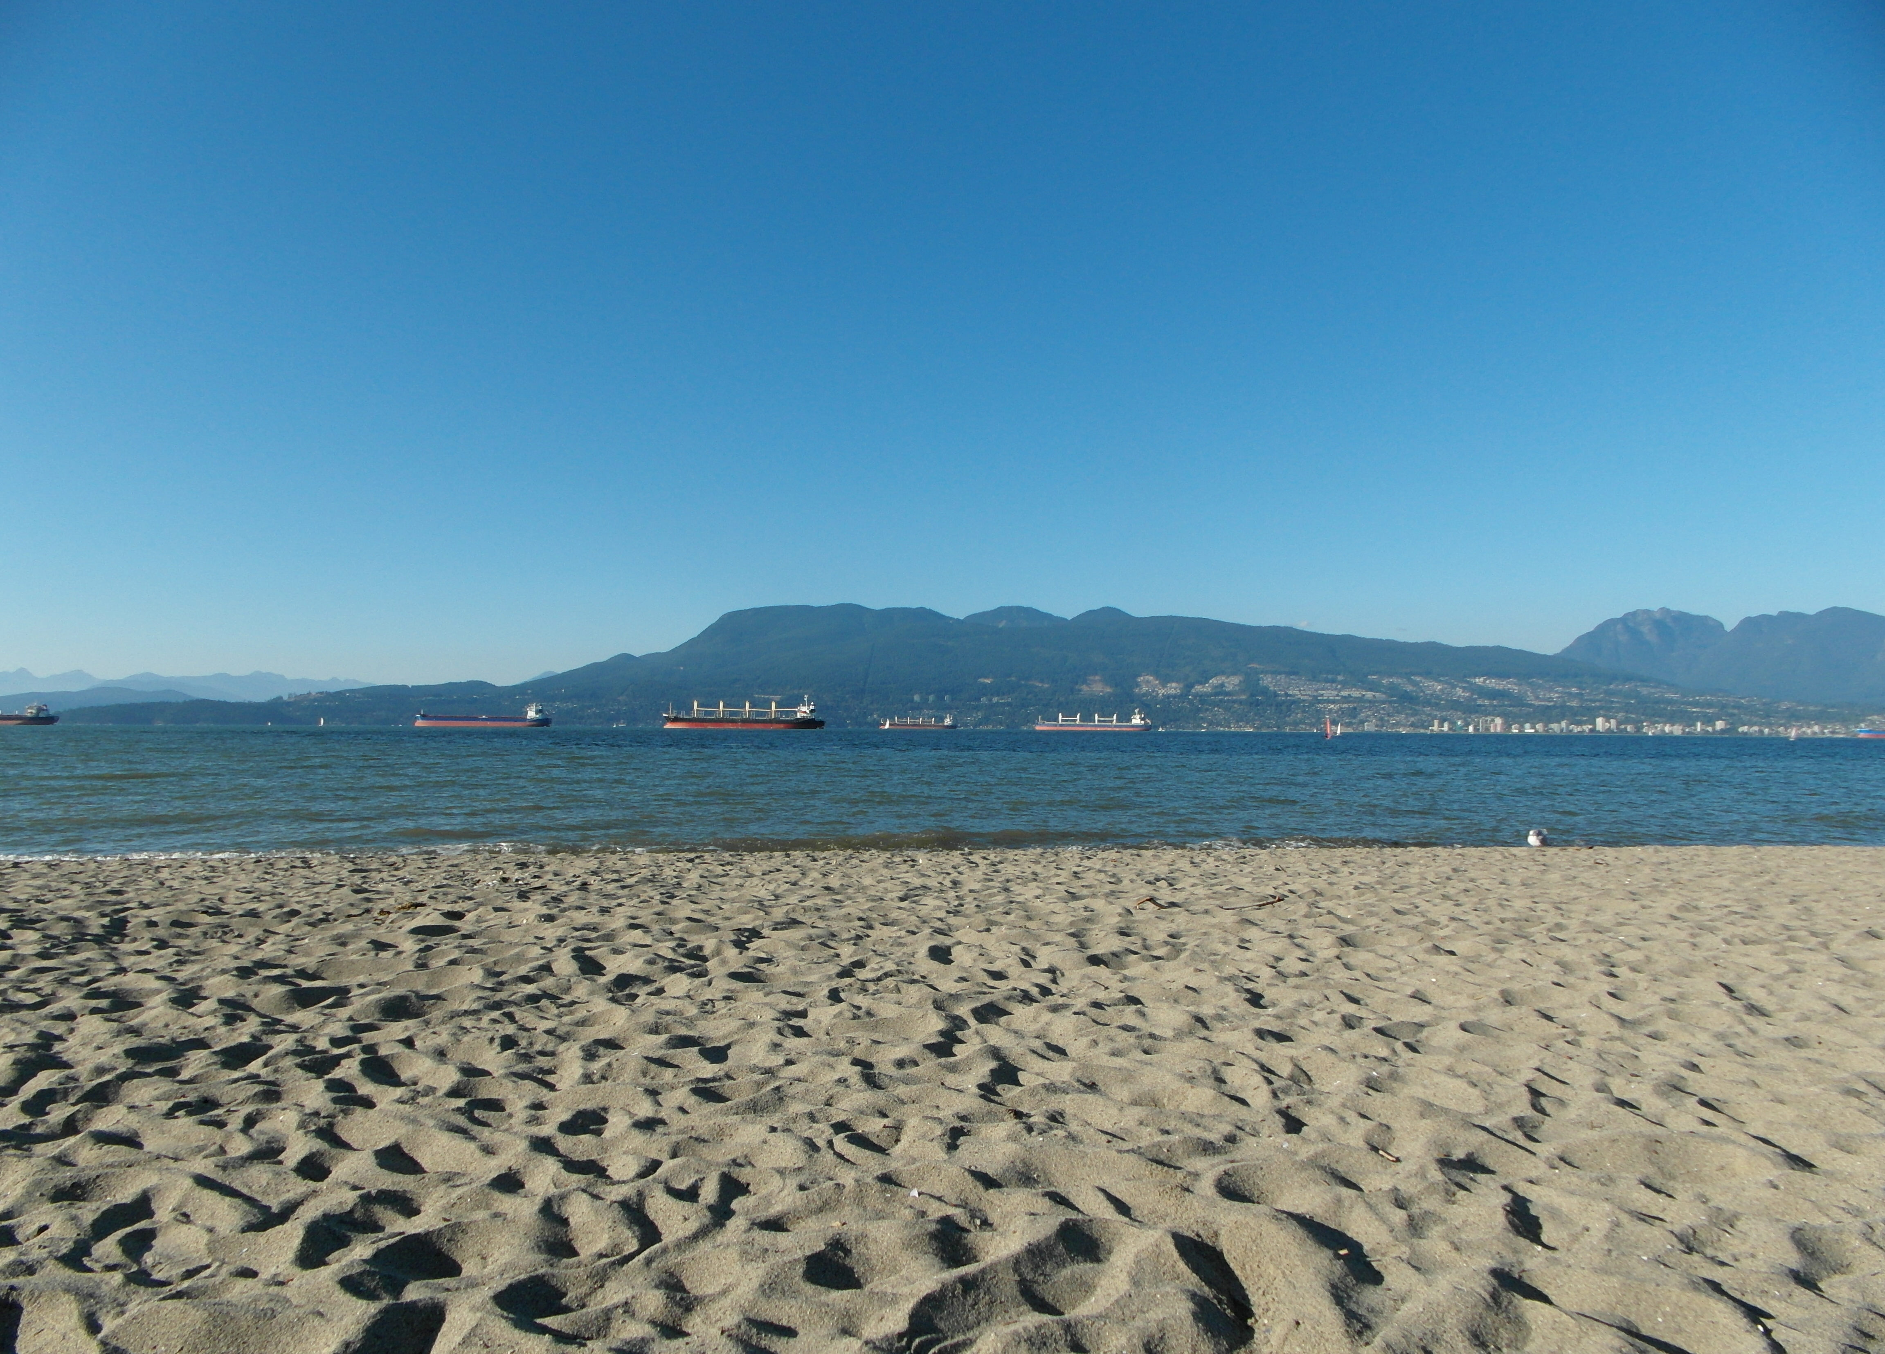
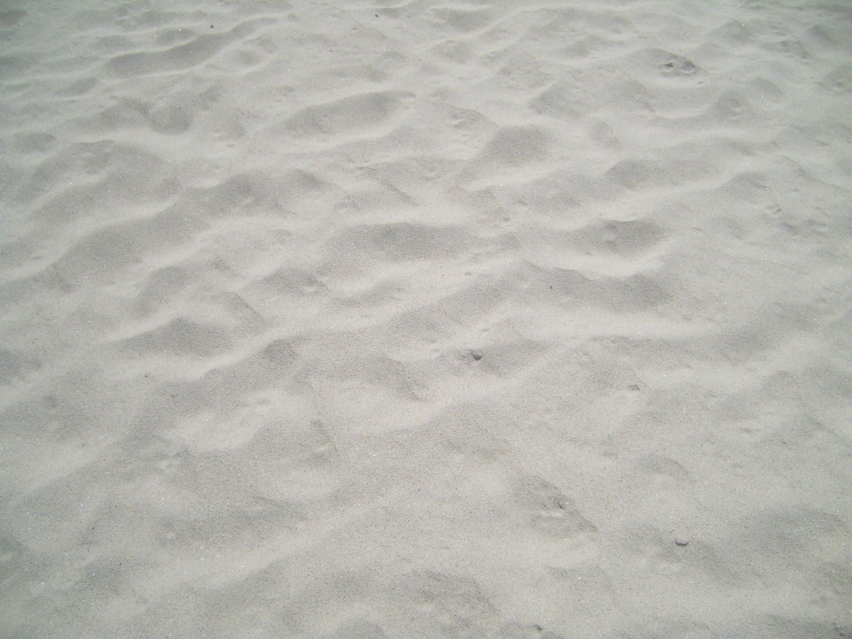
Touch
In the bright morning sun I stepped out onto the prickly grass and then onto the soft sand of Jericho beach. When I get ready I feel the water it is cold as ice, but it made me feel good and confident about myself because if I fall I will turn into and ice cube. But when I had a wet suit on my body felt nice and warm in the water.

Slide 5
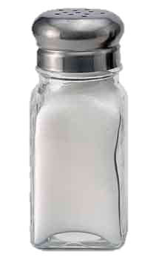
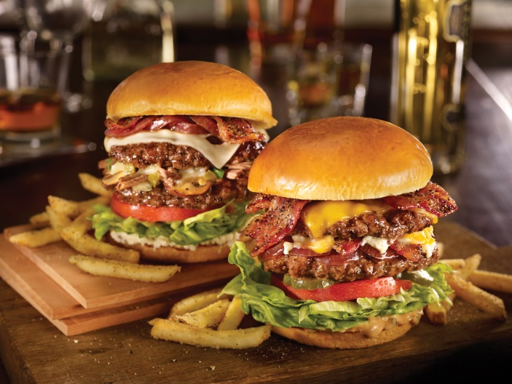
Taste
In the morning sun walking on to the sandy beach I could taste the salty ocean just from the beach. At lunch I had the best burger and fries it was like a bomb going off in my mouth. As we went onto the water I got accidentally drank salt water and it was so salty it was just like eating a whole salt shaker.

Slide 6
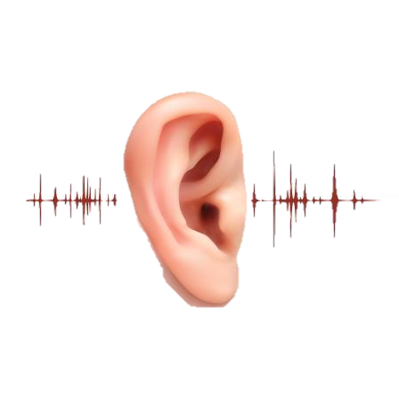
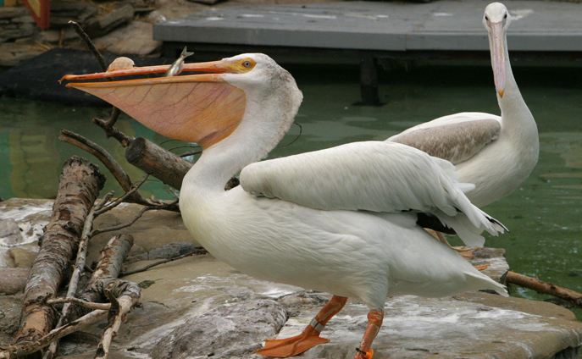
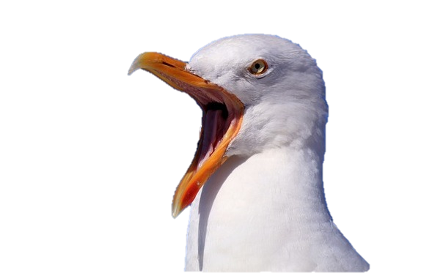
Hearing
In the morning at Jherico beach I heard the tankers in the distance honking there horns. But on the beach you can hear kids playing in the sand the waves crashing and the wind whistling like a coaches whistle. On the water I took the time to hear all different kids of birds Pelicans, Crows, Seagulls and Pidgeon's. I can also hear the screaming of my brother and dad.

Slide 7
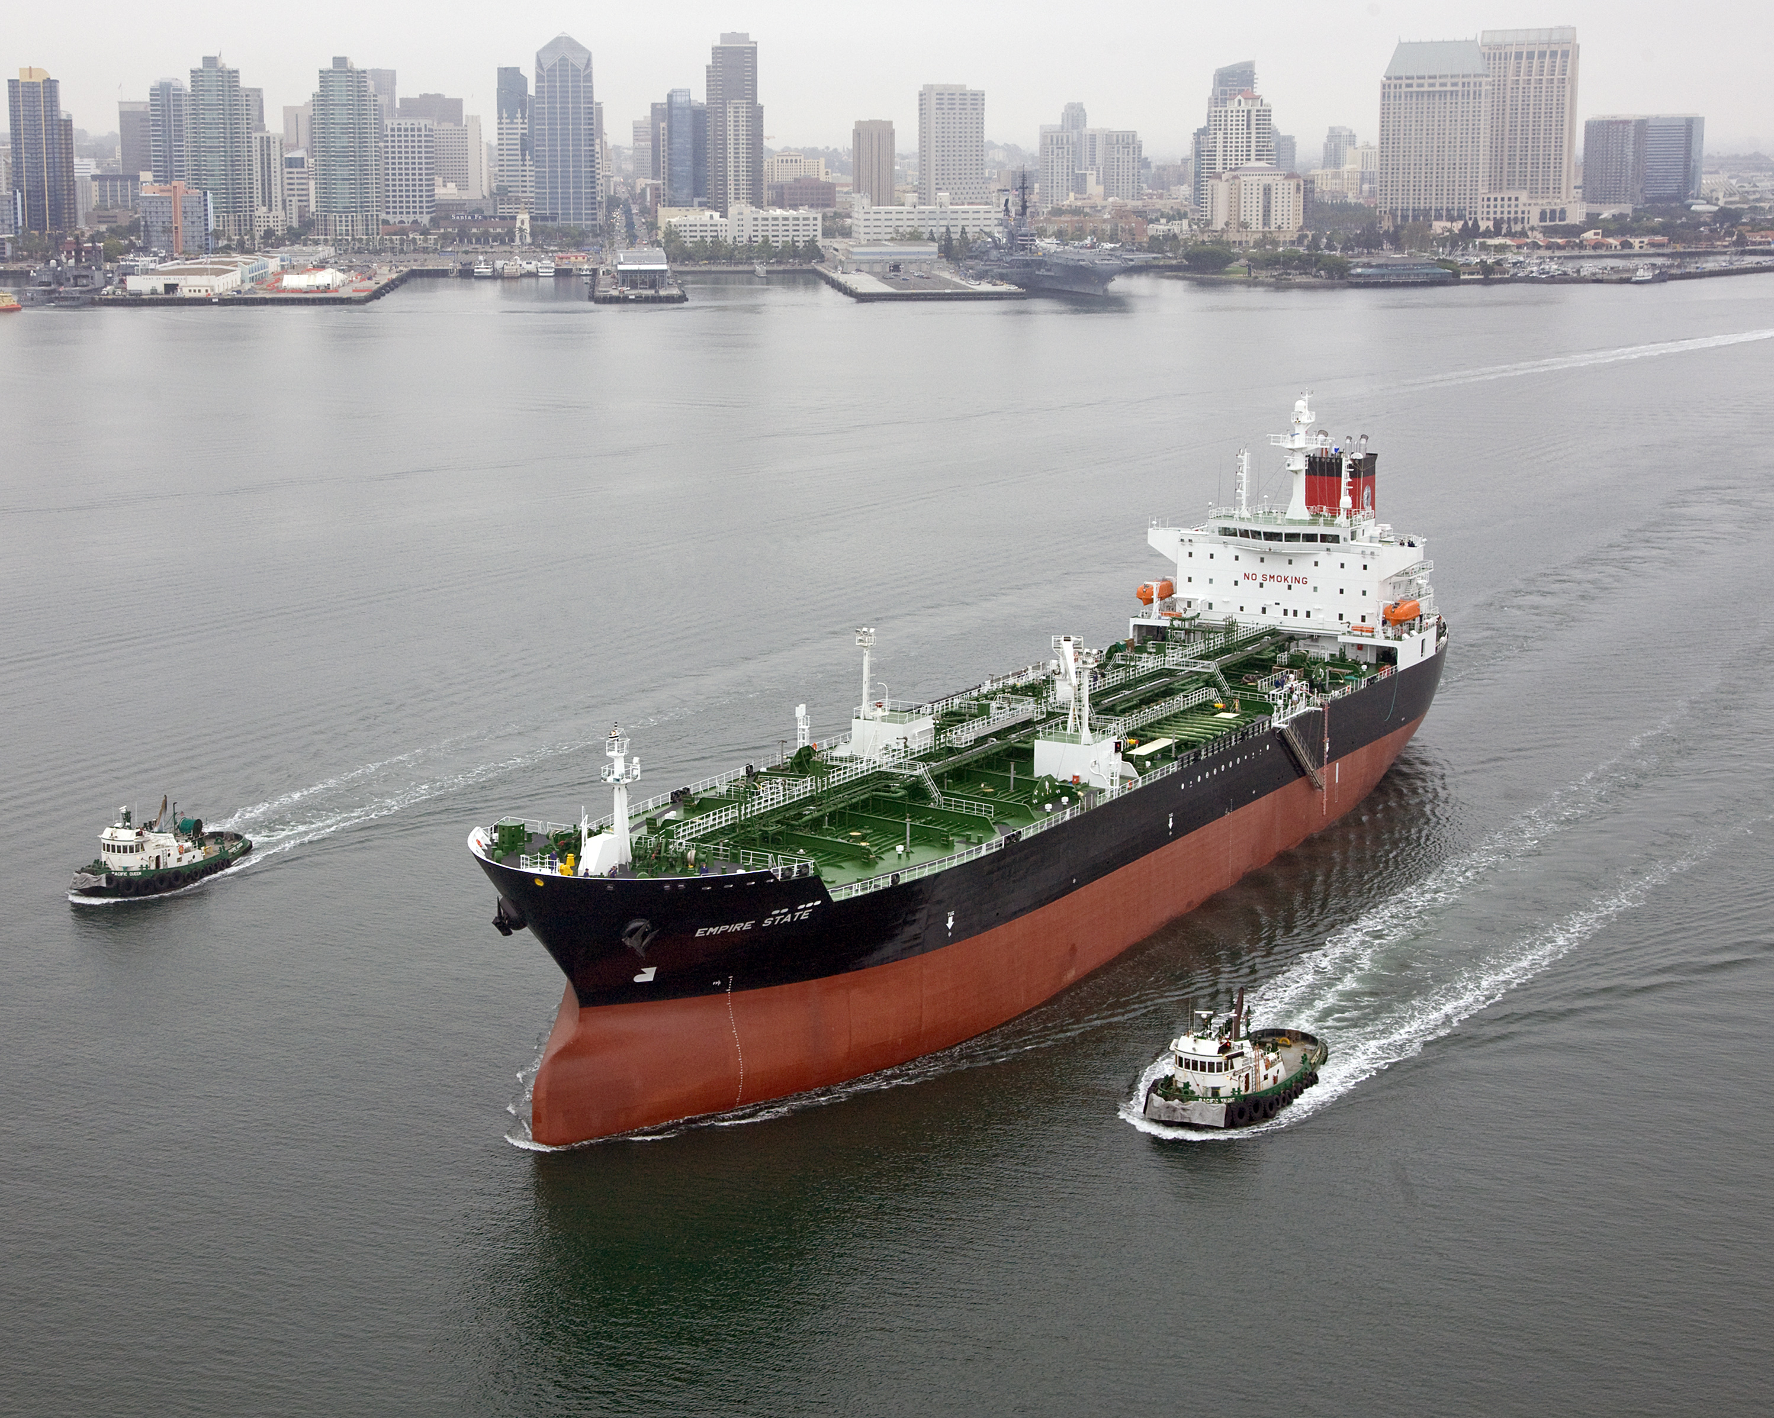
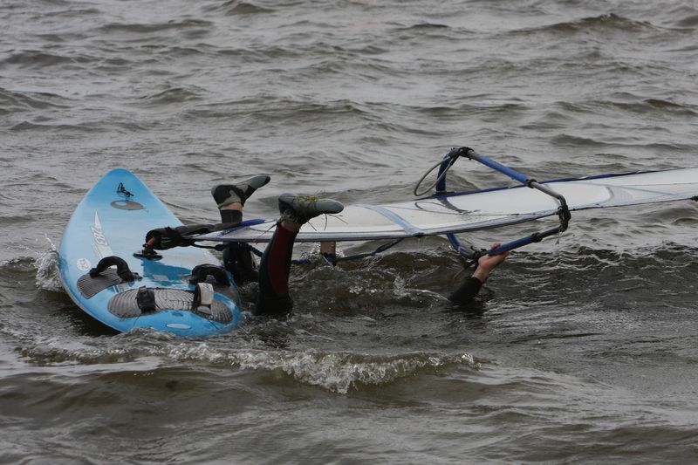
Sight
In the bright summer morning the sun glew in gold and the water was as blue as the sky but not as clear as the sky. In the distance I could see tankers they where as big as a apartment building and they where a bright red colour. Out in the water I always see my father and brother fall into that freezing cold water and that always makes me laugh.

