Slide 1
Child
LABOR
By Sarah, Taylor, Izzy

Slide 2
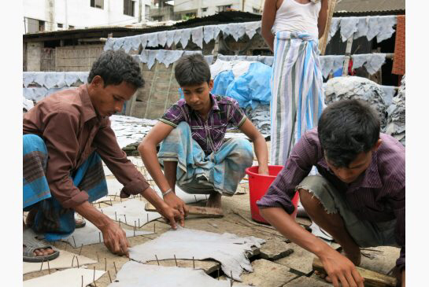
INTRODUCTION
Around 260 million children are in employment around the world, according to the International Labour organization. The ILO estimates that 170 million are engaged in child labour. 11% of the world’s children are in situations that deprive them of their right to go to school without interference from work. Many companies in the fashion industry uses child labor everyday to get things done, for example Nike, Wan-Mart, La Senza, H&M, Victoria's Secret and many more other companies use children. These children work in unhealthy work places and barley earn enough to buy one meal.

Slide 3
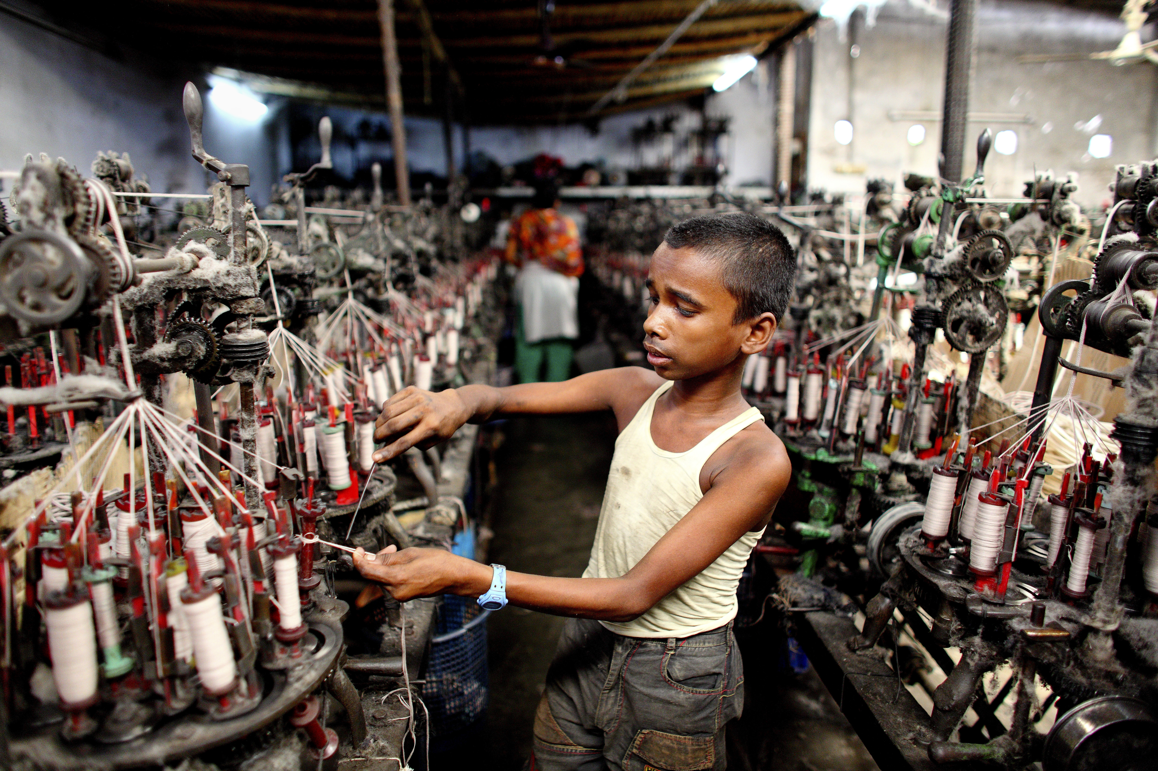
CHILD LABOUR TODAY
Child labour is against the law in most country's like in Canada but sadly it is still a reality for some countries. It has gotten better since the industrial revolution but it is still very much a problem.
168 million children are in child labour today and more than half of them, 85 million are working dangerous and hazardous workplaces. Asia and the Pacific has the almost 78 million which is 9.3% of child labour, Sub-Saharan Africa continues to be the region with the highest amount of child labour 59 million over 21%.

Slide 4
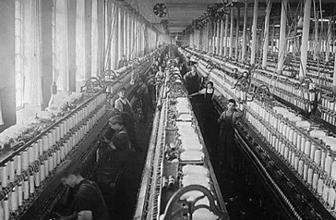
CHILD LABOR IN BRITAIN DURING THE INDUSTRIAL REVOLUTION
Children would be hired to work in factories with machines because there hands were small so they could use the machines easily, however they could use the machines easily, the machine ran so quickly that the children's hands, fingers, and legs would often get caught so there was many accidents occurred where the working children got injured or killed.
Children would often get illness’s and diseases because of the toxins and fumes that were inhaled while in the factories or mines.
Many adults did not allow their children to get an education because they needed money and needed their children to work.
Some children worked 19 hours with a one hour break
IMG_0919.JPG

Slide 5
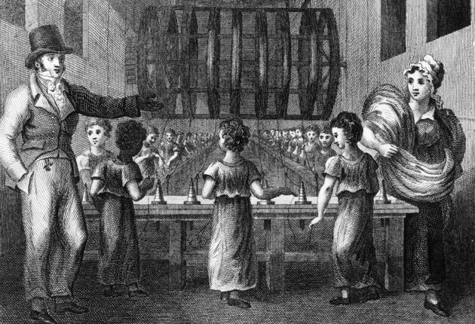
SIMILARITIES BETWEEN TODAY CHILD LABOR TODAY AND CHILD LABOR IN BRITAIN DURING THE INDUSTRIAL REVOLUTION
Child labor today and child labor during the industrial revolution has many similarities between them
Sadly they both have in common horrible work places
The kids that work didn't/don't go to school because their families can't afford it.
The parents both in the industrial revolution and today parents sell their kids off to recover from debt
In both they are very under paid

Slide 6
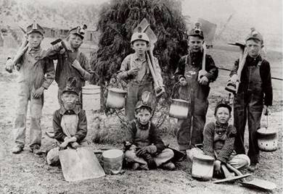
DIFFERENCE IN BETWEEN TODAY CHILD LABOR AND CHILD LABOR IN BRITAIN DURING THE INDUSTRIAL REVOLUTION
In the industrial revolution child labour was legal and more common then in today's generation.
In the industrial revolution it was "okay" for child labor.
Today most of the jobs that the children work at are in foreign countries
during the industrial revolution, child labour was everywhere

Slide 7
Has child labor gotten better since the industrial revolution?
In our opinion we think that child labor has gotten better over the past few years. There are so many foundations that get word out about child labor and there are more people trying to help like free the children. Even though it's not fully over its has gotten better, but it's going to get harder to stop child labor because child labor is so closely related to poverty, world hunger and government corruption so if you want to stop child labor you would have to stop all hose things. Even though child labor hasn't fully stopped, It has gotten way better since the Industrial revolution. And we think it's going to get better through out the years.

Slide 8
WHAT ARE SOME SOLUTIONS TO DEAL WITH CHILD LABOR
There are a few things that you could do to help with helping end child labor, You can easily help with child labour by donating some money or getting involved. Here are some websites to donate to:
http://www.gandhiforchildren.org/About-GWEI
http://harmonyfdn.ca/?page_id=861
http://www.freethechildren.com/
http://www.cheerfulheartsfoundation.org/tag/child-labour/

Slide 9
Citations
https://labs.theguardian.com/unicef-child-labour/
http://www.eiu.edu/eiutps/childhood.php
http://www.ilo.org/global/topics/child-labour/lang--en/index.htm

