Slide 1
l know a good place
my hometown Changchun China
^_^

Slide 2
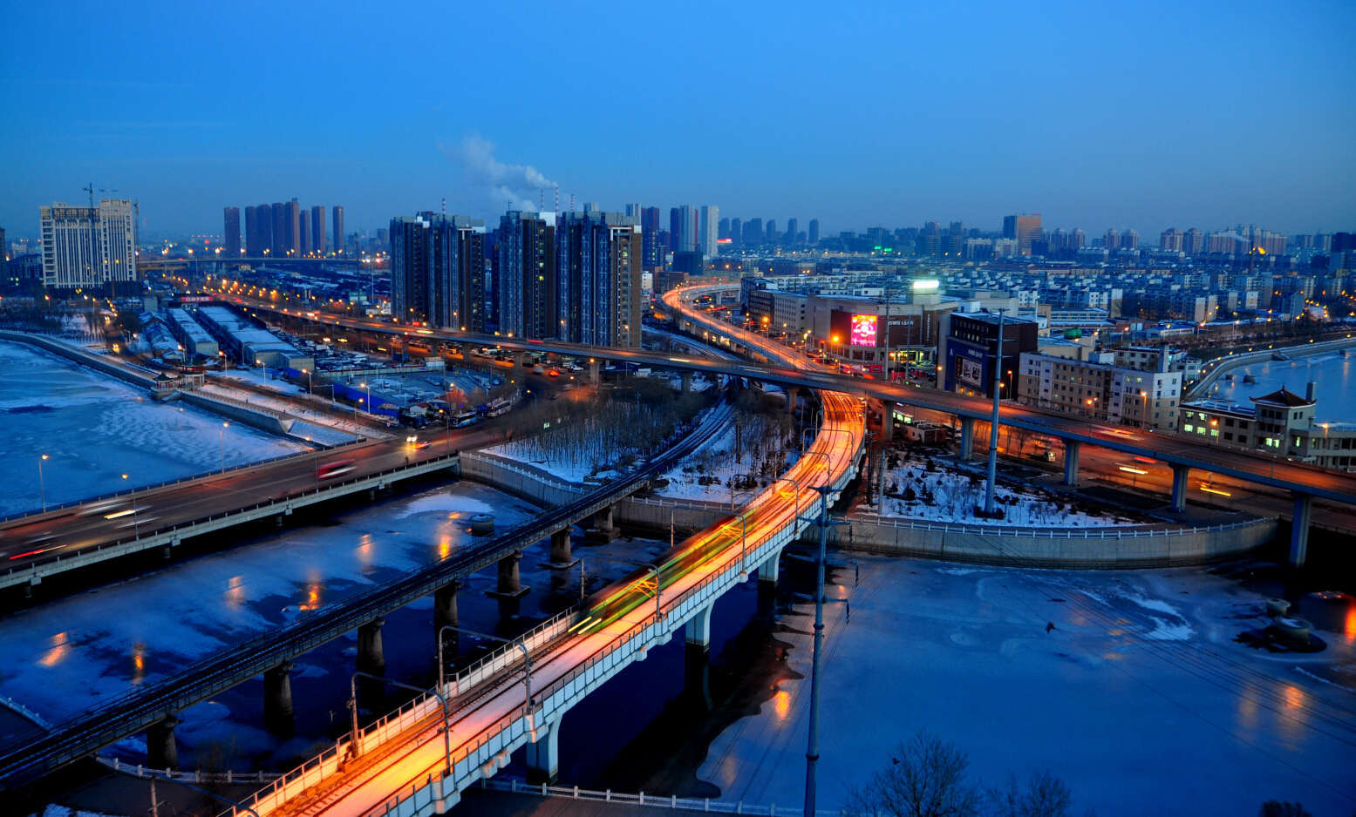
There is my hometown

Slide 3
delicious Chinese food!!!!!!!!!!

Slide 4
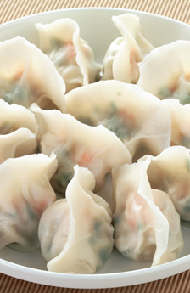
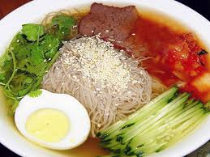
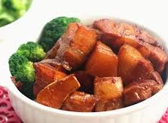

Slide 5
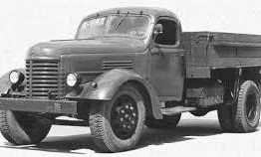
This is China first car!
In 1953, the production

Slide 6
There is good place Changchun China
Luka zhang

