Slide 1
Peter’s Career Path
How to become a Biophysicists

Slide 2
My Career Goals
I want to become a Biophysicist by 2025
To get there, I will need to:
Graduate high school by around the end of June in 2020
A bachelor's degree in a field of physics or related discipline (physicists usually require a master's or doctoral degree in a field of physics, engineering physics, or in a related discipline)

Slide 3
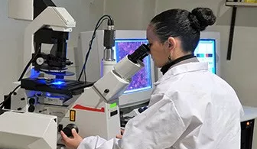
What is a Biophysicists?
Biophysicist conduct basic research to learn how nerve cells communicate and how proteins work
3 things I would have to do regularly:
Take detailed analysis of the structure of molecules
Seek answers to diverse biological questions
Use many instruments and scientific machines to conduct experiments

Slide 4
About my future career
Most of my time at this job would be in a laboratory and a office (research centre)
Salary range:
Low $34k
Median: 91K
High: $156K
Usual hours are more than 40 hours per week
Usual 8 hour shifts (ex. 9 am-5 pm)
Workdays 5-6 days a week
Average pay per hour: $39.51

Slide 5
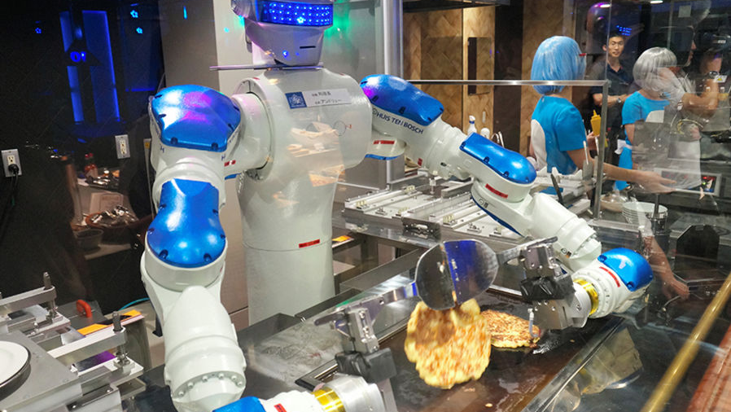
My job has a 1.2% chance of becoming automated
2 reasons why my job won’t become automated:
The job requires so much skill and knowledge that A.I would simply not be able to effectively do the job
Many hard biological questions will be faced and only a human would be able to go in depth to think and solve these problems

Slide 6
My compatibility
I am 94% compatible with this job.
The skills this job requires are:
Good problem-solving skills
Strong determination
The knowledge of working with complex machine
Being a team leader
Being a fast learner
A strong understanding in the field of science

Slide 7
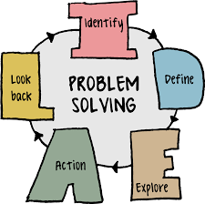
A Biophysicists would be a great career for me because…
I already have these skills for this career:
Team leader
Fast learner
Strong problem-solving skills

Slide 8
I am not quite ready for this career, but I will get there!
These are skills for the job I still need to learn:
Working with complex machines
A stronger understanding in the field of science
This is how I will get those necessary skills:
Entering the science field of a good university and expanding my knowledge

Slide 9
Job Outlook
In BC, the job outlook is a undetermined number of 3 stars.
Here are 2 reasons why:
Lack of info
Lack of research conducted in BC

Slide 10
This is what appeals to me with this career…
Science is fun subject for me
Ever since I was young, science always interested me and I want a job around this field
The pay is good
The pay range for this job is very good, and would allow me to live a good life
I love solving complex problems
Part of this job requires you to solve complex problems and I enjoy solving problems

Slide 11
These are some things I find less appealing about this career…
Long work weeks
With over 40 hours of work per week required, I would become very tired everyday
Lots of duties
There will be huge workload everyday

Slide 12
Potential obstacles to getting this career
The possible obstacles:
-Lack of sleep
-High stress level
-High competition
My plan to overcome them:
-Manage my time better and create a strict sleeping schedule
-Make sure to have sufficient leisure time each day to relieve stress
-Work harder than anybody else

Slide 13
Potential obstacles to being successful within this career
The possible obstacles:
-Lack of experience when
starting off
-Big workloads
-Lack of motivation to
push myself to be better
My plan to overcome them:
-Work harder than anybody else to catch up for the lack of experience
-Manage my time wisely
-Stay focused on my goal and not lose sight of it

Slide 14
The training/education required for my career is:
A bachelor's degree in a field of physics/science or related discipline (physicists usually require a master's or doctoral degree in a field of physics, engineering physics, or in a related discipline)
On-the-site training

Slide 15
I intend to go to St. Mary’s University for that career
Located Calgary, Alberta, Canada
I would take the science program with a concentration in biology
The length of program is 3 years
Certification earned = Bachelor of Science

Slide 16
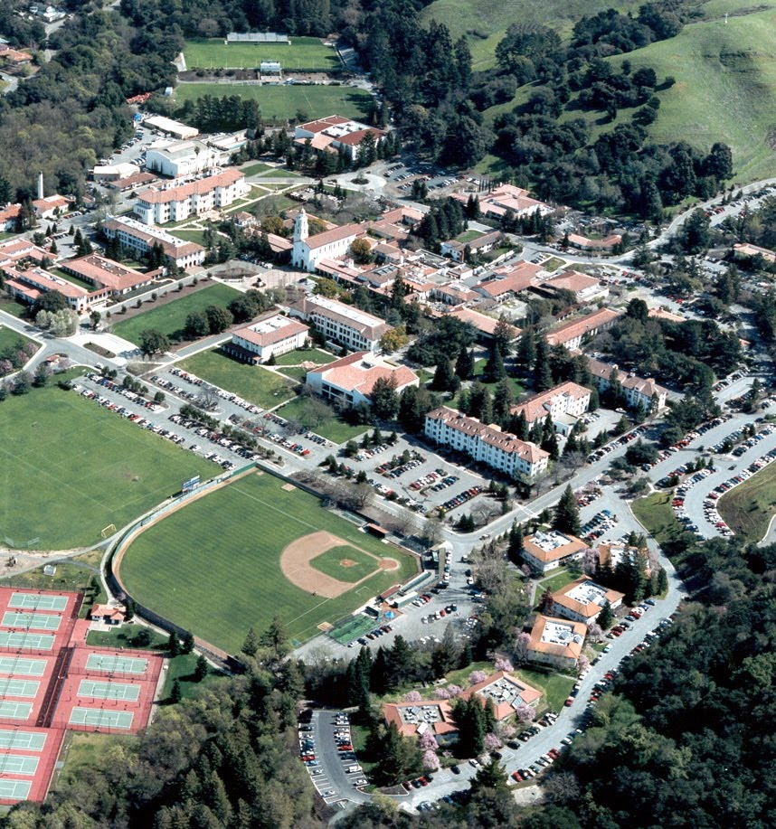

Slide 17
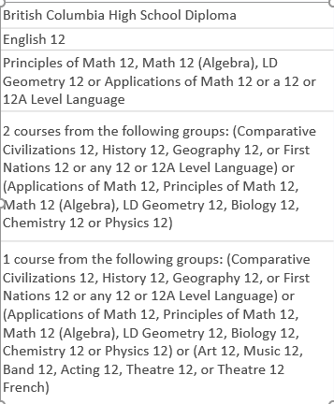
High school courses required
Grade 11 courses:
N/A
Grade 12 courses:

Slide 18
Additional admission requirements:
Good grades in grade 12 science courses
Saint Mary’s University is know for their strong programs in business and science
Since their science program is very good, it is my main reason for attending this school

Slide 19
Financial Plan
Total cost of program -> $6,405 x 3 = $19,215
I am going to pay for my program by:
Student loans
Using the money I am currently saving up during high school years
Working a entry level job on the side while attending the program

Slide 20
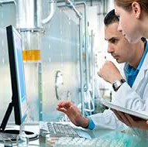
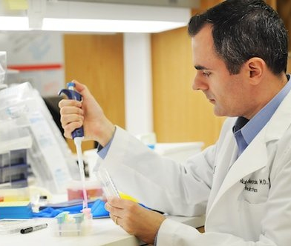
Some related occupations:
Geneticist
Medical Scientist
Bioinformatics Scientist

Slide 21
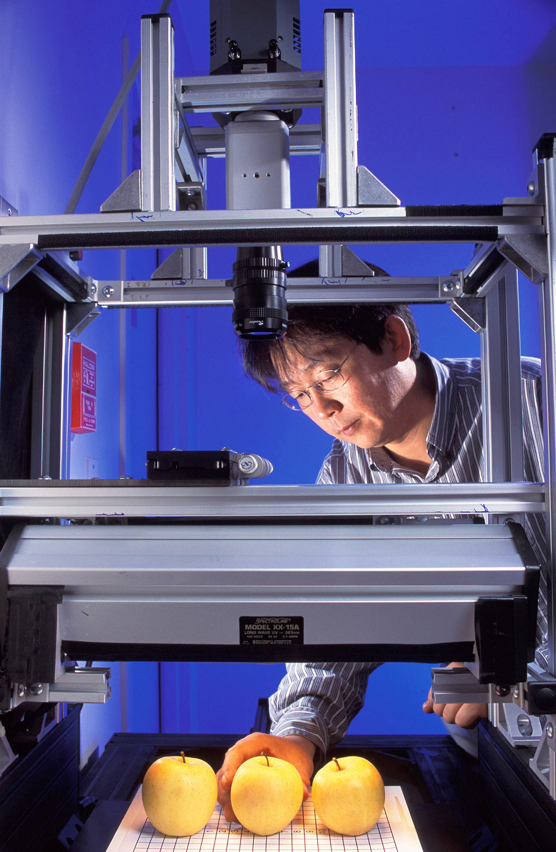
Biophysicists are awesome!!!
Everything about my job will always revolve around science
I will be also be able to regularly put my problem solving skills to the test
Operating cool scientific machines will be something I do regularly

