Slide 1
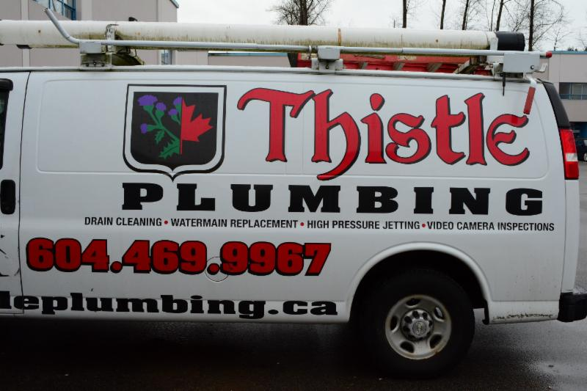
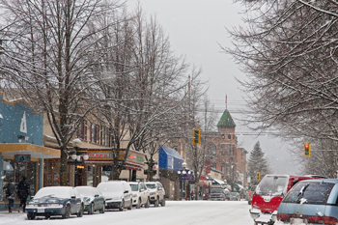
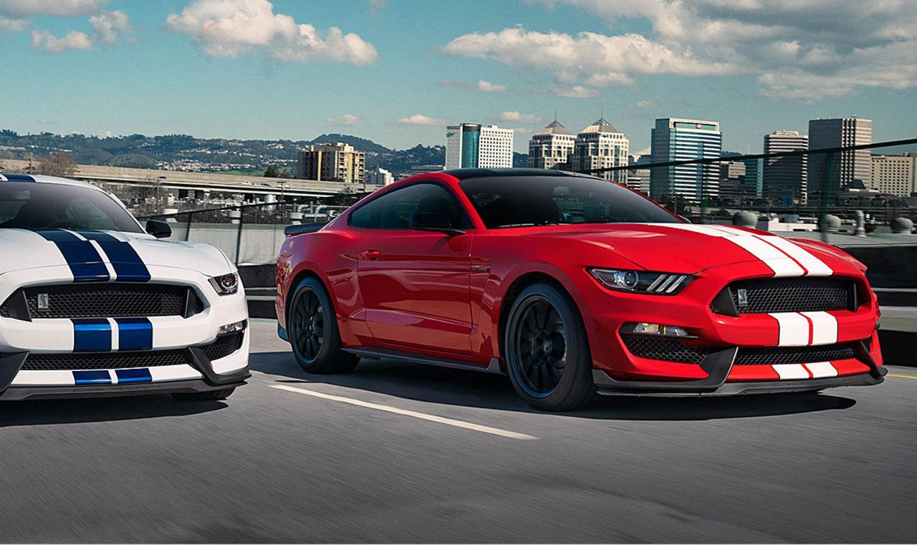
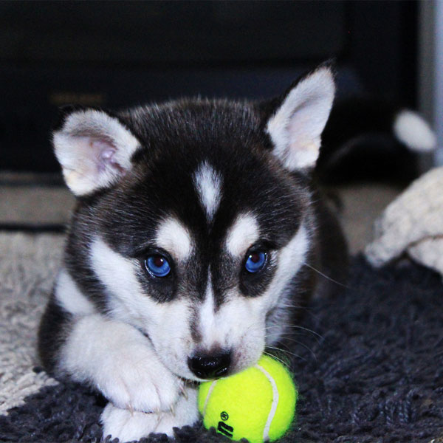
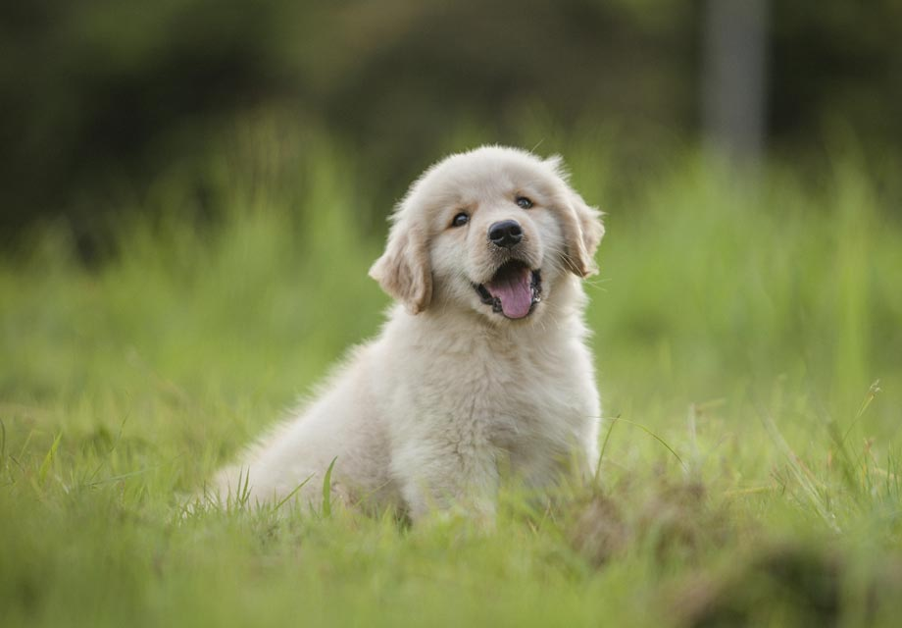
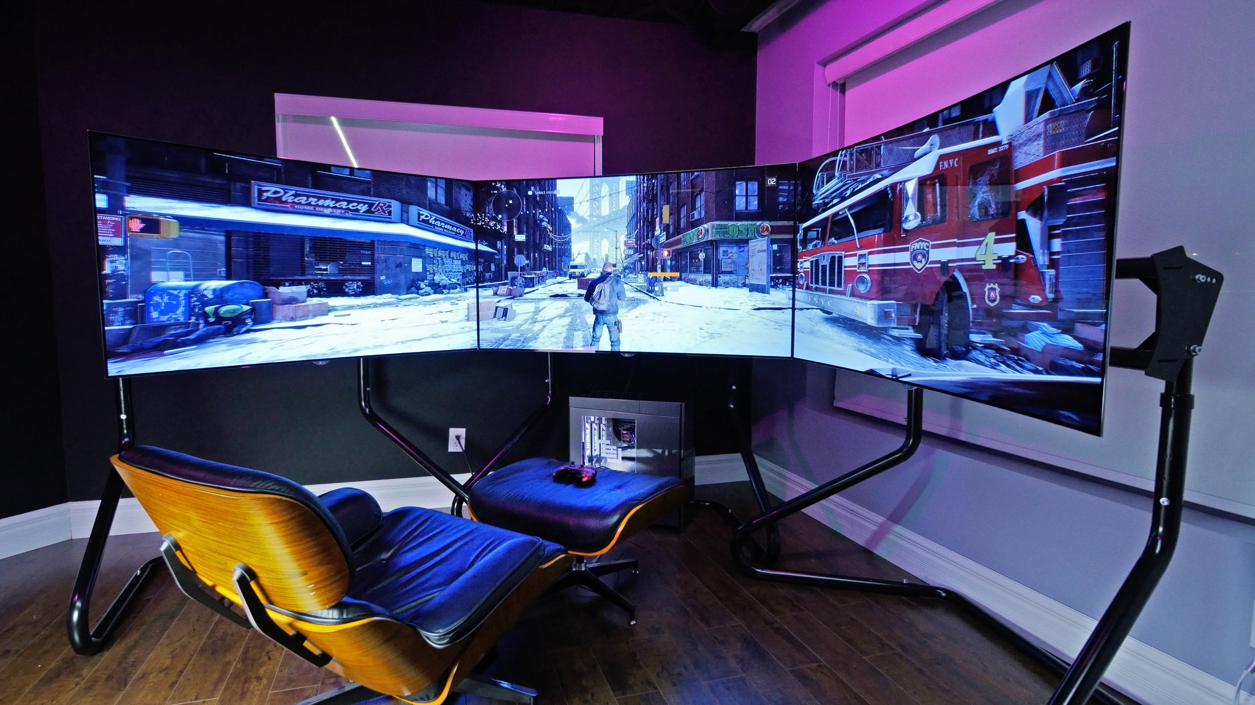
I would like to be a plumber working full time for Thistle plumbing.
I am fine with living in a smaller house until I can retire then I would like to live in a 3 story house located in Nelson BC, Canada beside the lake.
In the future I would like to drive a 2018 ford mustang in red with black stripe down the middle.
I would like a Husky named Thresh and a golden retriever named Tess and everyday the 3 of us can go hiking on all the hiking trails around Nelson
Gaming set up with all the latest tech of that time(computer, 4K flat-screen, latest Xbox, HTC VIVE, mini fridge ECT)

