Slide 1
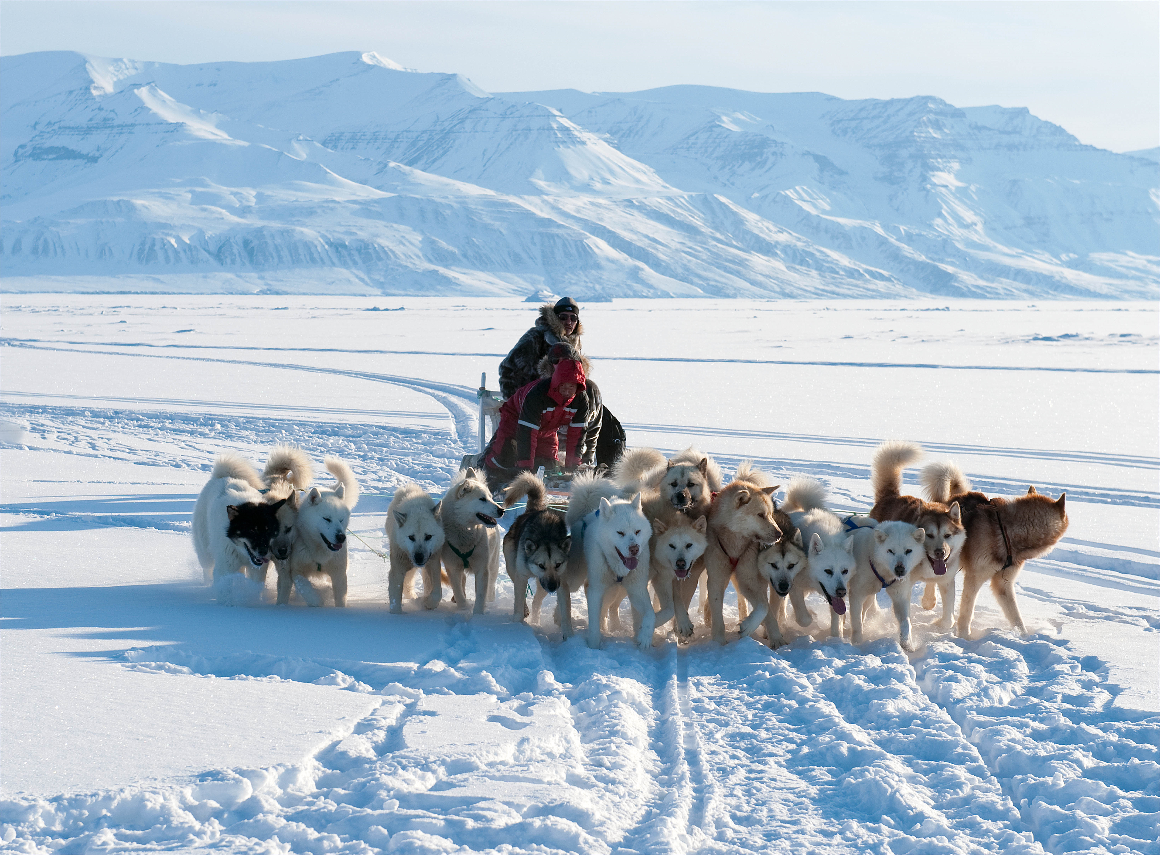
Inuit of the Arctic
By: Camilla and Minji

Slide 2
Map

Slide 3
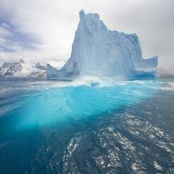
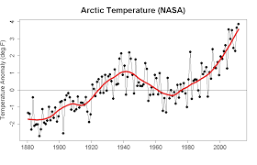
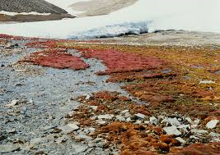
Map
Topography
The ocean is very flat
The mountains
were formed by folding and are presently covered by glaciers
Climate
It was very severe
Summer is very short, but not very warm
Winter is long and very cold
Vegetation
Trees can not grow on the tundra
Small shrubs, mosses, and lichens are the only things that can grow

Slide 4
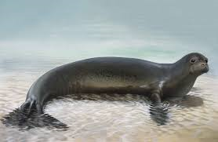
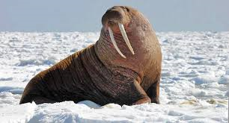
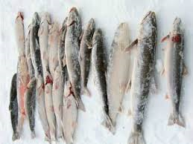
Subsistence
What type of food did they eat?
They ate fish, walrus, whales
The seals were important because of protein
Also ate land mammals
Snow was used as a source of drinking water
But eating snow in the cold can be dangerous
How did they obtain food?
Hunting
Fishing
Most of the tools were made out of stone or parts of animals
Notes:
다시 보기!!!!!!!!!!!!!!!!!! 내용

Slide 5
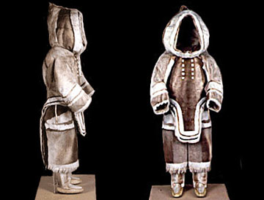
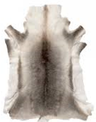
Clothing
What type of clothing do they wear?
Clothing made out of caribou skin.
Winter pants and parkas
Boots
What materials do they wear to make there clothing?
Skin of animals
Fur
Caribou was the most common skin choice for them to wear
Caribou Skin

Slide 6
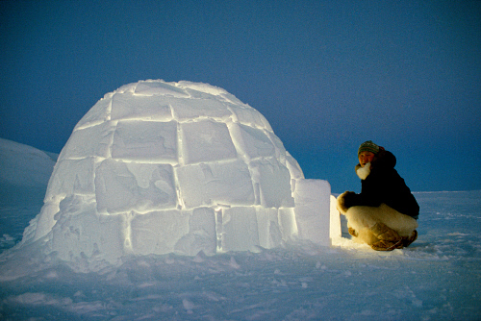
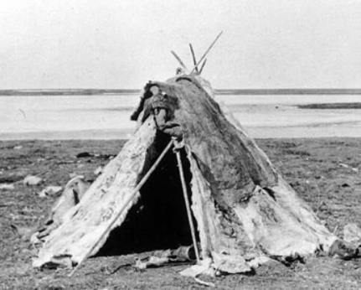
Shelter
What type of shelter did they build or reside?
What type of materials did they use for their shelter ?
-Igloo : snow
-Tent : driftwood or poles covered with animal skins, mostly caribou or sealskin
Winter : Igloo
Makes the igloo only using long knives less than an hour.
Warmed by the bodies of its occupants + seal oil lamp
= Igloo provides a secure and safe house.
Summer : tent
Their houses had to be
quick and easy to build.
Because they don’t stay
in one place very long.

Slide 7
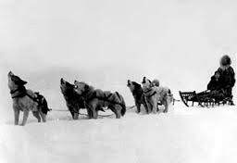
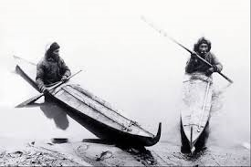
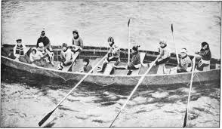
Transportation
What forms of transportation did they use?
In winter they used sleds
In the summer people just walked or they traveled by boat
Kayak
Umiak
What materials did they use to build their transportation?
boats,kayaks,umiak
Bones,wood,seal skin

Slide 8
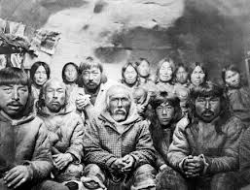
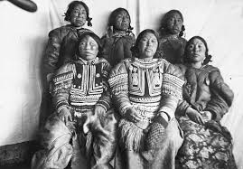
Social organization and government
How were members of the group divided or established?
- organized according to groups of people who hunted together, and on trading partnerships between groups who had different goods to offer
Who were the leaders and how were they chosen?
The Elders of the male were the leaders
They were chosen by other member of the community
Who had power and authority?
-The males and the elders
How were decisions made for the group?
-The leader directed the other members of the community.
What ceremonies were performed?
-Bladder Dance : Returned the bladder to the sea to help the animal’s spirit finding a new body.

Slide 9
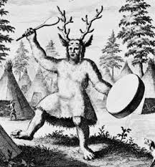
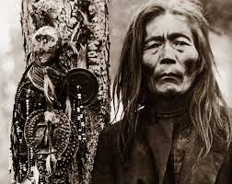
Religion
What were their spiritual beliefs? Who or what did they worship?
Animism
Living and non living
Animals inanimate
Who were their religious leaders?
Shamans or “angakoks”
Charms to communicate
Spirit world
What were the rituals or ceremonies? How were they conducted?
Carved masks
Powers
Enabled them to communicate with the spirits

Slide 10
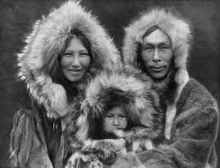
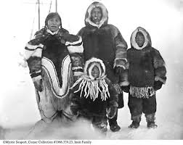
Kinship
How are family relationships organized (patrilineal, matrilineal, or both)?
- The Inuit society was patrilineal.
A newly wed couple would stay with the man's family and their children would be named after the man's family tree

Slide 11
Works Consulted
Murray, Cam, and Michael William Cranny. "The Native Peoples of Canada." Crossroads: A Meeting of Nations. Scarborough, Ont.: Prentice Hall Ginn Canada, 2000. Print.
"The Arctic People - Groups in This Region." The Arctic People - Groups in This Region. Web. 17 Dec. 2015. <http://firstpeoplesofcanada.com/fp_groups/fp_inuit1.html>.
"The Arctic People - Environment / Housing." The Arctic People - Environment / Housing. Web. 17 Dec. 2015. <http://firstpeoplesofcanada.com/fp_groups/fp_inuit2.html>.

Slide 12
Thank you for listening

