Slide 1
Should Canadians be Thankful for the two World Wars?
Mikayla Berry, Kristin Caktas, Katelyn Walker

Slide 2
Thesis Yes, Canadians should be thankful for the two world Wars because they led us on the road to autonomy, strengthened Women’s Rights, and opened citizen’s eyes to the needs of others.

Slide 3
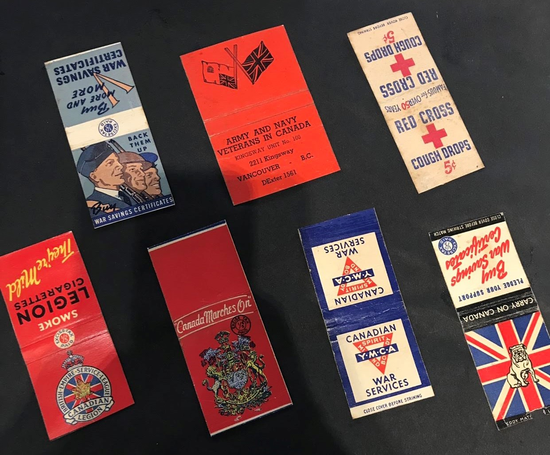
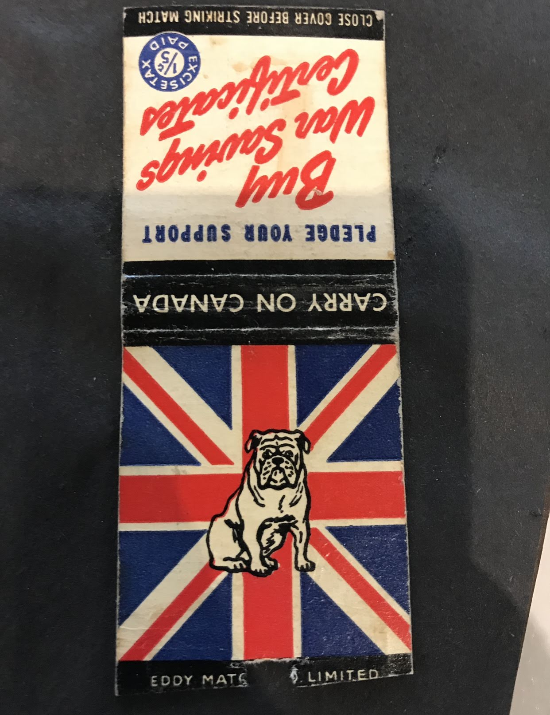
How So? Canada Before World War One
Our Autonomy
We weren’t independent from Britain
Felt patronage towards Britain so decided to send soldiers to fight

Slide 4
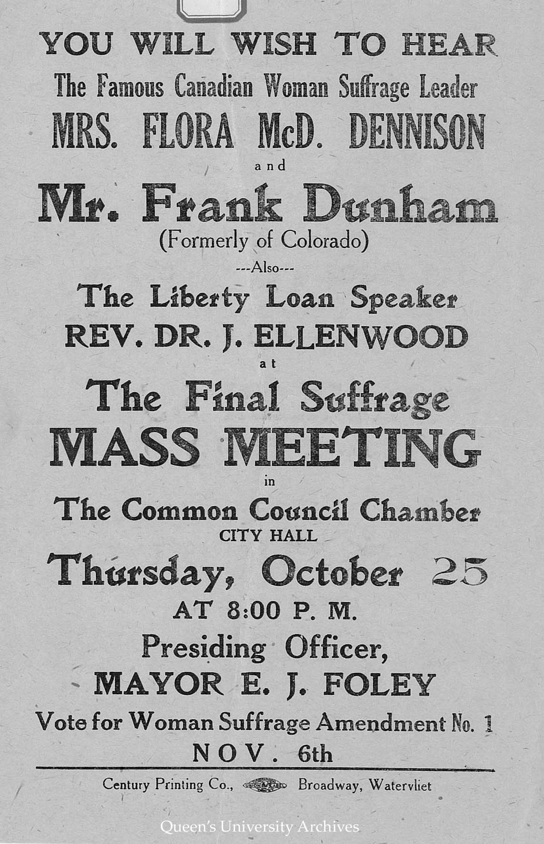
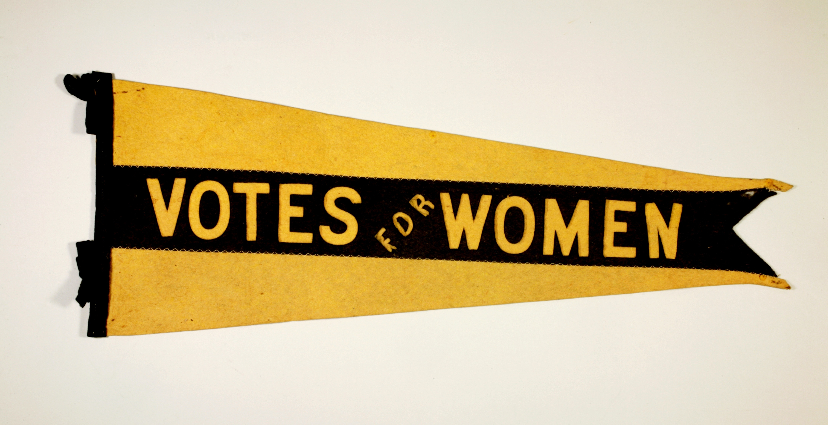
How So? Canada Before World War One
Women’s Rights
No awareness around Women’s Rights
Were fighting to earn their vote

Slide 5
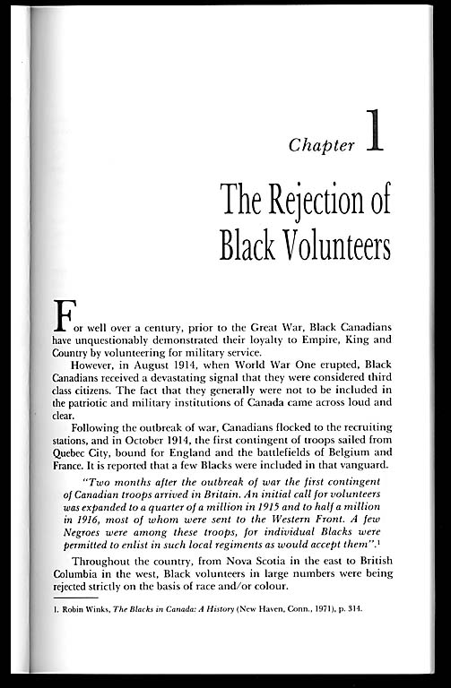
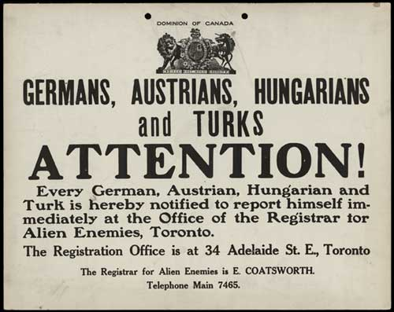
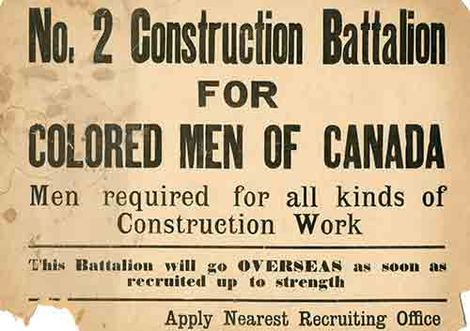
How So? Canada Before World War One
Needs of others
Discrimination towards minorities

Slide 6
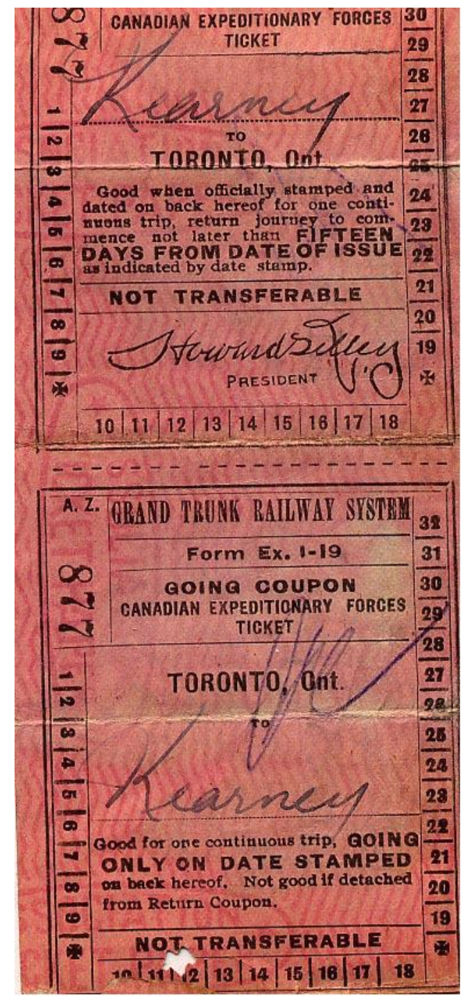
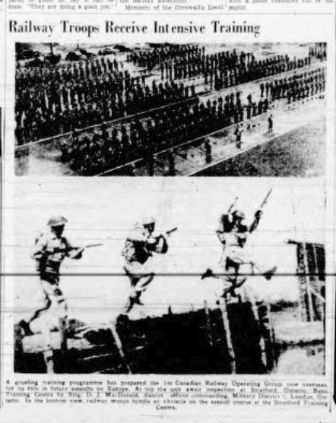
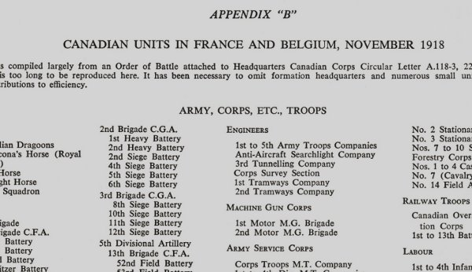
How SO? Canada During World War One
Our AUTONOMY
Had slight independence from Britain
CEF fought as Canadian Unit and trained together

Slide 7
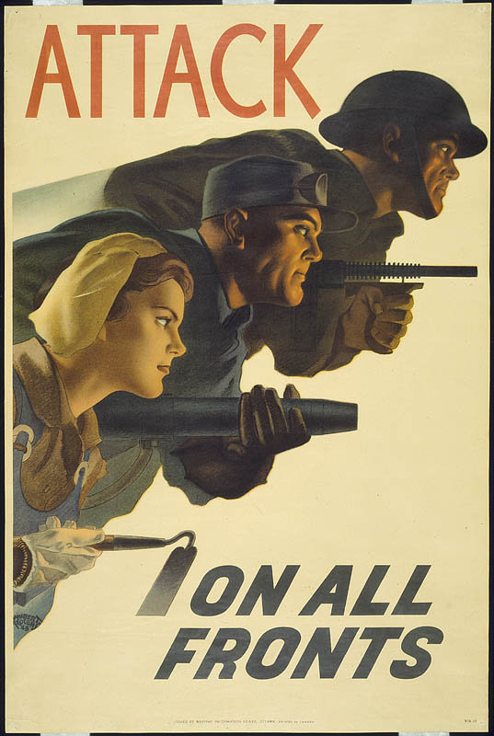
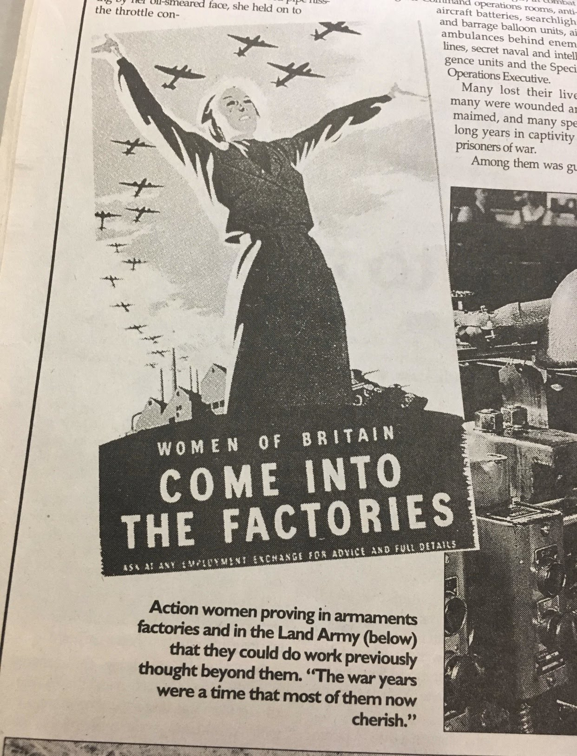
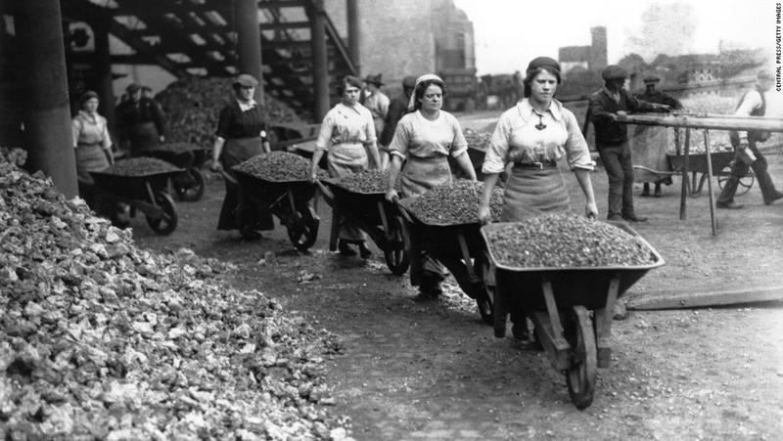
How SO? Canada During World War One
Women’s Rights
Women took over the men’s jobs
Wartime production boosted our economy

Slide 8
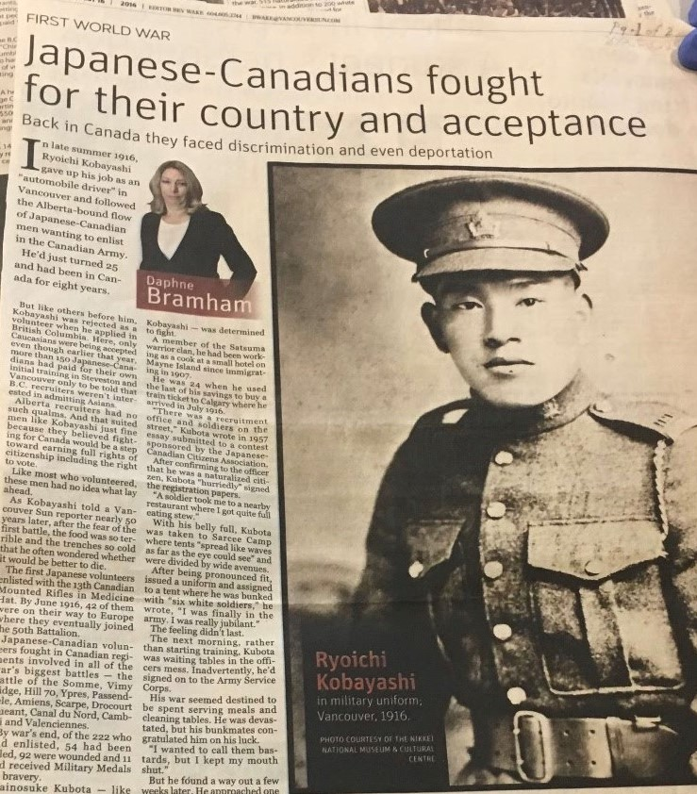
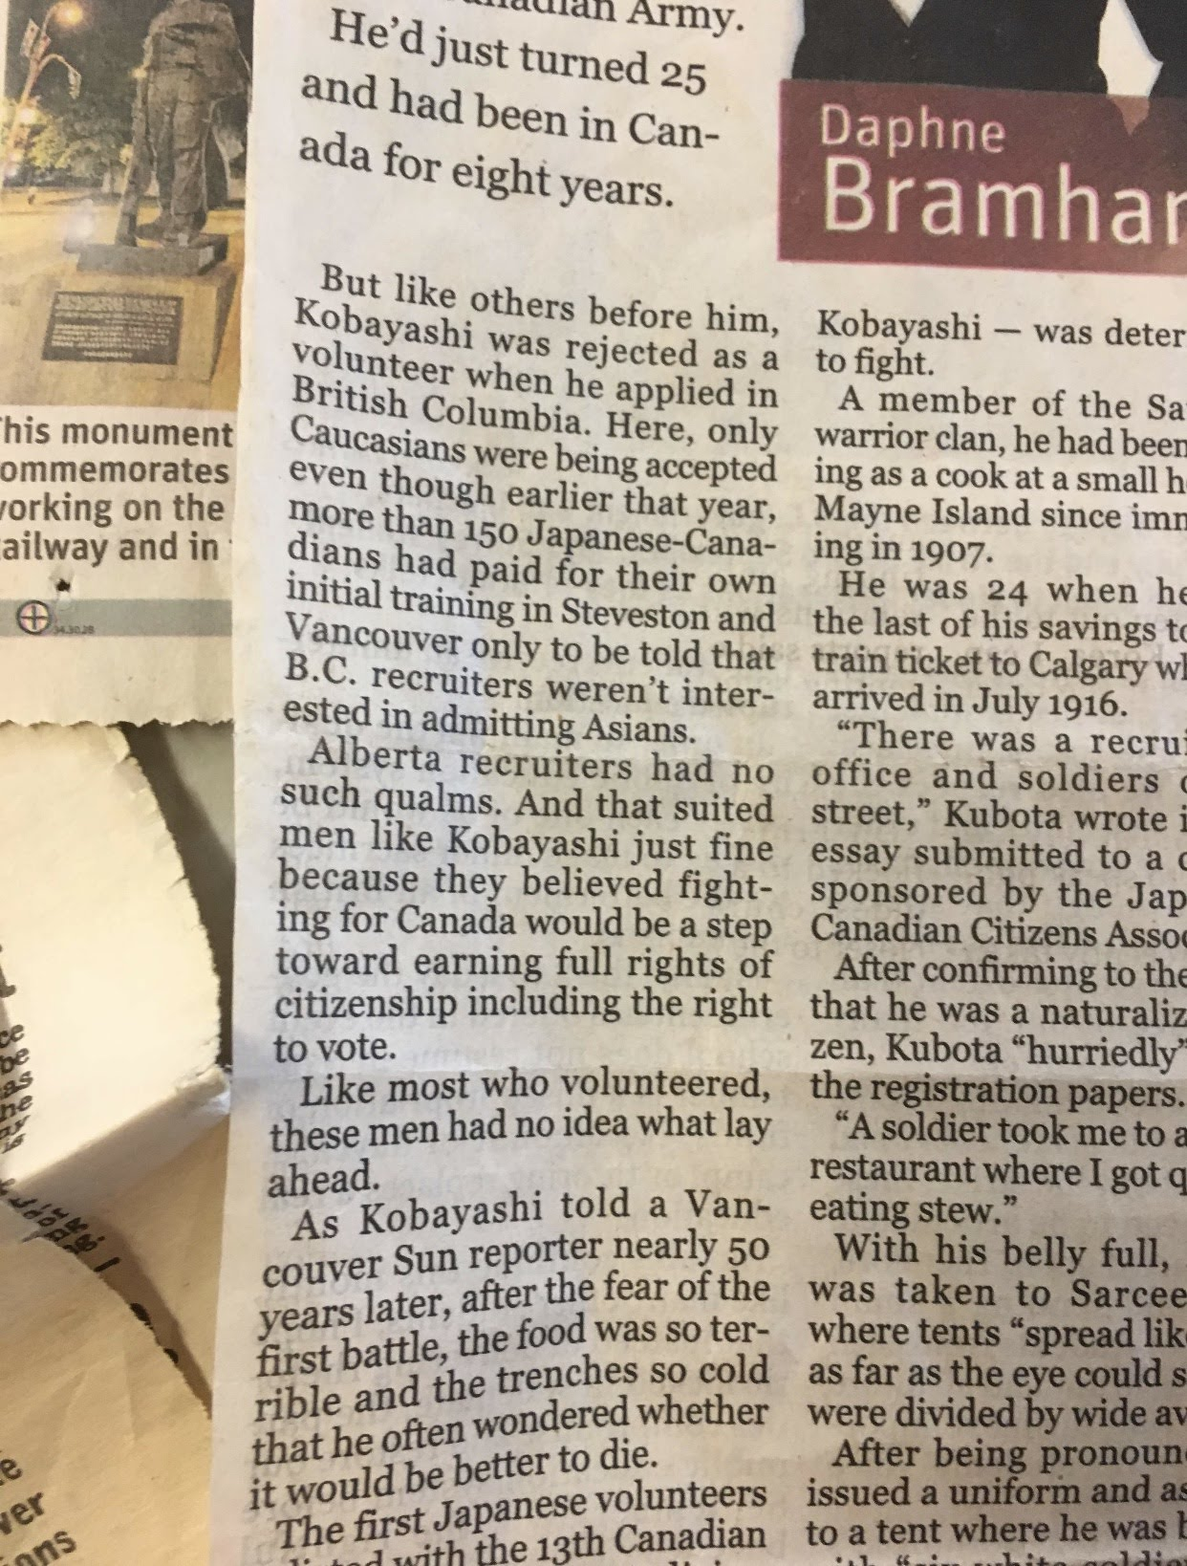
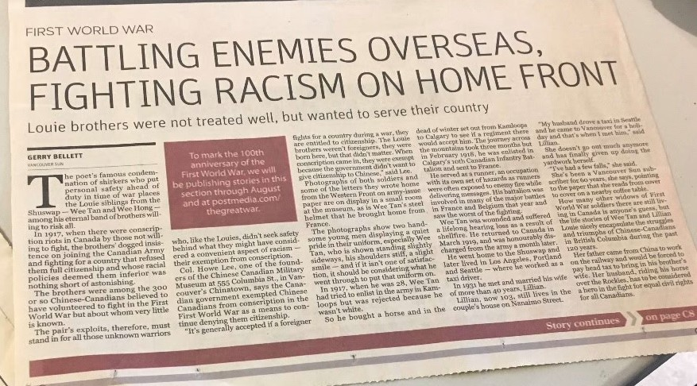
How SO? Canada During World War One
Needs of others
Minorities fought alongside Canadians in WW1

Slide 9
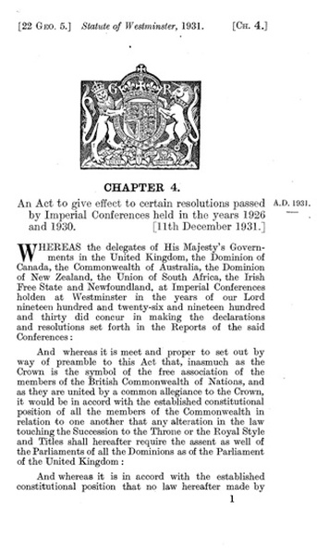
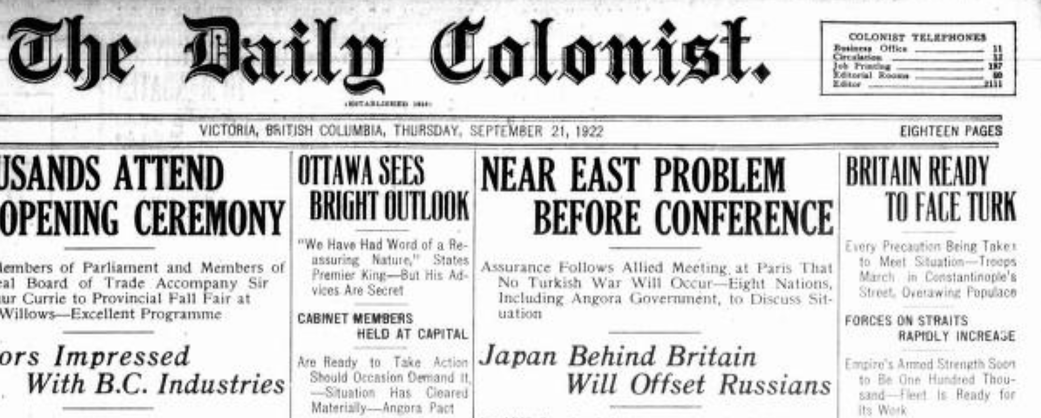
HOW SO? Canada Before World War Two
Our Autonomy
Chanak Crisis
King Byng Affair
Statue of Westminster

Slide 10
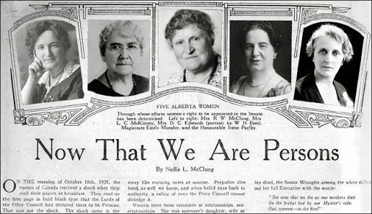
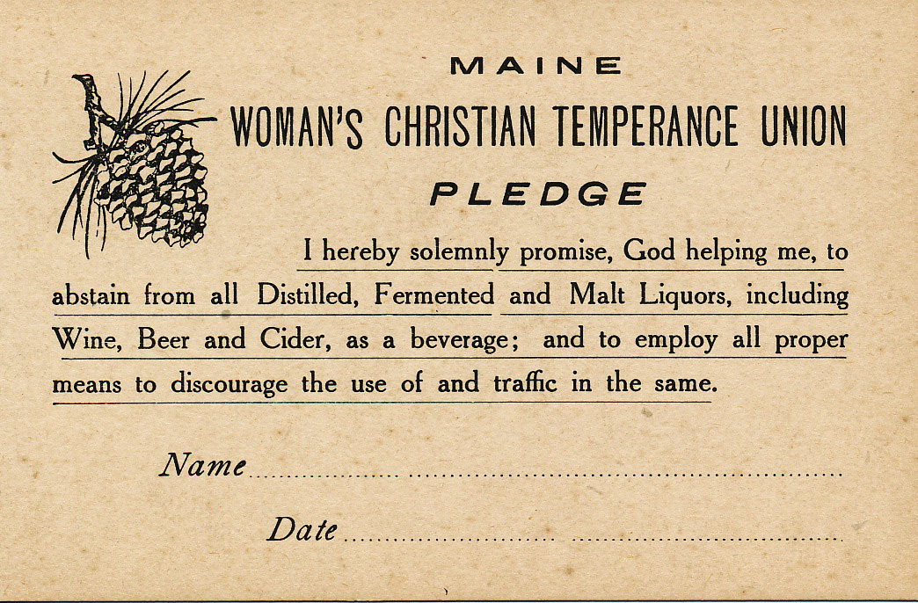
HOW SO? Canada Before World War Two
Women’s Rights
WCTU and the Famous Five created to bring awareness to Women’s Rights

Slide 11
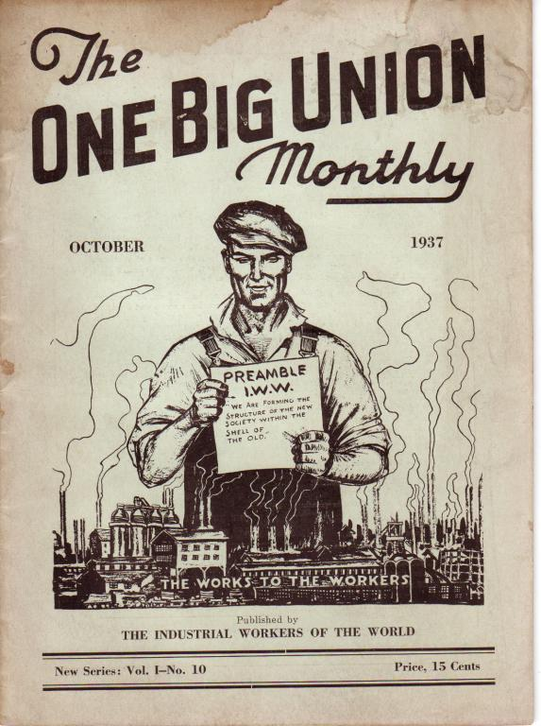
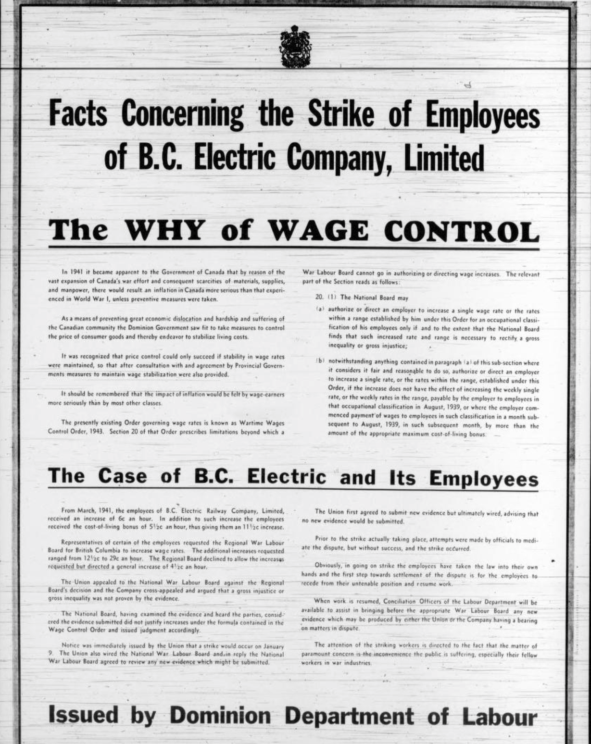
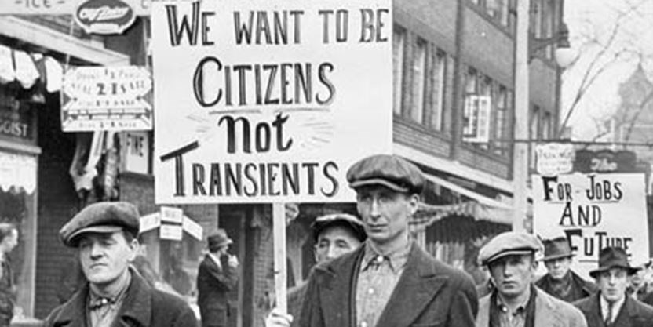
HOW SO? Canada Before World War Two
Needs of others
Discrimination is still an issue
Soldiers returned home to no pension, medical service, or jobs
Canadian workers begin to strike and the “One Big Union” is formed
Opened Canada’s eyes to workers rights

Slide 12
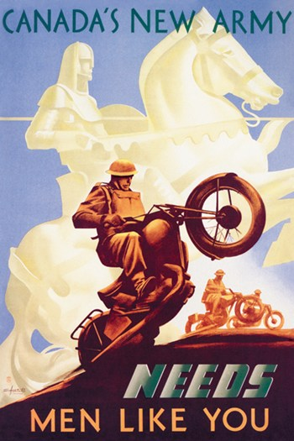
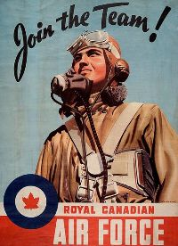
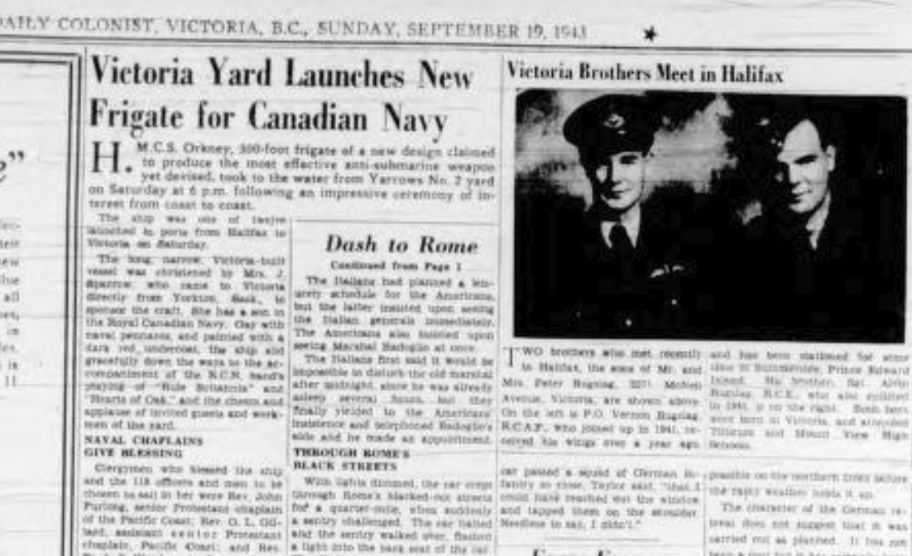
HOW SO? Canada During World War Two
Our Autonomy
Canada voted on the choice to join the War
Fought as own unit/provided own aide and production of goods and ships

Slide 13
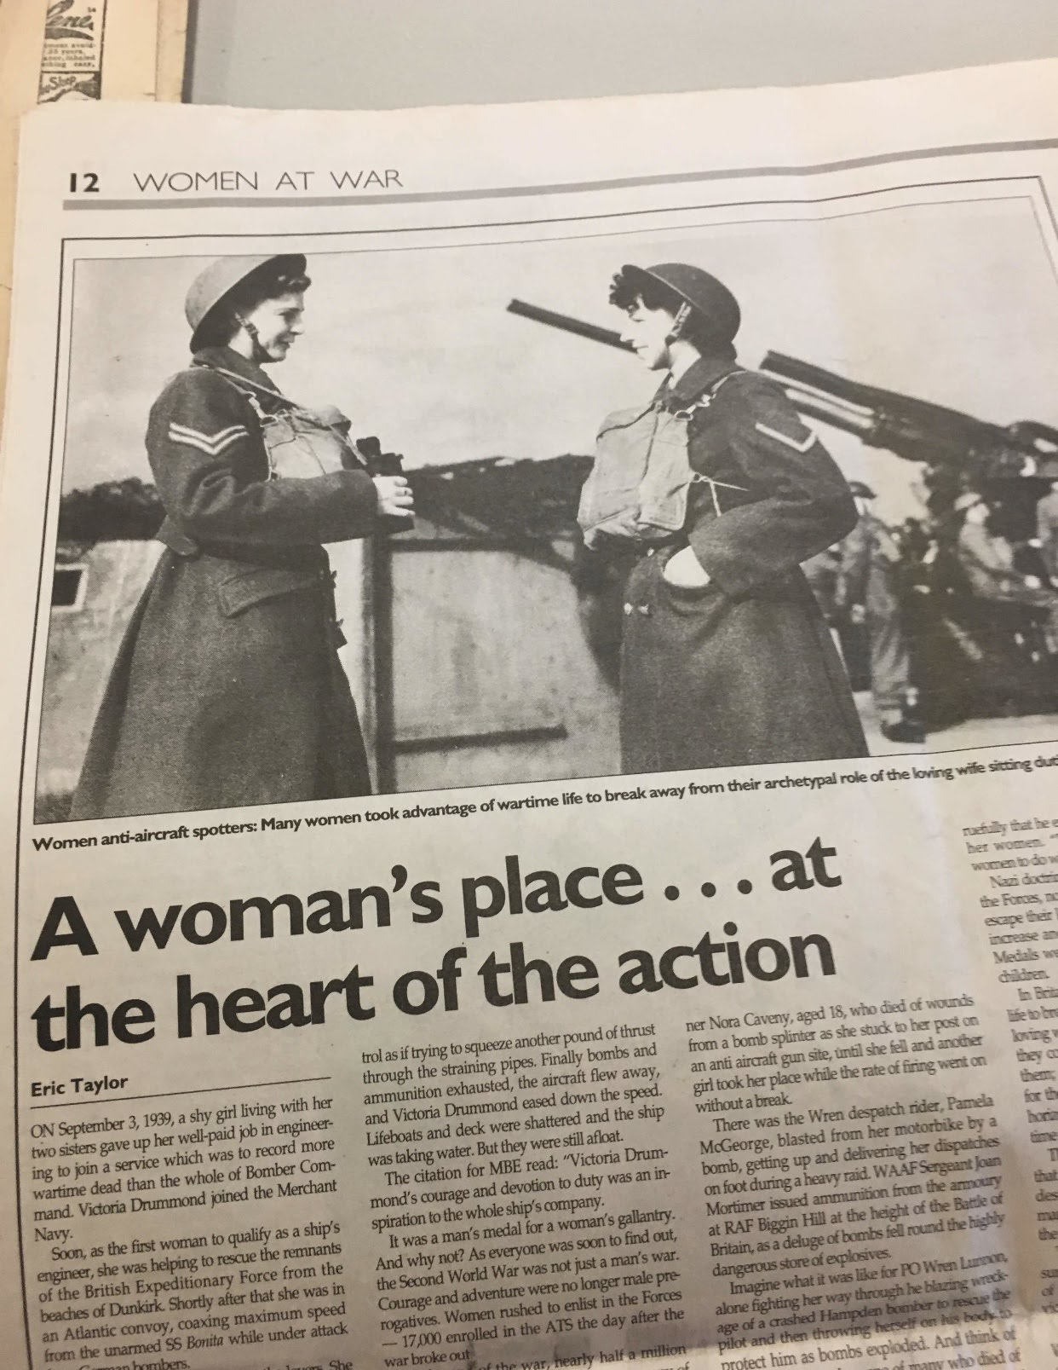
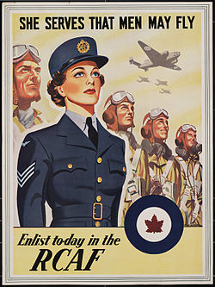
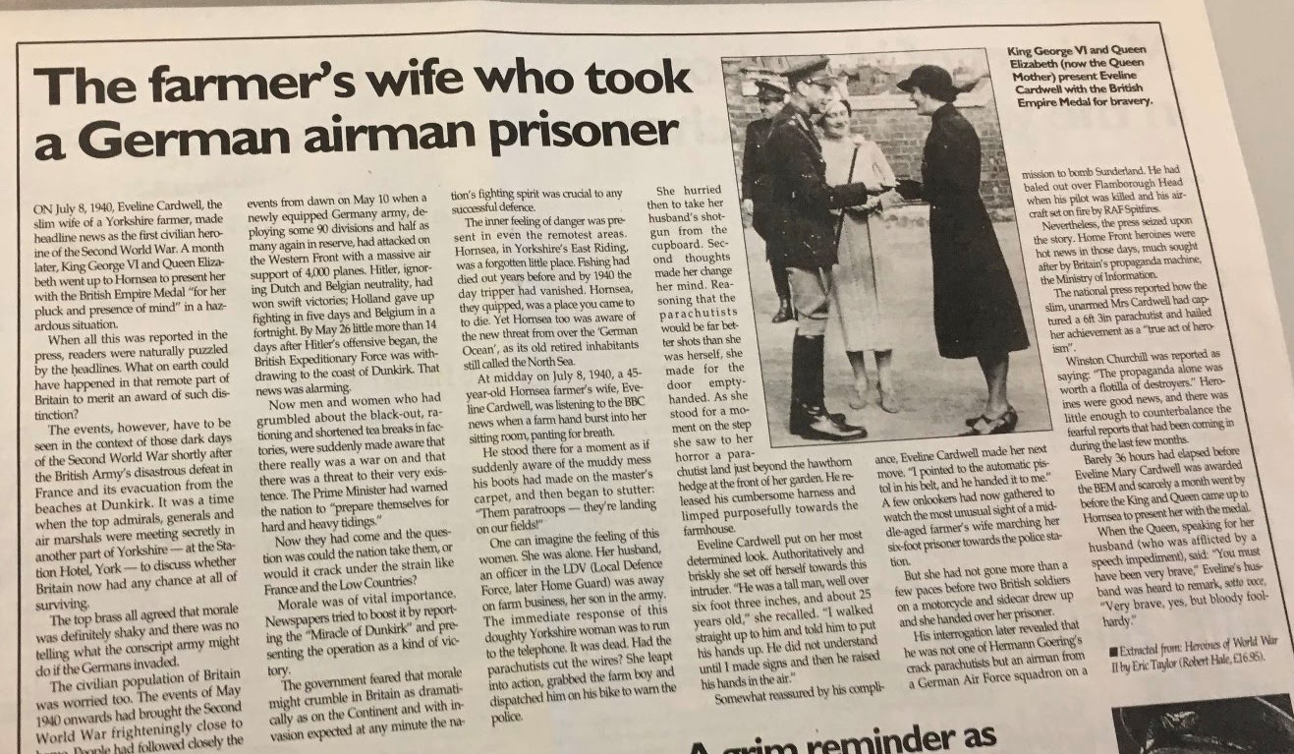
HOW SO? Canada During World War Two
Women’s Rights
Women took over men’s roles again while they were away fighting

Slide 14
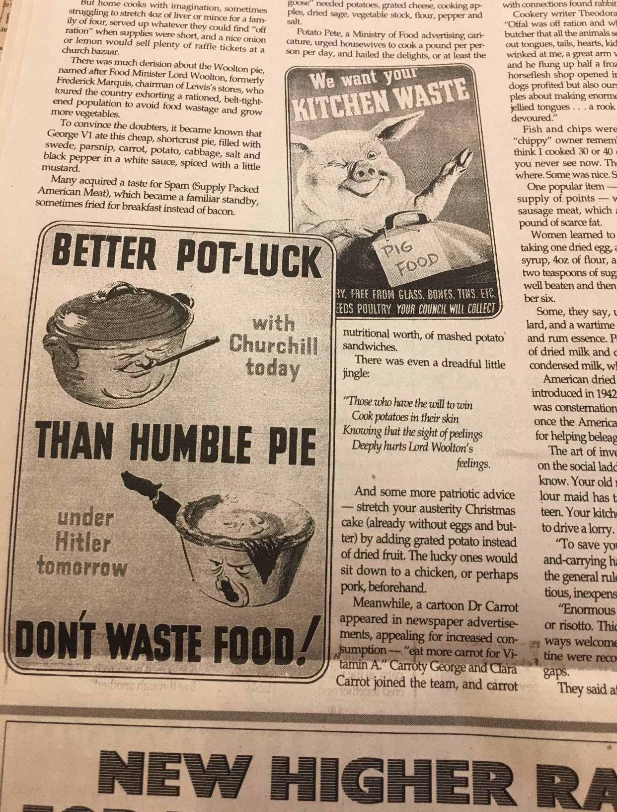
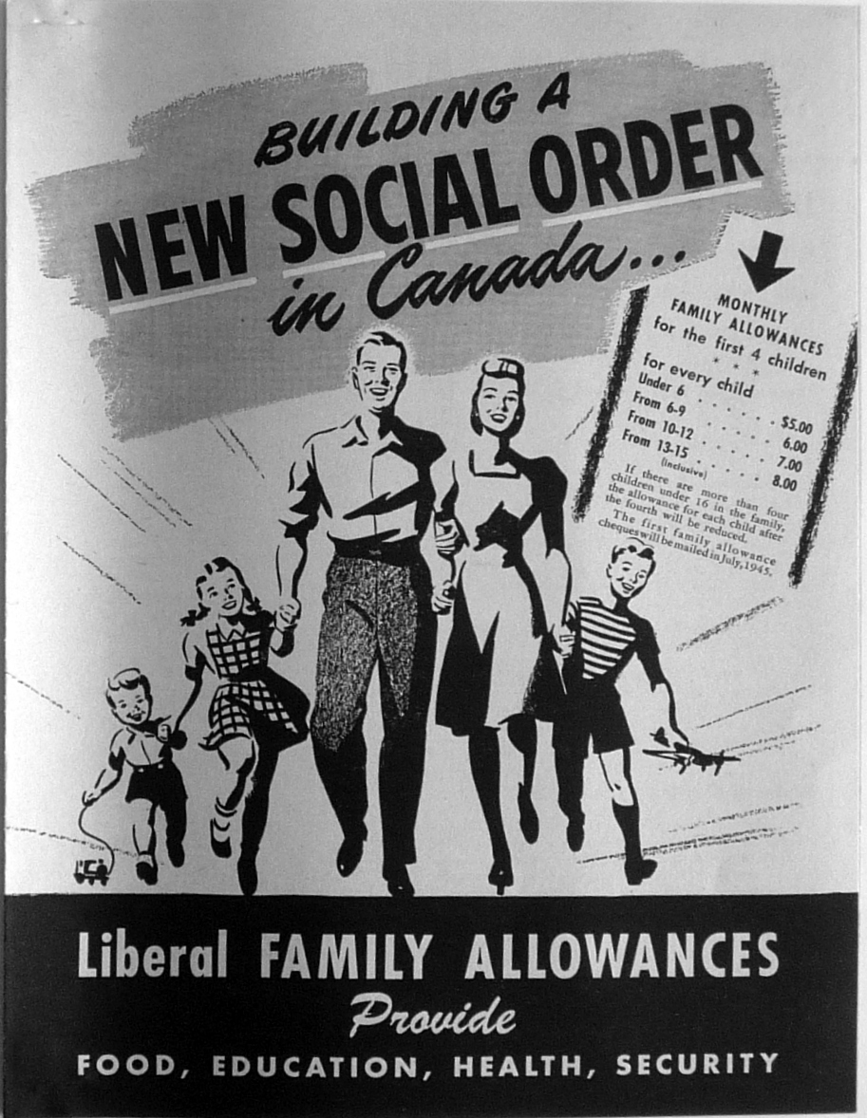
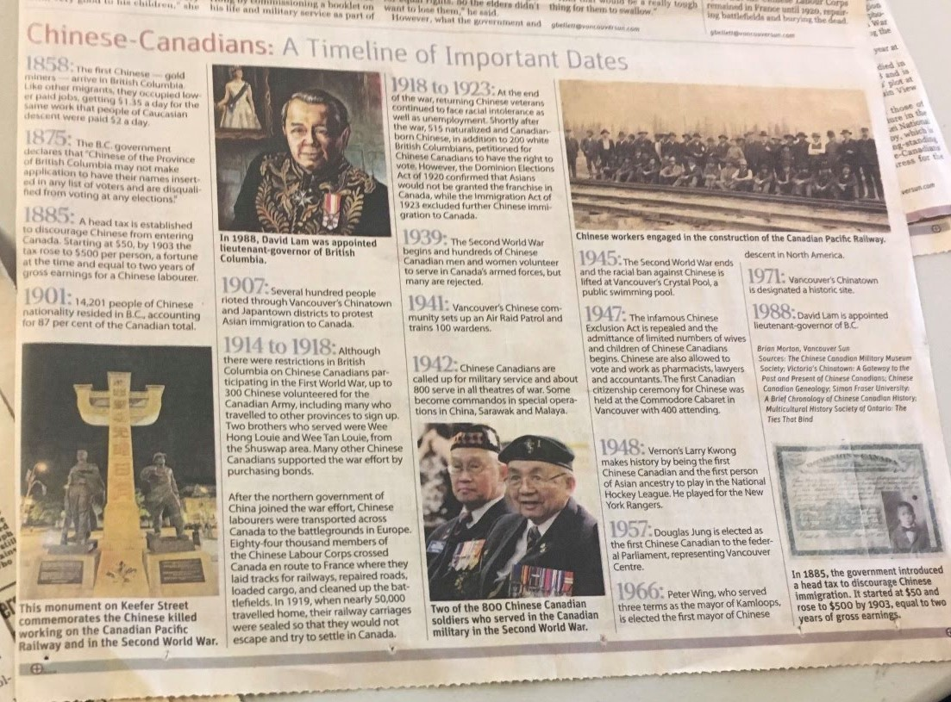
How SO? Canada During/After World War two
Needs of Others
People began to realize the importance of rationing/no waste
Importance of the minority groups in Canada (slow increase of awareness)
Family Allowance Plan/Old Age Pension

Slide 15
Conclusion Based on all of the information found through our primary sources, Yes, Canada should be thankful for the two world wars Since it helped with our autonomy, strengthened Women's Rights, and opened citizen’s eyes to the needs of others.

