Slide 1
Zeno’s Paradoxes
Inquiry Project
-Liam

Slide 2
One of the Paradoxes
In order to get from point A to point B, you need to pass a half way point, but once you pass that halfway point, there’s a halfway point between that point and point B, and once you get to that halfway point, there’s another, and so on, basically saying that you’ll never get to the end point, because there’s always another halfway point.

Slide 3
Logical?
From point A to point B, there will always only be one halfway point, which is halfway, and will remain in that same spot regardless where you are.
From the person to point B, depending where the person is, the half way mark will always change. The closer you go towards point B, the closer the halfway mark will be to point B. This would mean that you would never really hit a halfway point until you actually make it to the end point.
Technically every spot from point A to point B would be a halfway mark, depending on how you look at it at once.
Once you pass point B, that halfway point would then be behind you, it wouldn’t stop you from ever reaching point B.

Slide 4
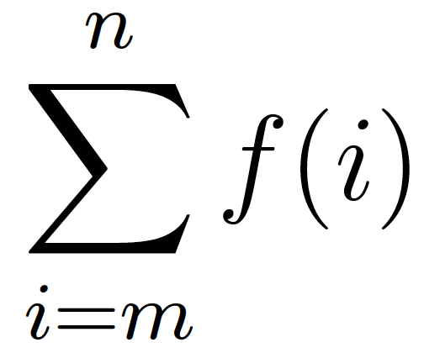
Equations – Sigma Notation
Upper Limit of the equation
Summand
Index
Lower limit of the equation

Slide 5
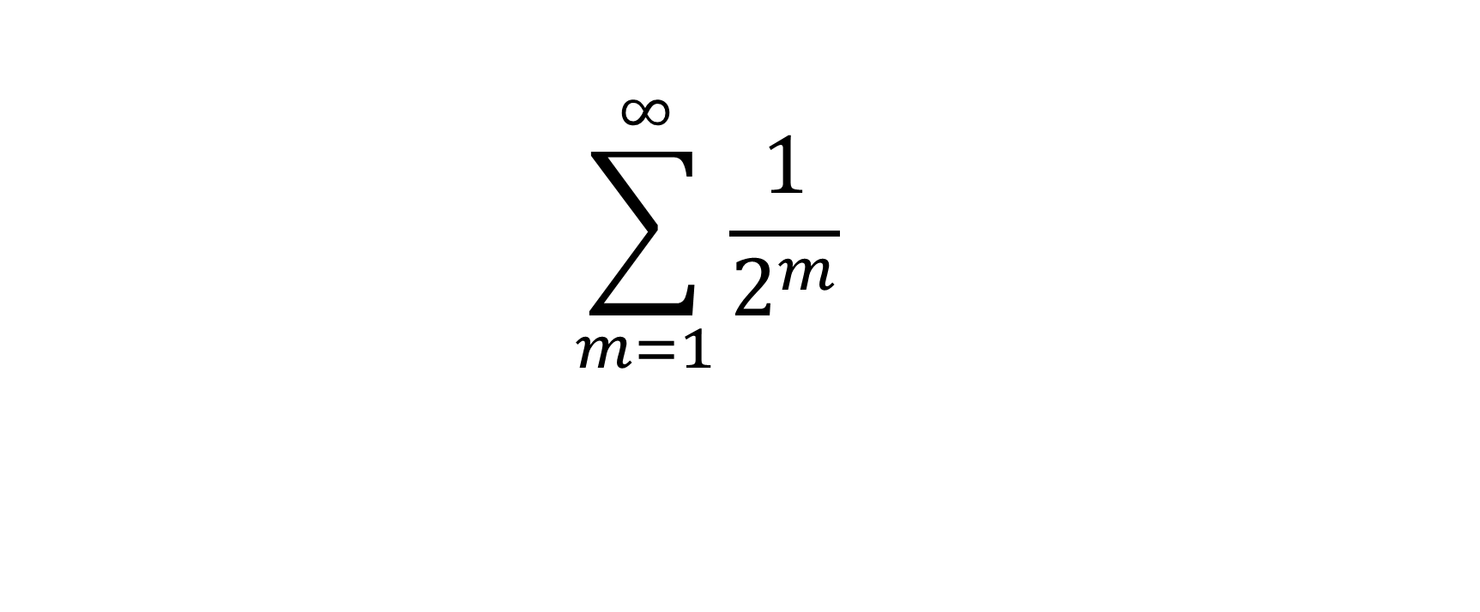
Zeno’s Paradox in an Equation
$$\sum_{m=1}^{∞}{\frac{1}{2^{m}}}$$

Slide 6
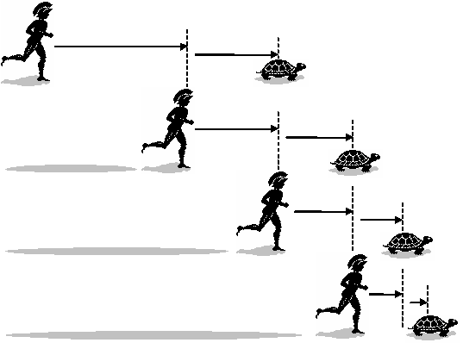
Another One of Zeno’s Paradoxes (Achilles)
Achilles is in a footrace with a tortoise, but the tortoise has been given a head-start of 100 meters. Once they start, both racers are moving at a constant speed, in which Achilles is obviously going much faster. Once he passes 100 meters, in which where the tortoise had started, but the tortoise had moved about 10 meters passed that start. Achilles then runs the 10 meters the tortoise had got to, but the tortoise once again, moved a bit farther. Every time Achilles gets to where the tortoise once was, the tortoise has always moved a bit ahead, meaning that Achilles can never pass the tortoise.

Slide 7
Plausible?
In order for the tortoise to always maintain a lead in this race, would mean for it to be faster than Achilles.
What happens when Achilles is very close behind the tortoise?
Common sense…

Slide 8
Arrow Paradox

Slide 9
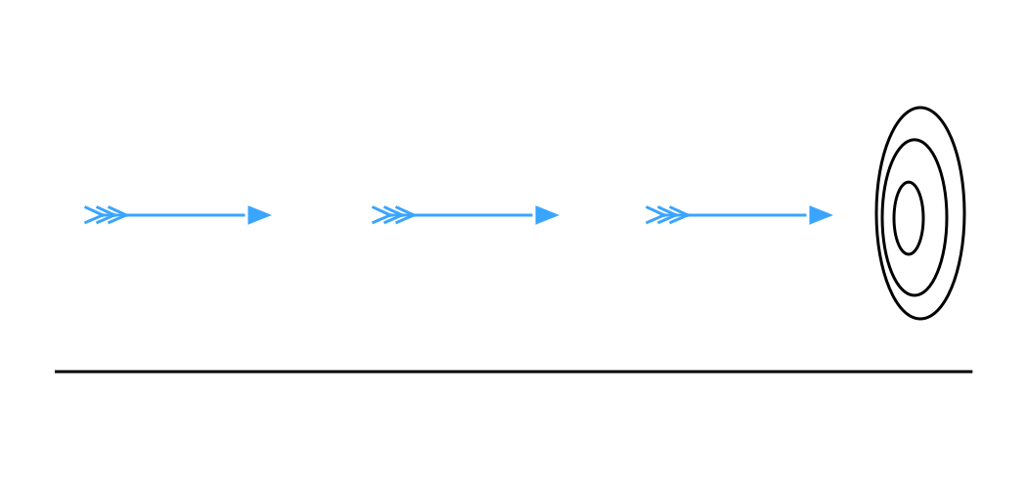
Last Paradox to Talk About (Arrow Paradox)
An arrow cannot move through the air because there is “no time” to do so, and an arrow must occupy a space equal to itself in every moment, which would be at any ‘place’ and since places do not move, nor does the arrow move.

Slide 10
Valid?
If this was the case, that means that nothing moves, including humans
Common sense, again..

Slide 11
Importance?
Zeno was attempting to prove that change and motion may not actually exist with these (and more) paradoxes by trying to find flaws in the way the real world works if there was motion.

Slide 12
Citation slide (All the websites I used)
Youtube Video “The Arrow Paradox” “What is the Answer to Zeno’s Paradox” by Brain Palmer
By Carneades.org: (Explains what the meaning behind the paradoxes might be).
https://www.youtube.com/watch?v=cw3V5BruAwI Link was too long so click this for the website
Internet Encyclopedia of Philosophy by Bradley Dowen
(Stuff on the Paradoxes themselves)
http://www.iep.utm.edu/zeno-par/#SSH3ai
Summation Notation
(Stuff on the equations)
http://www.columbia.edu/itc/sipa/math/summation.html
Sums of Infinite Series by OKJ
(Infinite Series’ that converge and diverge)
http://home.windstream.net/okrebs/page135.html

