Slide 1
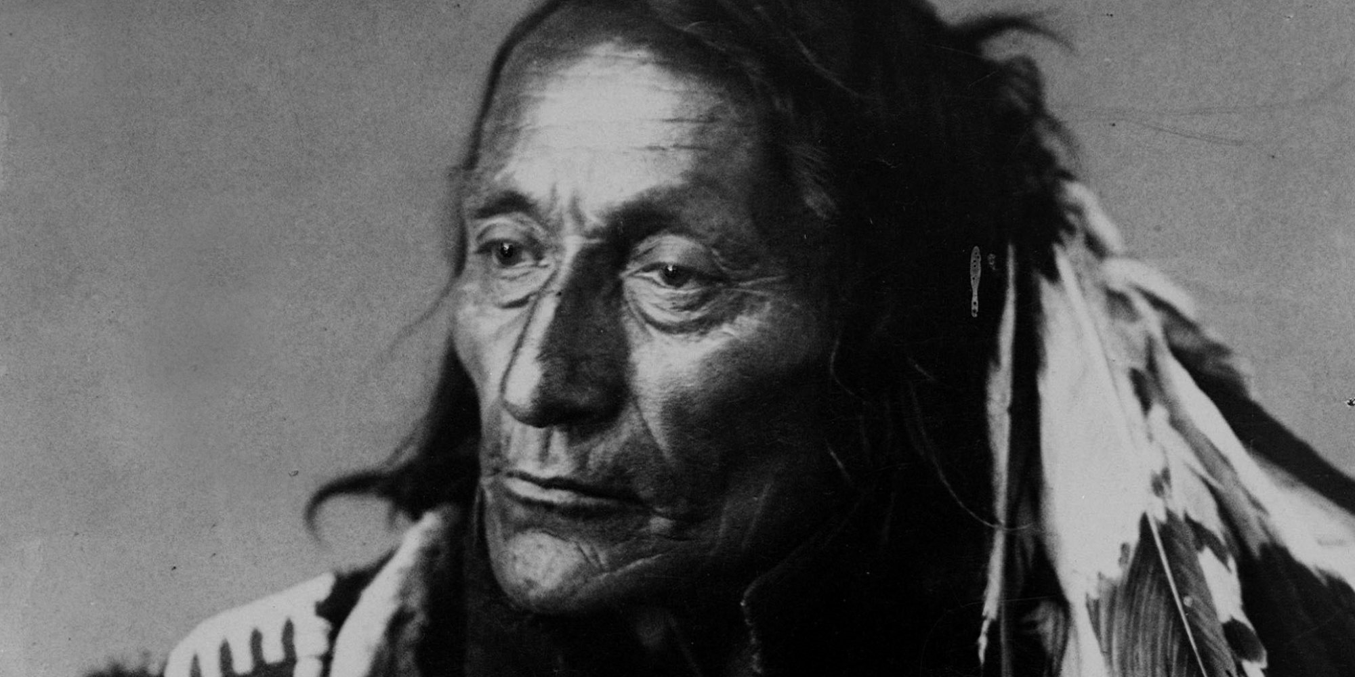
Crowfoot
By: Ken Gabales

Slide 2
Early Life
Born circa 1830 near Belly River, AB
Father killed when he was young.
Mother remarried to a Blackfoot.

Slide 3
War and Chiefdom

Slide 4
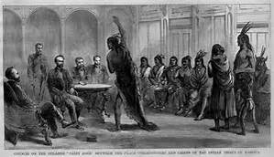

Slide 5
North-West Mounted Police (NWMP)

Slide 6
NWMP Officer James Farquharson Macleod
founded Fort Macleod
suppressed the whisky traffic
having won the confidence of the Blackfoot chiefs
negotiated Treaty 7

Slide 7
Adopted Cree Poundmaker.
A Cree Chief

Slide 9
Crowfoot in middle and Family

Slide 10
Crowfoot in his Deathbed (25 April 1890, near Blackfoot Crossing, AB).

