Slide 1
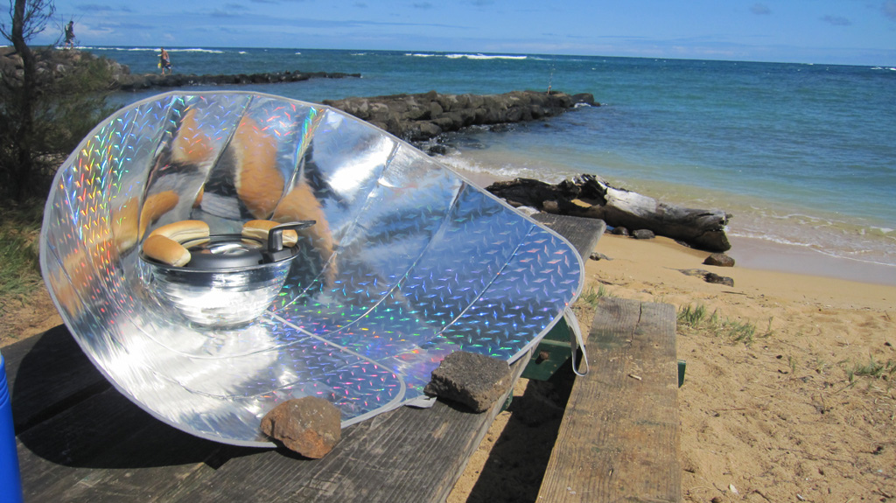
solar oven
Gary Zhao

Slide 2
Information Gathering
1. Cooking with the sun‘s power is a fun way to use a renewable resource, and with excellent results。The light rays of the light source form shadows, which can be absorbed, reflected and refracted.
2. The light rays of the light source form shadows, which can be absorbed, reflected and refracted.
3. Many organizations are introducing solar cooking to the world's less developed regions to prevent further deforestation in fuel-starved areas

Slide 3
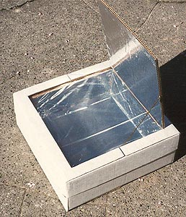
Plan
1. Take a large box and cut it in half. Put half of it on one side for the lid. The other half becomes the base
2. Fold an extra piece of paper to form a pad around the base.
3. Cut along this line, leaving four labels
4. Paste the aluminum foil into the inner and outer bottom of the liner
5. Fold the label and fold it under the flap of the inner box so that it blocks the four-angle hole
6. Now these fragments are glued to the current configuration
7. Color sheet metal (or cardboard) black and place inside the oven

Slide 4
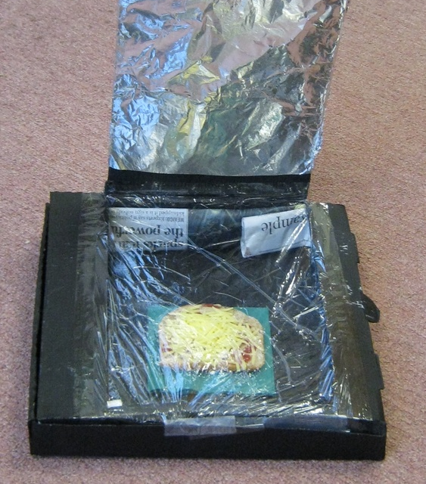
Scientific Knowledge
In this activity, we learn how to use the energy of the sun to meet our needs. Introducing the sun into solar cooking (heat) around the concept of solar energy - dark colors are used to absorb sunlight, greenhouse effects, and luminescent colors for reflection and insulation. Using this scientific knowledge, they will build and use solar ovens.

Slide 5
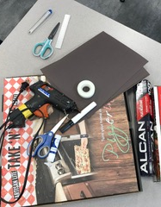
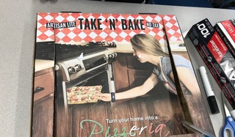
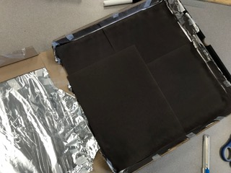
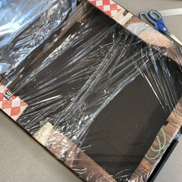
Construction-Care Taken

