Slide 1
Eddie’s Career Path
How to become a lawyer

Slide 2
My Career Goals
I want to become a lawyer by 2026
To get there, I will need to:
Graduate high school by 2019
Get into university by 2019
Go to university for 3 – 4 years studying law

Slide 3
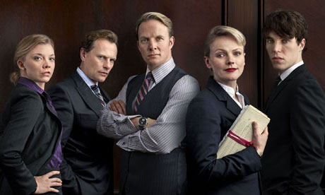
What is a lawyer?
The layer. They provide accounting and business advice to companies and individuals, Accounts make sure they can help clients figure out how certain choices will affect their taxes.
Ready to appear in court, appear in court, interview with consultant unit leadership and participate in the consultant unit

Slide 4
About my future career
This is job done in an office and court
This job's salary range is 65,000—100,000.
This job usual 9 hours a day. They are 54 hours per week. From 8:30 to 17:30.

Slide 5
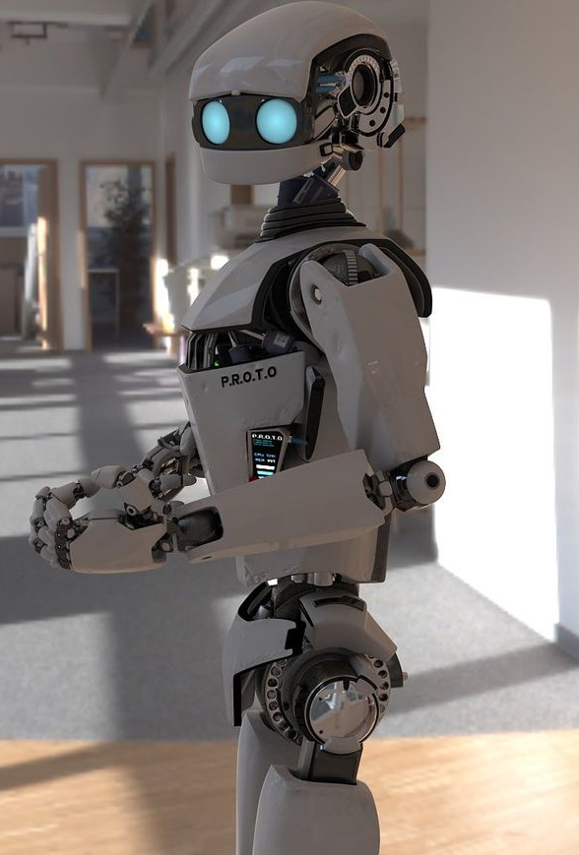
My job has a _3.5__% chance of becoming automated
Robots can replace part of the lawyer work, but can not replace all, after all related to social environment, legal environment do not allow the robots replace human work completely

Slide 6
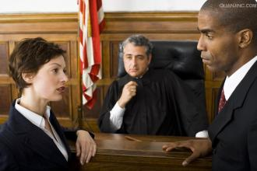
Lawyer would be great for me because…
My analysis ability and debate ability is very well

Slide 7
I am not quite ready for this career, but I will get there!
These are skills for the job I still need to learn:
Law, logical capability,
analytical ability and organizing ability
This is how I will get those necessary skills: Study law after high school

Slide 8
This is what appeals to me with this career…
I think the law is the symbol of justice and I am a fair person.

Slide 9
These are some things I find less appealing about this career…
It take a long time to analyze a law case
You need to have a good performance to be agree
Work pressure

Slide 10
Potential obstacles to getting this career
The possible obstacles:
Bad at debate
Text not fair
My plan to overcome them:
Give some idea to my friends
Do more exercises

Slide 11
Potential obstacles to being successful within this career
The possible obstacles:
Work pressure
Sales are not good
My plan to overcome them:
Do something my like at break time and weekends.
I will reflect on myself and improve myself

Slide 12
The training/education required for my career is:
I will learn law in university.

Slide 13
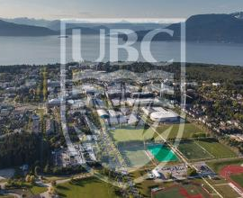
University of British Columbia

Slide 14
I intend to go to University of British Columbia for that career
2329 West Mall, Vancouver, BC V6T 1Z4
Law
Certification earned diploma
4 years

Slide 15
Here is where I can get that:
High school graduation, LPI level 5, the average score of 80% or more
English math science physics

Slide 16
Financial Plan
I am going to pay for my program:
I will get a job to pay
I want to get a storefront employee

Slide 17
High school courses required
Grade 11 courses:
Sociology
Grade 12 courses: English 12 math 12

Slide 18
Lawyer are awesome!!!
I like about I will get some strange law case, Every legal debate will make me progress and I can make friends

