Slide 1
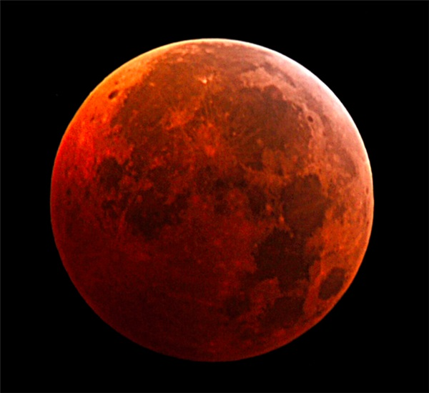
Elon Musk wants to send people to mars
Connor Gaucher

Slide 2
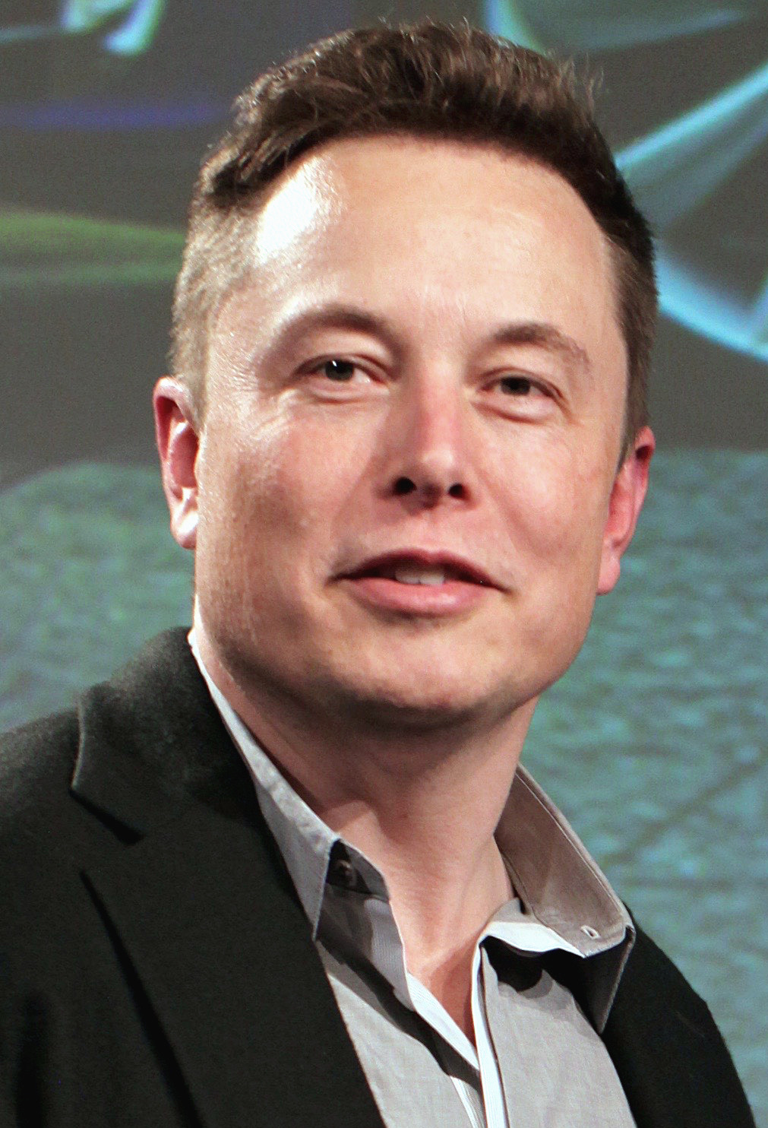
Elon Musk
Born June 28, 1971
co founder of tesla
SpaceX

Slide 3
He wants to send people to mars Below is a prototype of a colony on mars

Slide 4
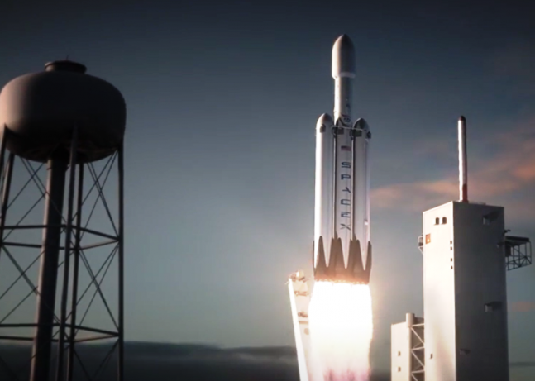
Why he wants to send people to mars
People really want to go
Climate issues
Abandoning earth
Co2 greenhousing

Slide 5
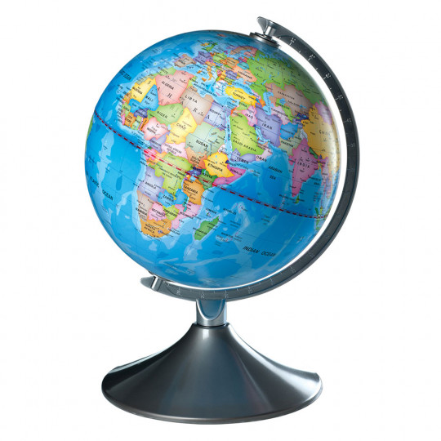
Where will this take place?
Their headquarters are in Hawthorne, California, USA but they will launch rockets at NASA in Florida.

Slide 6
When will he send people to mars?
He would like to send people to mars within a decade, if everything goes to plan however he will have to find people willing to go to mars.

Slide 7
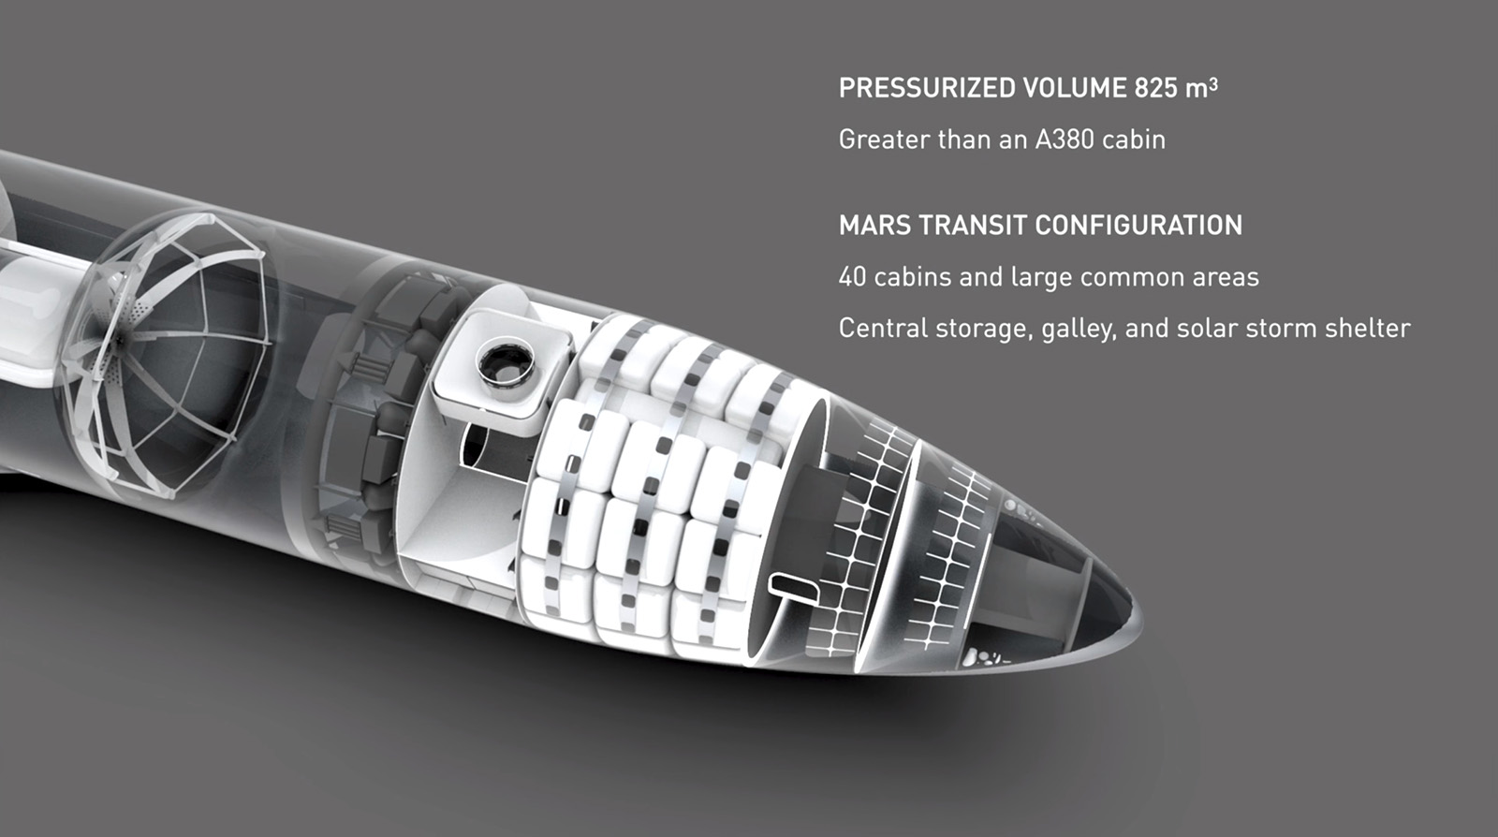
How will he send people to mars
There is a video of a spaceship and a rocket in space which would separate in orbit, making the booster go back to earth relaunch and refuel the spaceship to go to mars
However he will need a magnetosphere to outweigh the solar winds

Slide 8
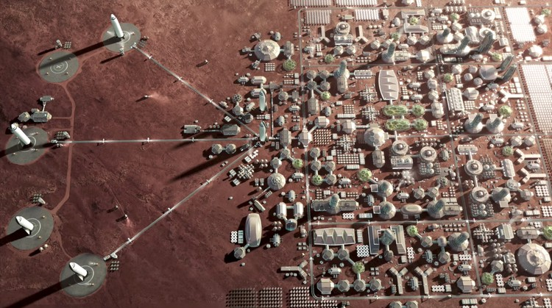
What will people live in on mars?
They will live in small houses and will have struggling living conditions because Mars is not habitable

Slide 9
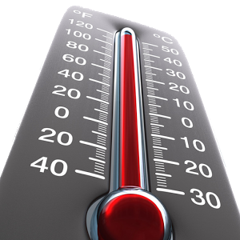
What is the temperature and the ground like on mars?
Differing in values have been reported for the average temperature on Mars, with a common value being −55 °C (218 K; −67 °F). Surface temperatures may reach a high of about 20 °C (293 K; 68 °F) at noon, at the equator, and a low of about −153 °C(120 K; −243 °F) at the poles.

Slide 10
How long will it take to get to mars?
300 days
Need a lot of food and water there and at mars.
Need to carry the supplies over in the ship for the voyage and to survive when they get there.
They need to carry fuel to get up again.

Slide 11
Typical day and year in mars

Slide 12
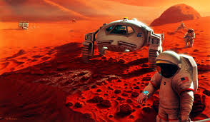
Other problems
Windstorms
Oxygen
Water
Food
Solar winds
Its more susceptible to meteorites

Slide 13
Conclusion
Many people think Elon Musk won’t be able to do it and he is spending money on something impossible.
However, Elon Musk has done a lot of things. He is a self made millionaire as he co-founded X.com, Open AI, Solarcity, Powerwall, Hyperloop, SpaceX, and Tesla Motors.
He is a genius and he has succeeded in everything he’s done so far.
Who ever thought he could do this down below?
https://www.youtube.com/watch?v=Tj0gbu1Zc6U

