Slide 1
Digital Footprints
By Alyson Young

Slide 2
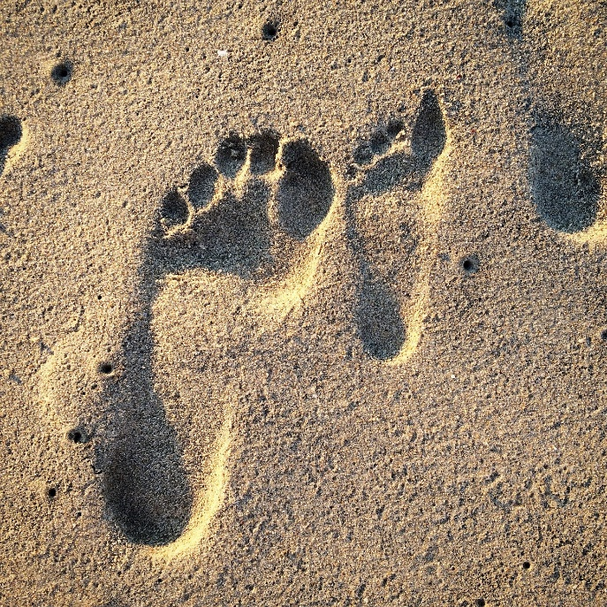
What is a digital footprint?
A digital footprint is information on who you are that was put online.
Digital footprints are started before you are born.
Ultrasounds, shared pictures, bracelet numbers etc.
Social media plays a big role in your digital footprint as well.

Slide 3
Why are digital footprints important?
Everything you do online is recorded somewhere.
Even if it’s in an incognito tab or on private, somewhere it can be found.
Information regarding your digital footprint can be viewed by others.

Slide 4
How could it effect the future?
If future employers wish to learn more about you, they need only to google your name.
From there they will be able to see your digital footprint.
People you could potentially be in relationships with can find out what kind of person you are by looking online.

Slide 5
How to keep our digital footprint safe
Think before you post
Don’t do anything you could regret later
Post only things you wouldn't mind the entire world seeing
Is it appropriate?
Is it absolutely necessary?
What would your parents think?
Why do you need to post this?

Slide 6
What have I learned?
To be conscious of what I put on the internet
I have learned that what I do on the internet stays on the internet
Your digital footprint will follow you your entire life and even beyond that.

Slide 7
Thank you! All photos credited to www.istockphoto.com

