Slide 1
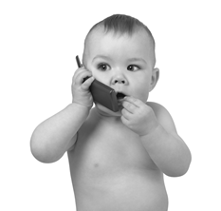
Developing Communication Skills

Slide 2
One of the major tasks for infants is to learn to communicate effectively with others.
This skill depends on development in all areas physical, social, emotional, and intellectual.
There are wide differences in the rate of development from baby to baby.
A normal baby should show steady development in communication skills.

Slide 3
Communicating Without Words
1. Crying
First means of communication
Cry Patterns - cries, stops, waits for response, cries again
Different cries for different needs
2. Sounds
Practices making special sounds
Babbles, grunts, shrieks, giggles
3. Gestures
Wiggle, cling, push away

Slide 4
Learning to Speak
First needs to learn to associate meanings to sounds/words
Encourage by:
Using simple words (minimize baby talk)
Speak to baby to develop listening skills
Respond and imitate baby’s sounds
First words spoken between 8-15 months
Common first words are dada, mama, bye-bye

