Slide 1
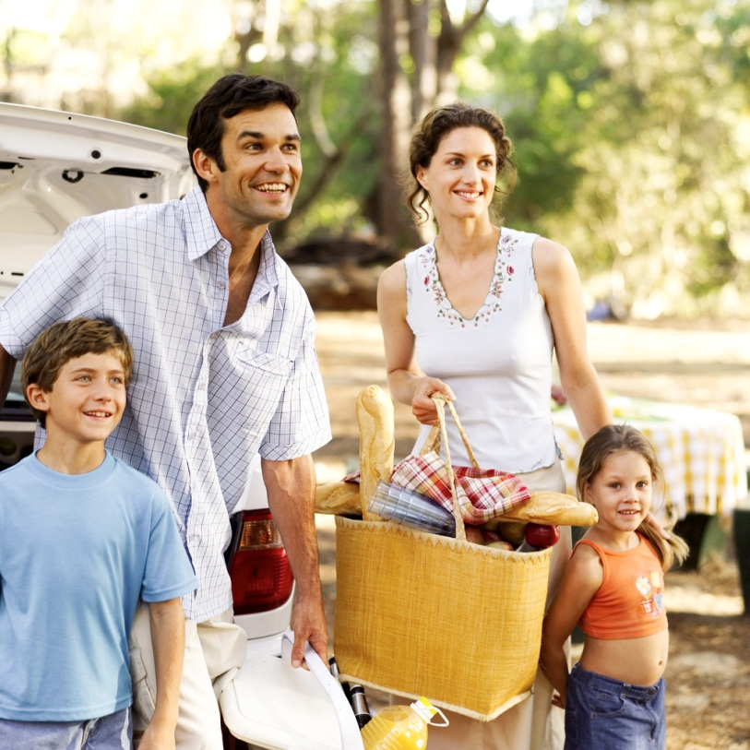
THE THINGS FAMILIES DO

Slide 2
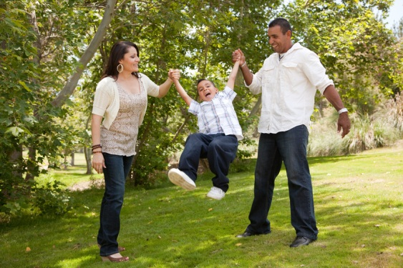
Families and their members generate a lot of activity. They serve one another and themselves. They earn, purchase, and consume. They save and spend, care and nurture, borrow, share and give.
Here are some glimpses of family members as they fulfill some of the basic functions of families…

Slide 3
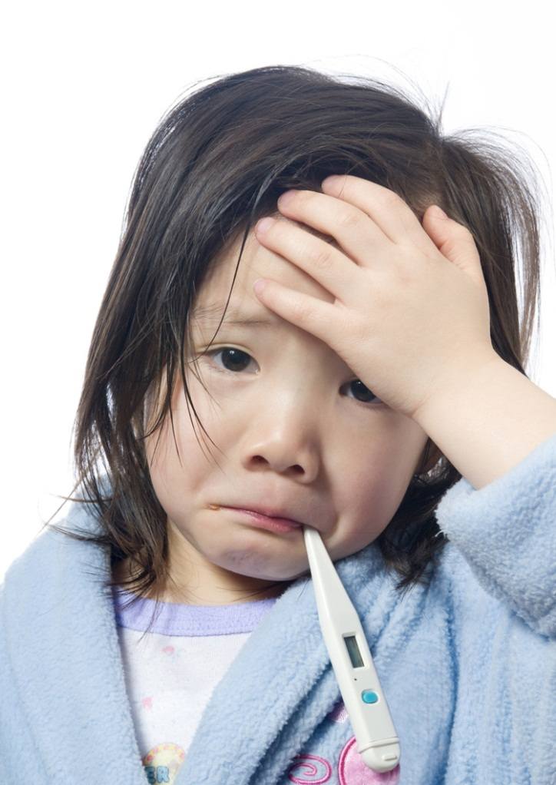
Two tired parents spending a sleepless night with a sick baby who can’t quite fall asleep.

Slide 4
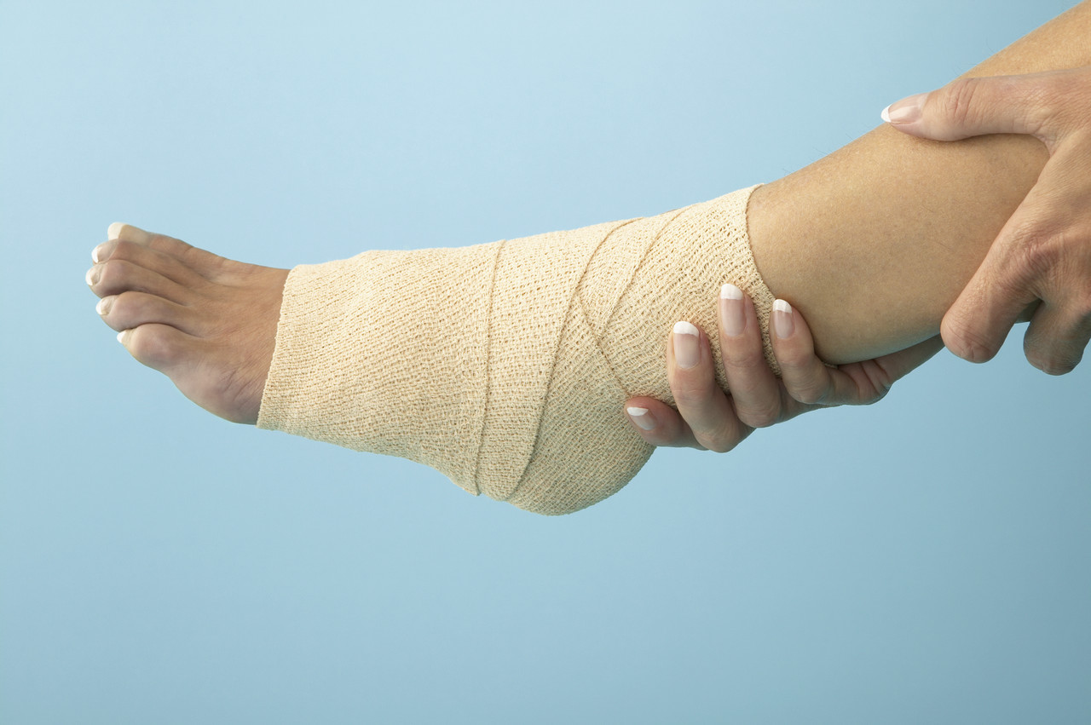
A teenage boy going to the store for Uncle Arnold, who fell off the porch and sprained his ankle.

Slide 5
A young father learning to iron shirts properly and clean behind toilets.

Slide 6
Nervous, expectant parents attending prenatal classes.

Slide 7
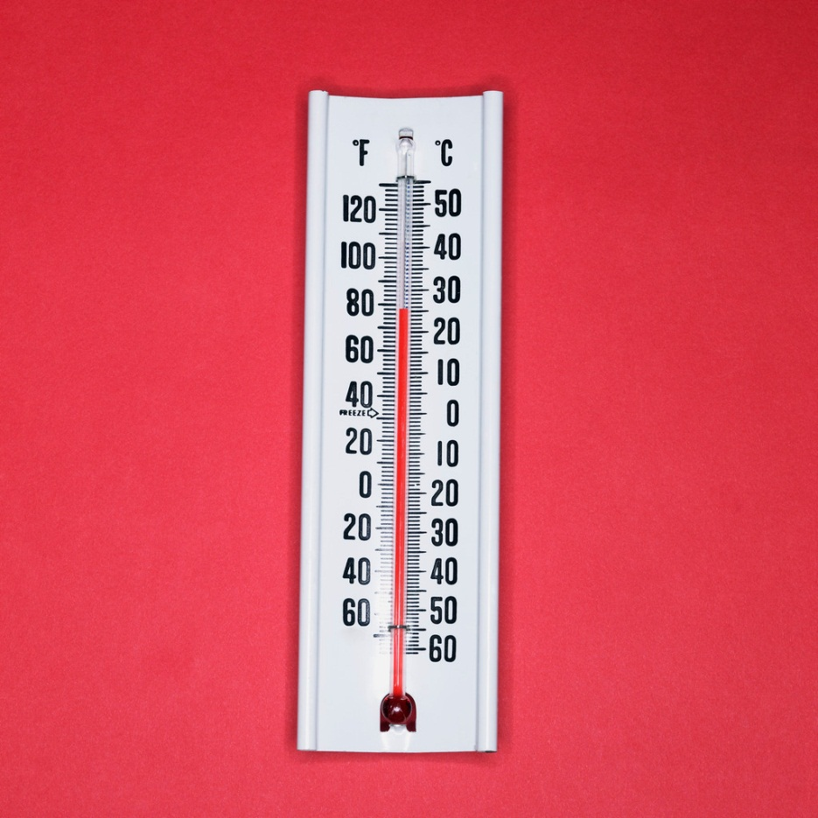
Couples with problems getting pregnant mastering the ability to take and track their daily temperature.

Slide 8
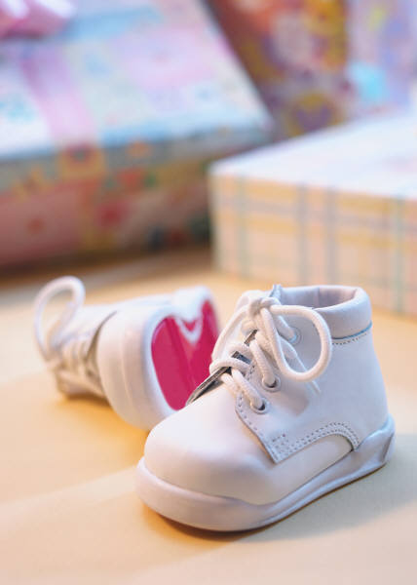
A childless couple waiting for the arrival of an adoptive infant.

Slide 9
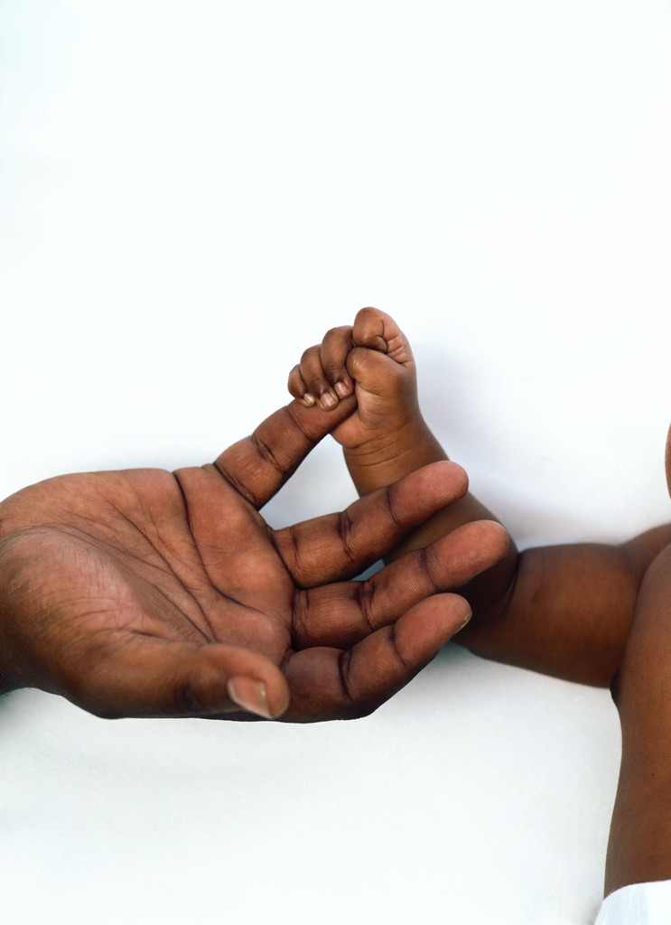
A couple adopting a special needs child.

Slide 10
Two parents puzzling over the latest math technique with their ten-year-old.

Slide 11
A father and mother taking turns getting up at 5am to take their son to hockey practice.

Slide 12
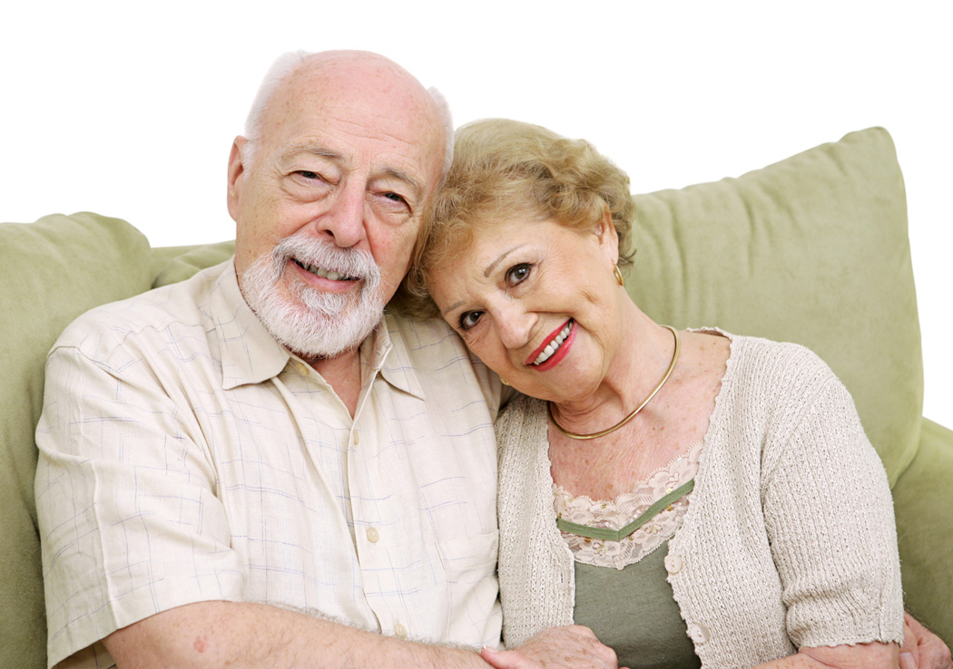
A 14-year-old going with his folks to visit his grandparents on Sunday when he’d really rather be skateboarding.

Slide 13
A young girl apologizing – under parental orders – to the neighbours who’s window she broke.

Slide 14
A teenager bringing her boyfriend home to meet her parents for the first time.

Slide 15
Three adult siblings worrying over coffee about the woman their elderly father plans to marry.

Slide 16
A young father missing his children while at work.

Slide 17
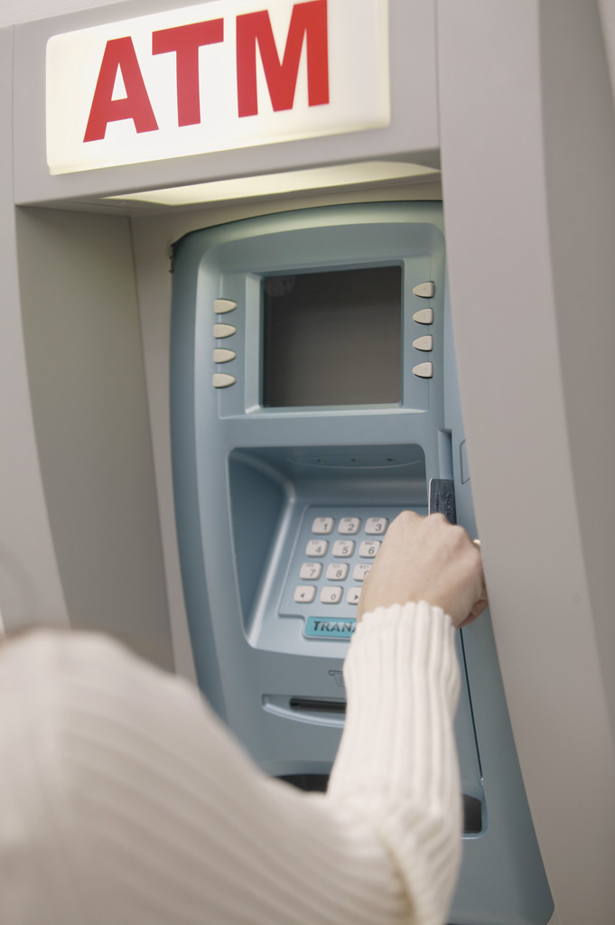
A 45-year-old single mother working as a teller at the local bank.

Slide 18
A family of five with arms full of groceries, forgetting where their car is parked.

Slide 19
An elderly couple welcoming the working mother who is delivering their meals-on-wheels.

Slide 20
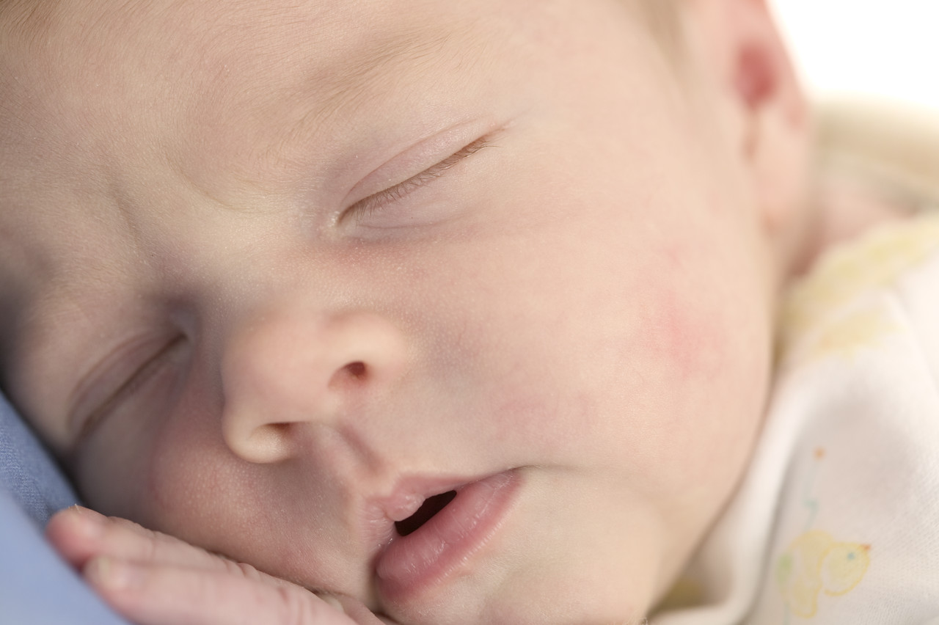
Two new parents spending an entire day gazing at their newborn and ignoring all phone calls.

Slide 21
A young parent making sure that every day, they spend one-on-one time with their child to let them know they are loved.

Slide 22
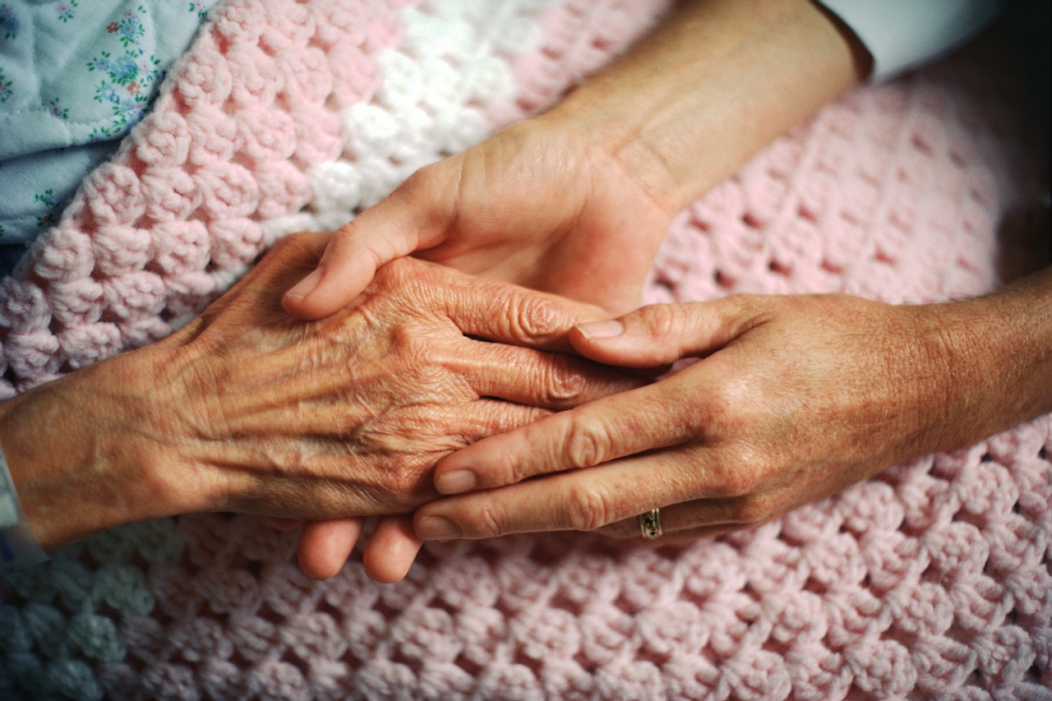
A woman calling in sick to work so she can spend the day with her dying mother.

