Slide 1
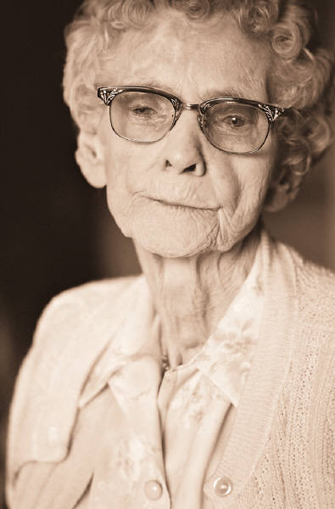
STEREOTYPES & the elderly

Slide 2
Attitudes Towards Aging
All around you are signs that today’s emphasis is on youth. Products that hide the gray, reduce wrinkles, and cover age spots all point to a preoccupation with staying young. Youth is desirable; old age is not.
Although progress is being made against this attitude, some people are still prejudiced against older adults. They feel that older people cannot be as alert, intelligent, and capable as younger people. This bias is called ageism. Like all prejudices, it is unfair. It views all people as alike, instead of as distinct, unique individuals. Ageism prevents older adults from living their lives to the fullest. It also denies others the opportunity to benefit from their talents and experience.

Slide 3
RECOGNIZING STEREOTYPES
ROBB: “After old Mr. Applegate moved into the Fraser house down the street, my friends and I knew after one look at him that he would be a grouch, and we were right. The first time he saw us skateboarding down his driveway, he started yelling out the window at us. No one likes him. He got mad at my friend Carl, who delivers the paper, too. The paper missed the porch a few times, and you think old Applegate could walk down three steps to pick it up? No way! Looks to me like he could use the exercise.”

Slide 4
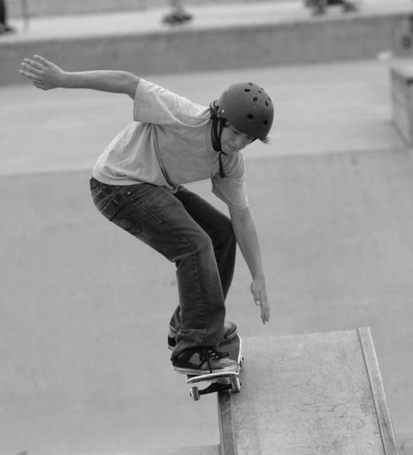
Can you recognize the stereotypes?
When you recognized stereotypes, you are aware that a common belief about a group of people or things may not be true.
Does Robb have a stereotypical idea about Mr. Applegate? What is it?
Did Robb form his opinion before or after anything happened?
Is Robb’s opinion accurate? Explain
What can a person do to avoid believing stereotypical ideas?

Slide 5
The other side of the story…
MR. APPLEGATE: “Moving into the Fraser house hasn’t been easy for me. I left my friends in the town where my wife and I lived. Living here I could be closer to my daughter, who can help me since my wife is gone now. I don’t get around very well anymore because of my arthritis. I don’t know people in the neighbourhood, because I can’t get out much. The kids in the neighbourhood try to ride their skateboards on my driveway, but I can’t have them getting hurt on my property. In my old neighbourhood the kids used to come by and sit and talk to me. I miss that.”

Slide 6
What could Robb and Mr. Applegate each do to improve this situation?

Slide 7
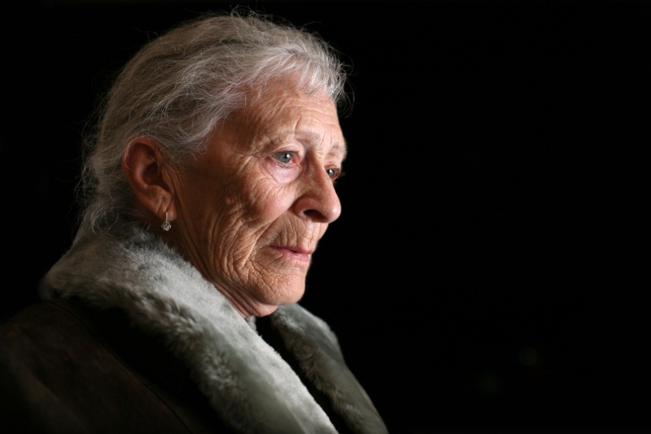
Negative Stereotypes
If you don’t know older adults very well, you might find it easy to believe many stereotypes about them. Most stereotypes about older adults are negative.
As a group, list as many as you can think of. Be prepared to share with the class

Slide 8
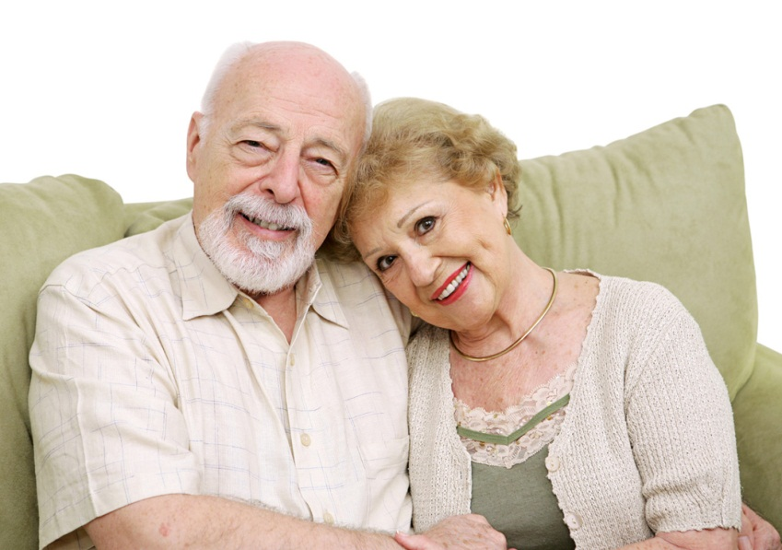
Positive Stereotypes
Some stereotypes, on the other hand, are more positive.
As a group, list as many as you can think of. Be prepared to share with the class

Slide 9
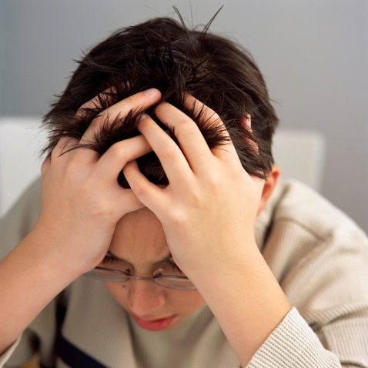
More stereotyping…
Older people may or may not have any of the qualities that are listed as stereotypes.
What are some negative stereotypes regarding teenagers?
Are these true of you? Your friends? While you or your friends may exhibit one or two of these qualities, it is doubtful that all that you listed are true.

Slide 10
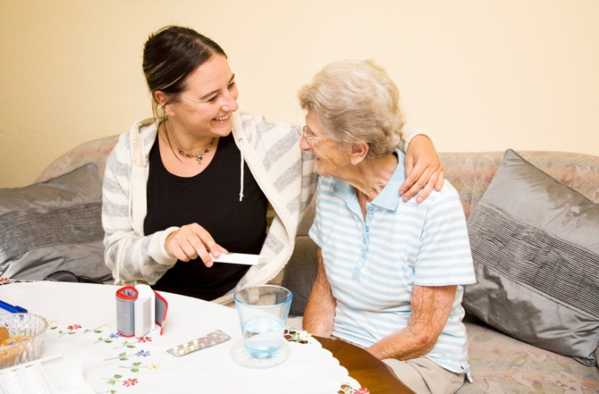
Beyond Stereotypes
In general, members of society are grouped by age. Most people spend the majority of their time with those in their age group. As a result, many young people have not had much contact with people over age sixty-five.
Is this true for you?

Slide 11
Stereotypes never tell the whole story.
Older adults are not all the same, just as teens are not all the same.

Slide 12
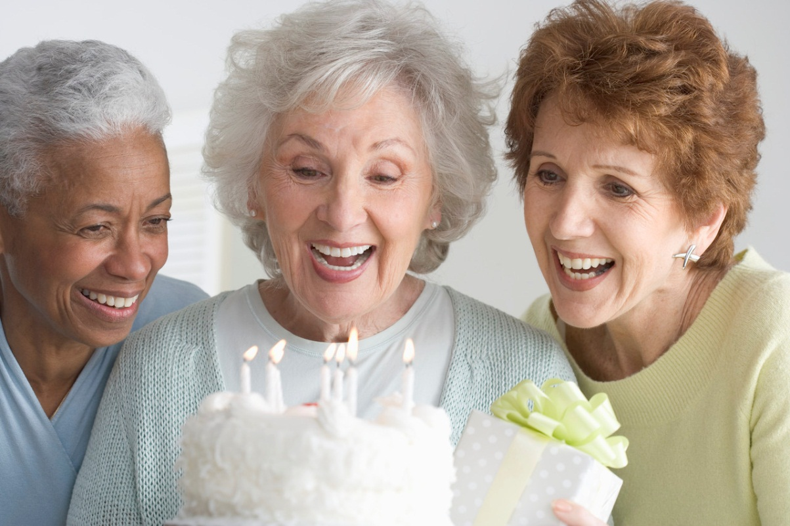
You must look at individuals and understand what aging is all about in order to see the real people behind the myths!

Slide 13
Theories on Aging
The aging process is a natural part of living. Gerontology is the study of the aging process. It has helped many people understand older adults and the problems and rewards of growing older.
Two general theories explain how the lives of older adults change as they age. These theories appear to contradict each other.

Slide 14
Activity Theory
This theory say, “Use it or lose it.” In other words, active, involved people cope with aging more easily than people who are less active.
Physical, mental and social skills remain strong when they are used often.
Those who don’t exercise soon can’t.
This theory suggests that older adults should stay as busy and active as possible.

Slide 15
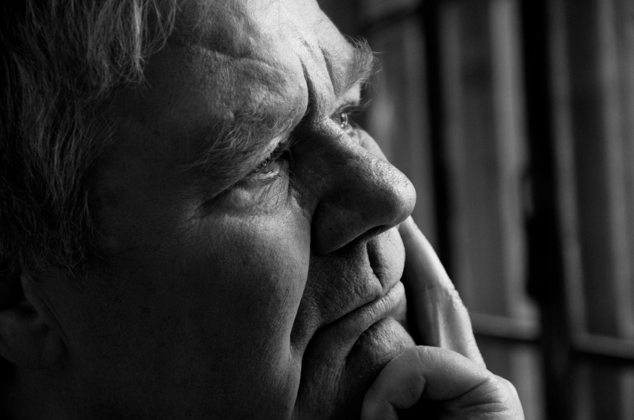
Disengagement Theory
Disengagement means withdrawal from others and activity.
This theory states that in old people, it is normal and healthy for people to become more solitary and sedentary.
Social activities and contacts are less frequent and important. Physical activity diminishes as the body ages.
Older people grow less concerned about others and focus more on themselves.
Disengagement may seem like a logical
progression for older people. Studies
have shown, however, that disengaged
people are less happy, healthy, and
satisfied in almost every area of life than
those who remain active and involved.

Slide 16
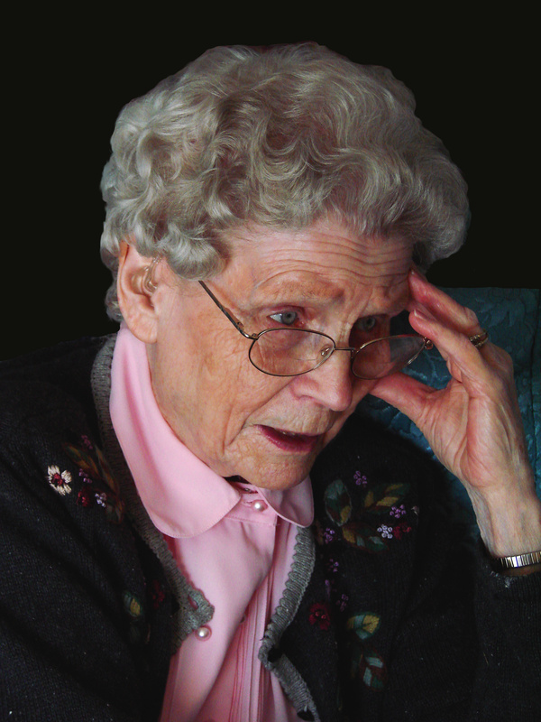
Which theory is accurate?
Given the broad range of older adults—from sixty-five to ninety-five and older—it’s possible that both theories are true.
When people first retire, having outside
interests and activities may be the healthiest,
most fulfilling lifestyle.
As they age and approach death, however,
disengagement may be one way to prepare
to leave family and friends.

Slide 17
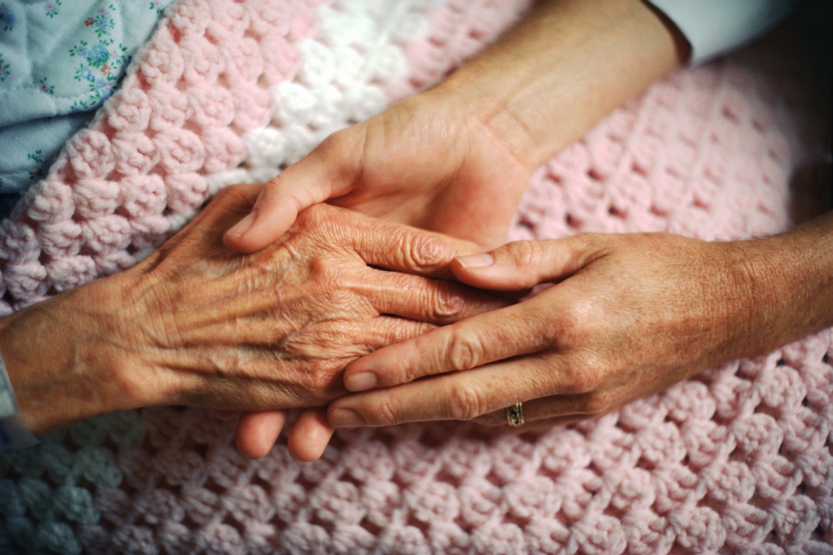
Changes as People Age:
Aging affects people in many ways. Changes occur physically, mentally, socially, and emotionally.

Slide 18
Physical Changes:
The physical effects of aging are usually the most apparent ones. In general the body weakens and abilities decrease.
Examples: overall weakness, slower reactions and reflexes, loss of hearing & vision, brittle bones, decreased sense of smell and taste, chronic diseases, Alzheimer’s
Maintaining Physical Health: exercise is as beneficial and no more dangerous to older adults than to younger people, good nutrition is important (many physical problems are made worse by poor eating habits), attitude can be a major factor in determining physical ability - older people who realize that aging is not a disease and that sickness is not inevitable are more likely to work at maintaining their health.

Slide 19
Mental Changes:
Some changes that older adults experience have to do with the mind. As the body slows, the mind often does, too.
Examples: Many encounter problems with memory & problem solving but these are often due to outside factors such as depression, grief, poor health, poverty, and a lack of trying
Maintaining Mental Health: Mental stimulation is necessary to keep older adults thinking effectively. Their activities should require active, not passive, participation. Some older people join clubs or become politically active. Others take part-time jobs, continue their education, or serve as volunteers. Many community groups and activities offer discount rates to older adults to encourage their participation.

Slide 20
Social Changes:
Older adults may see differences in their social roles and relationships. As some roles become less important, they often develop new ones.
Examples: often they have difficulties dealing with retirement (lose sense of worth), changes in role, loss of family and friends (through death, moving away etc.), friendships become more rewarding and healthy.
Maintaining Social Health: social individuals tend to stay that way, just as those who live a quiet life maintain the pattern, there are many community programs available for the elderly to maintain their social lives and also buses and transportation to get them to and from the events.

Slide 21
Emotional Changes:
As they age, some people feel that life no longer has meaning for them.
Examples: They may believe that no one needs or respects them. Sometimes this occurs in retirement due to loss of the work role. Older adults may become depressed or discouraged about living. This can be a response to the death of a spouse or friends, or to increasing health problems. Childless men whose wives have died are most likely to lack the will to live. This feeling of despair also worsens the effects of other physical conditions and diseases.
Maintaining Emotional Health: Need to balance activity and involvement with the tendency toward disengagement. In addition to being active, they also need opportunities to talk about the past. By reminiscing, they sort through their experiences and make sense of their lives. Contact with friends and family members is one of the best ways to maintain emotional health. Younger people can encourage conversation, visit, and show appreciation for the wisdom and experience that older people have.

