Slide 1
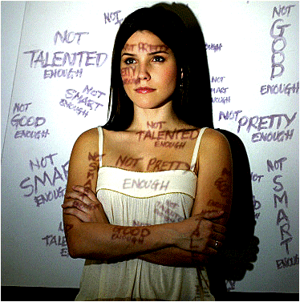
SELF CONCEPT

Slide 2
Self-concept is comprised of one’s conscious and unconscious:
Skills
Abilities
Ideas
Feelings
Understanding
Thoughts
Values
Compassion
Beliefs
Attitudes
Imagination

Slide 3
Some parts are genetic/inherited:
examples - sex, body chemistry, body structure, physical characteristics.

Slide 4

Some parts are environmental/acquired:
examples – exposure to environment, interactions with parents, siblings, peers, relatives, teachers, friends, enemies, significant others…

Slide 5
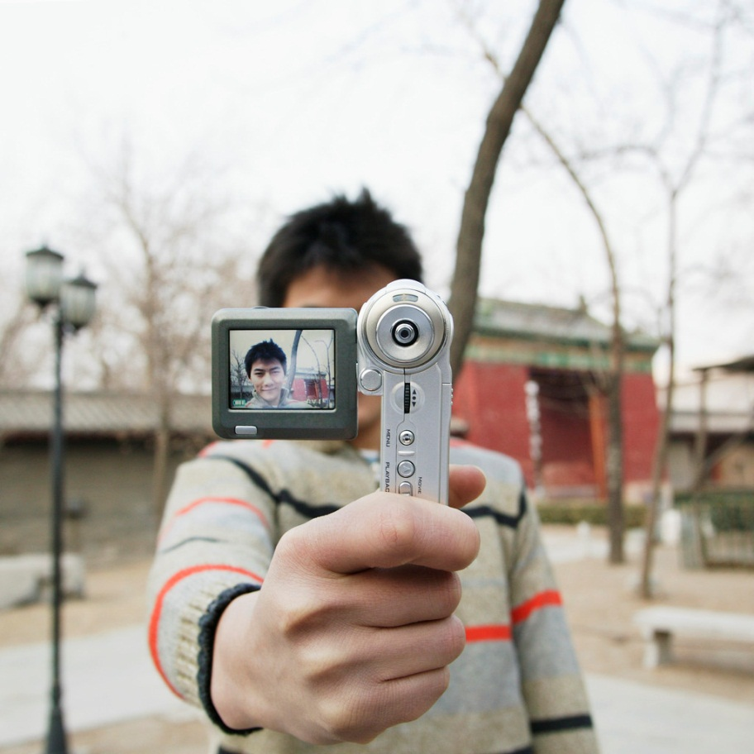
FIVE DOMAINS OF SELF:
Physical Self
Self as a Process
Social Self
Perceptual Self
Ideal Self

Slide 6

Physical Self:
  The body and all biological activities and attributes (ex. disease, downs’ syndrome, car accident)

Slide 7
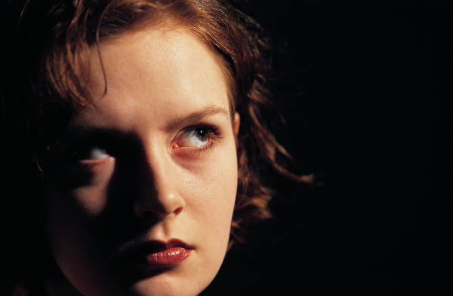
Self as a Process:
  What one experiences mentally and the action one takes as a result of these experiences (there is a constant flow of thoughts, emotions, behaviours, self-talk, etc).

Slide 8
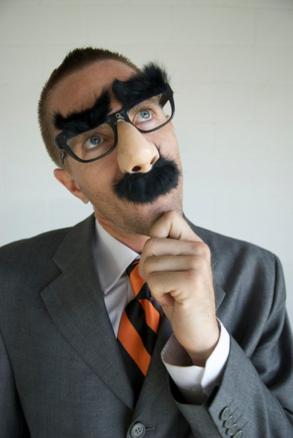
Social Self:
  The way one appears to self and others in social situations (often a mask/role playing).

Slide 9
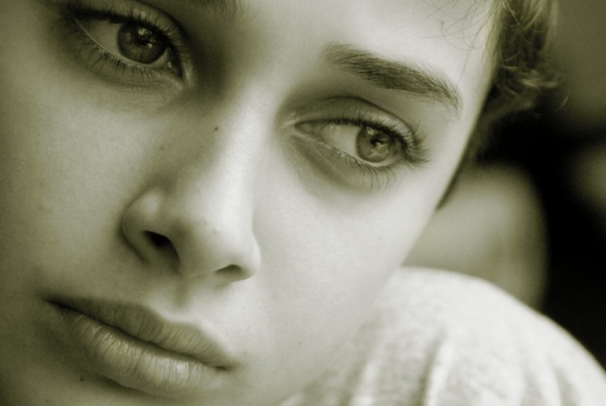
Perceptual Self:
  The perception one has about oneself which encompasses self-knowledge, personal expectations, and self-evaluation.

Slide 10

Ideal Self:
  The aspirations one strives to attain (dreams, hopes, desires).

Slide 11

Characteristics of a Positive Self-Concept:
Belief that you are a worthwhile person.
A focus on your possibilities and potential.
Emphasis on individual strengths.
Formation of a positive picture of yourself.
Exploration of options in order to make wise decisions.

Slide 12

Characteristics of a Negative Self-Concept:
Belief that you are not a worthwhile person.
A focus on your limits and lack of potential.
Emphasis on your weaknesses.
Formation of a negative picture of yourself.
Failure to explore options and to make wise decisions.

Slide 13
Techniques to Enhance Self-Concept:
Seek experiences you can handle.
Seek people & activities which make you feel confident & competent.
Work to strengthen your weaknesses.
Recognize that all people have limitations.
Develop positive attitudes:
  Work to develop good feelings about yourself & your abilities.
  Try to learn from new experiences (pleasant or unpleasant).
  Be willing to learn new skills and experiment with new ideas.
  Develop a positive perspective.
  Think positively about others.
  Treat others as you would like to be treated.

Slide 14

Applying the Information…
Please work with a partner to complete the questions relating to the case study.

