Slide 1
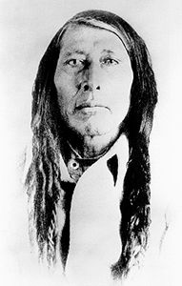
Poundmaker
An Ignite Presentation by Aidan Schulmeister

Slide 2
Poundmaker’s Early Life
Just an ordinary Indian!
Poundmaker’s early life would’ve been described as an ordinary Cree!

Slide 3
Poundmaker’s Early Life
Noticed!
Crowfoot, the Blackfoot chief noticed that Poundmaker was a Blackfoot’s son!

Slide 4
Poundmaker’s Early Life
Adopted
Poundmaker was adopted and was named: Makoyi-koh-kin (WolfThin Legs).

Slide 5
Poundmaker’s Influential Life
Denial
Poundmaker began to earn his respect by refusing to sign the 6th treaty!

Slide 6
Poundmaker’s Influential Life
Alongside Riel
Poundmaker fought alongside Louis Riel during the Northwest Rebellion!

Slide 7
Poundmaker’s Influential Life
Battle of Cut Knife Hill
After warriors came to attack the Cree, the Cree was able to defend it!

Slide 8
Poundmaker’s Late Life
Sentenced!
When Riel surrendered, Poundmaker also surrendered and was sentenced 3 years in jail!

Slide 9
Poundmaker’s Late Life
Death
After a year in jail, Poundmaker was released and died 4 months later due to an illness!

Slide 10
Poundmaker’s Impact in Society
How Poundmaker fought for rights
Poundmaker was against the Canadian Government after they issued treaty No. 6

Slide 11
Poundmaker’s Impact in Society
How Poundmaker helped the Metis!
Poundmaker stood alongside Riel and the Metis, fighting for their rights!

Slide 12
Poundmaker’s Impact in Society
The Metis get representation!
The Metis gained representation in the Government!

