Slide 1
Career Compass to Becoming a Detective
Aaron Quilapio
Block A

Slide 2
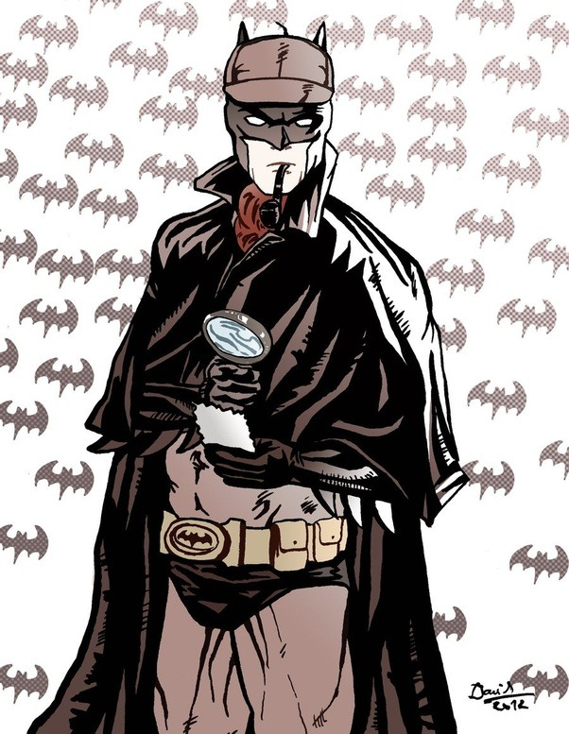
Why?
Growing up I’ve been influenced a lot by things like superheroes and as a kids I wanted to be like that.
I knew I couldn’t obtain superhuman strength or be bitten by a radioactive spider but there was one hero that stood out for me.
It was Batman. I really liked the way he was able to solve crimes or resolve his conflicts using his brain. He is known for being a great detective.
I want to be a detective because to me it’s the closest to being some sort of superhero.
This is also something my parents would like me to pursue.

Slide 3
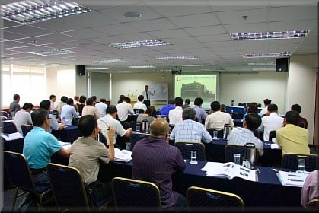
Short Term Goals
Graduate High school averaging 85% or higher in all my courses
Do required training and courses for this field
Gain entrance into Simon Fraser University

Slide 4
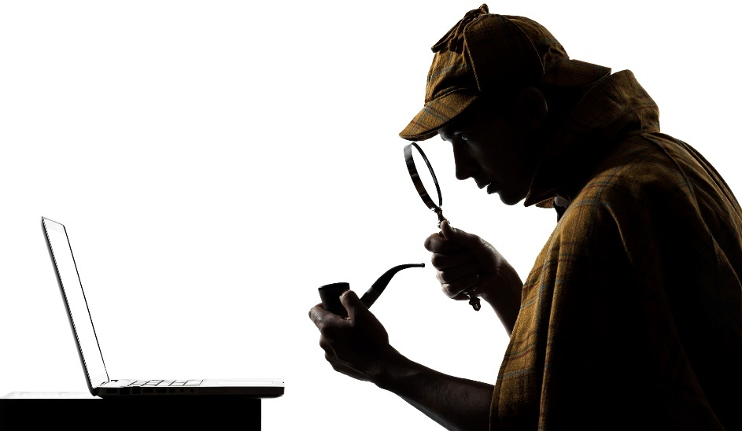
Long Term Goals
Work my way up to Senior Detective
Graduate University with a Criminology Bachelor of Art
Work Full-Time as a Detective

Slide 5
Skills and Attributes
Calm
Remaining calm under most circumstances
Controlling emotions
Detail-oriented
Pays attention to the details
Determination to explore the problem
Work well as part of a team
Cooperative with others
Strong communication skills
Problem-solving skills
Quick to make a reasonable solutions
Able to solve a variety of problems
Observant
Very patient
Quick to notice things.

Slide 6
Job Description
Detectives are trained officers that solve many different types of crimes such as; homicide, robbery, gang violence and more. Gathering facts, evidence and information to crack a case. Working under pressure many time
Detectives tasks:
Take pictures, gather physical evidence, and interview witnesses at crime scenes
Identify and investigate suspects, keeping records of the findings
May go undercover to obtain evidence
Make arrests and testify in court
This job is well suited for me because I am great at handling certain situations were it may be hard to keep calm. I am also very good at making reasonable judgements/assumptions.

Slide 7
Salary
The average salary of a Detective is around $75,000
Ranging between $35K-$125k
Very dependent on:
Years of experience
Your level of education
Location of workplace
Usually after training and Post-Secondary education one who works hard and does all requirements is a full time detective after 5-10 years after High school Diploma
Years of Education Before becoming a Detective

Slide 8
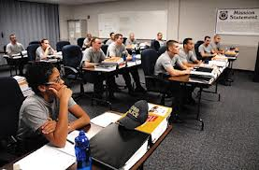
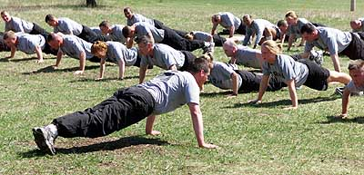
Post-Secondary Requirements for a Detective
Police training
Required to become a detective
Fitness requirements

Slide 9
Simon Fraser University School: Criminology Program
Institution: Simon Fraser University
Program: Criminology
Length of program: 4 Years
Tuition fees: $5,217
Admission Requirement
English 11 Language 11 (includes beginner's language 11, American sign language 11 or 12, and language 12 courses)
Science 11
(Includes Biology 11, Chemistry 11, Earth Science 11, etc.)
Foundations of Math 11-60% or greater
English 12- 60% or greater

Slide 10
Potential Obstacles
Potential Obstacles | Strategies to Overcome
Financial Restraints | -Apply for student loans -Part-Time Job -Money my family is willing to give
Not getting accepted to SFU | -Apply for various other Post-Secondary institutions that fit my needs.
Difficulty of education | -Study hard/ do very good in High School -Tutors
Time Management | -Have a plan -Be organized

Slide 11
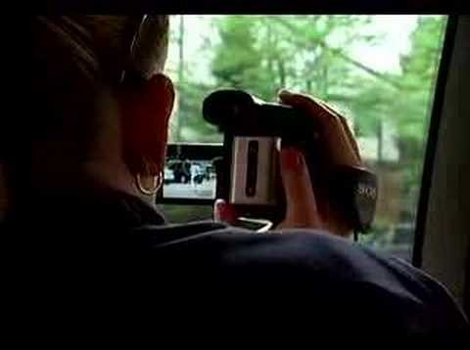
A Day in the life of a Detective/ Investigator

